Slide 1
Emily Cahill
emily.cahill@dioceseofsalford.org.uk

Slide 2

Year of Francis
Decree of the Apostolic Penitentiary on the occasion of the Eighth Centenary of the death of Saint Francis of Assisi, by which a special Jubilee Year is proclaimed, with associated Plenary Indulgences

Slide 3
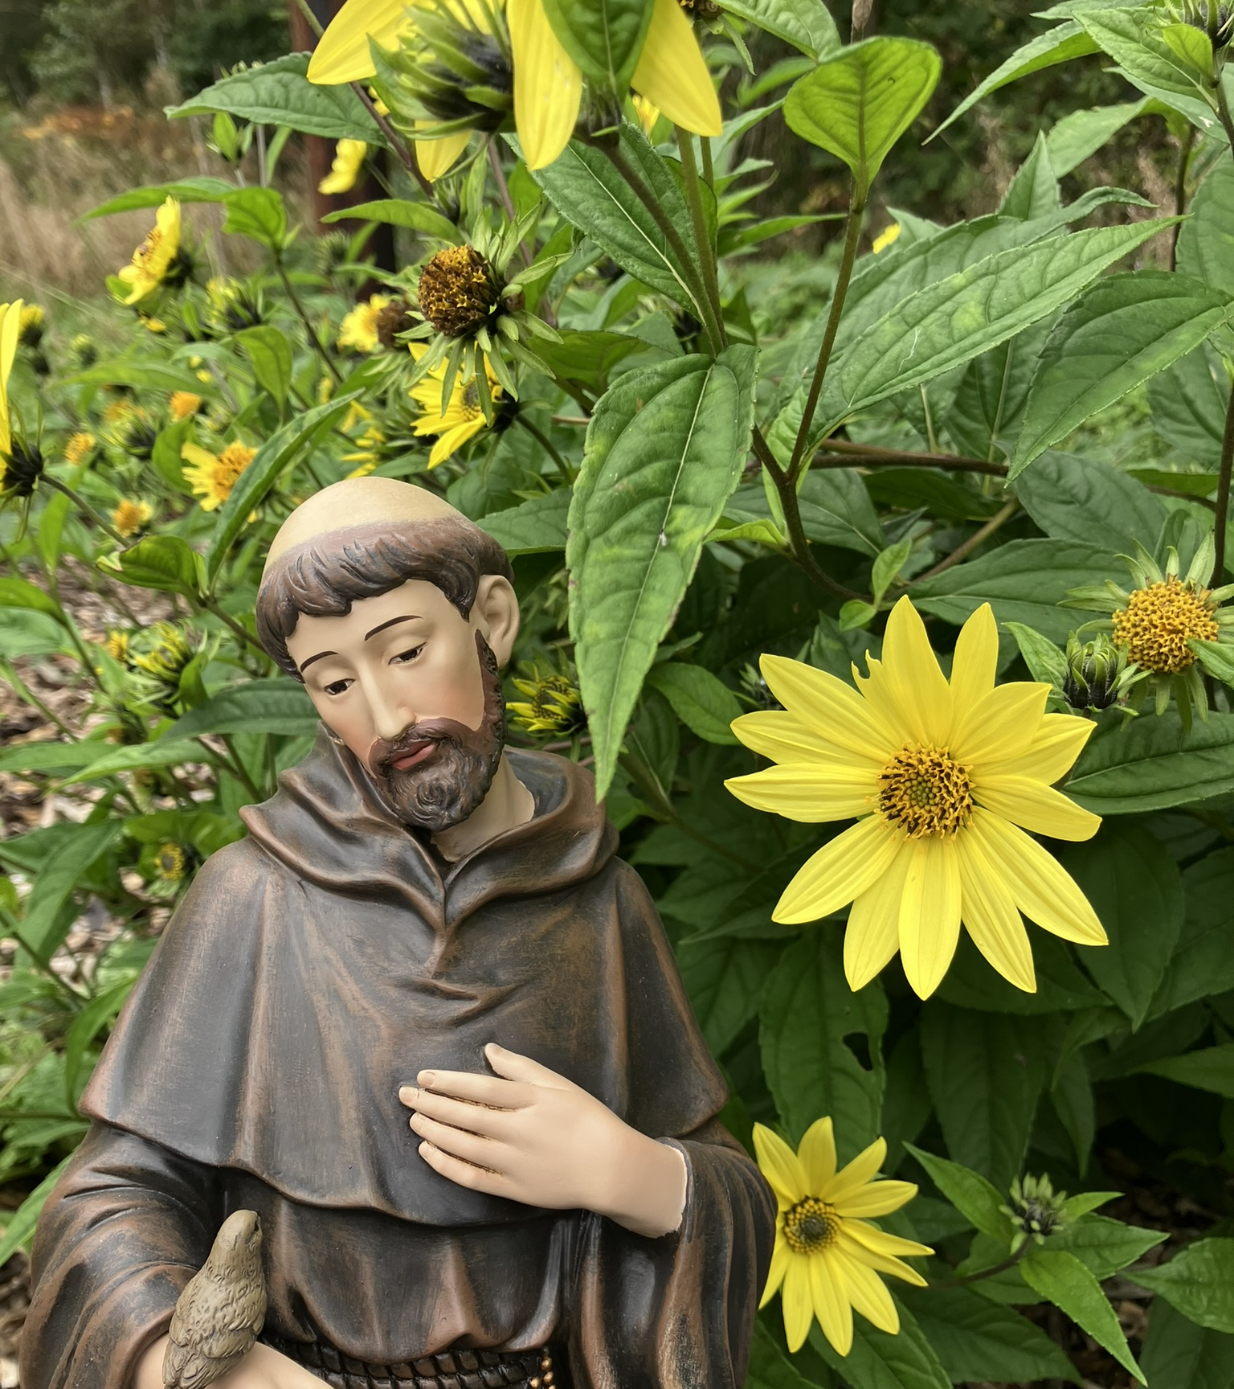
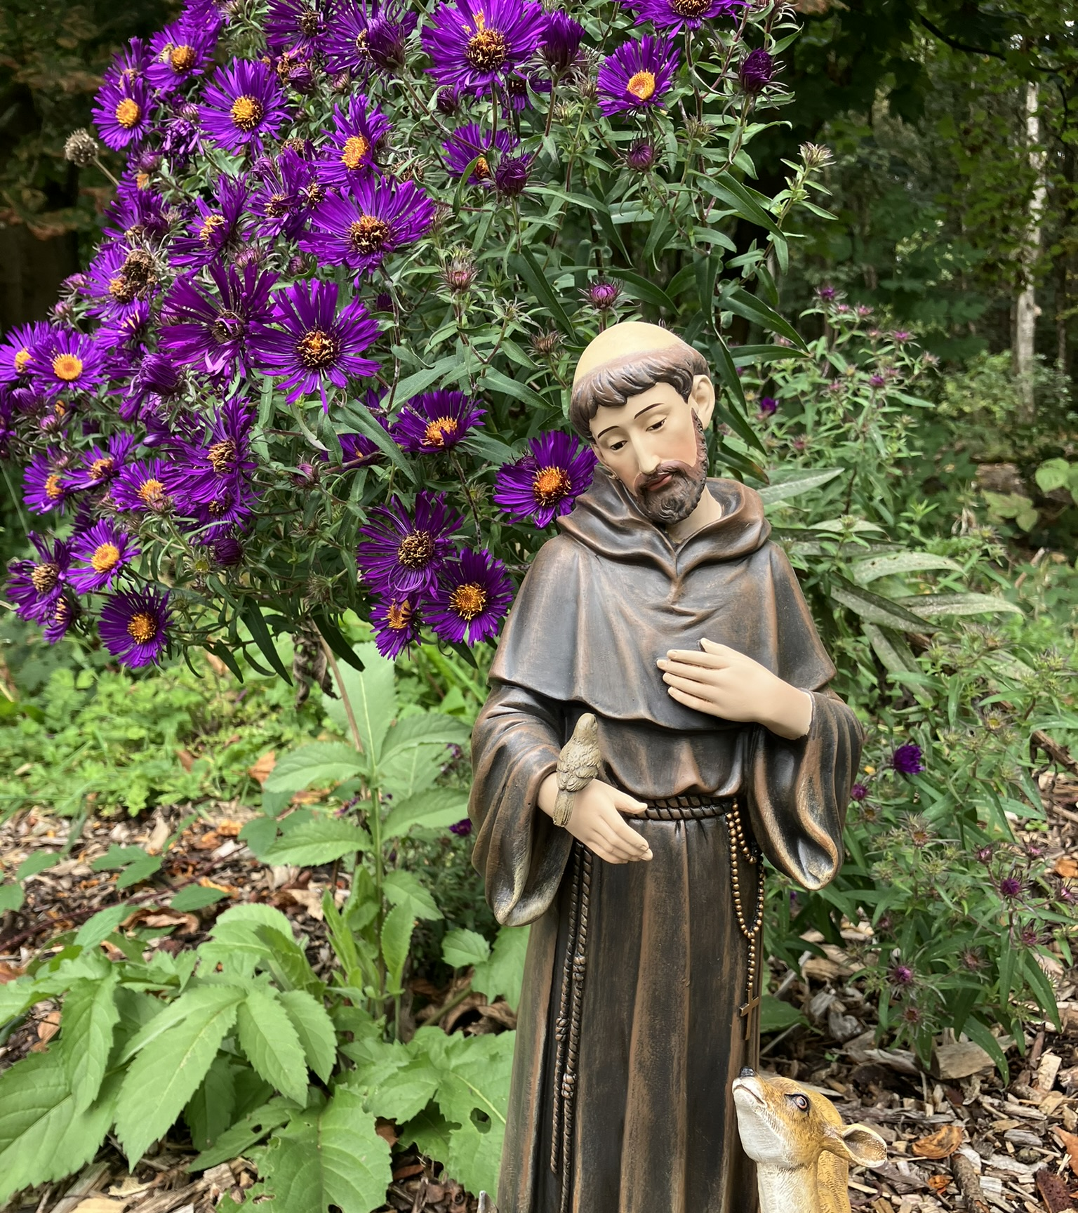

Slide 4
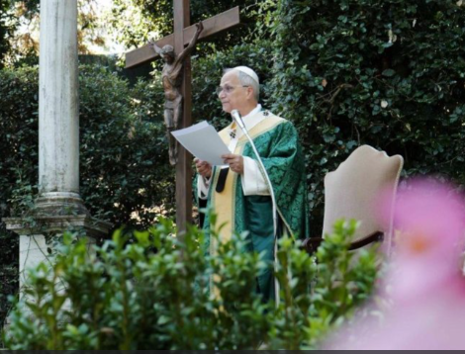
…all the Christian faithful are invited to follow the example of the Saint of Assisi, becoming models of holiness of life and constant witnesses of peace. Pope Leo,
7th January

Slide 5

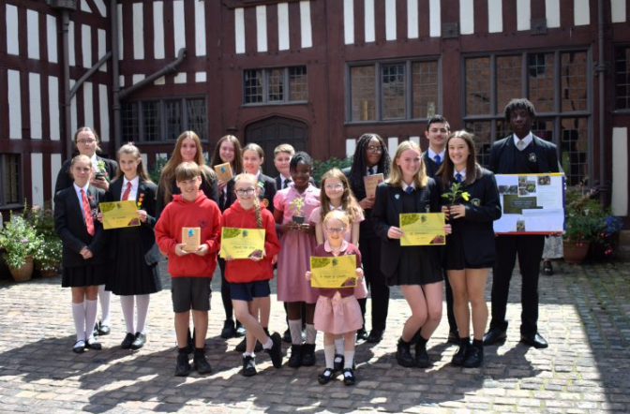
Deadline: Friday 22nd May 2026
Presentation: 2nd July 2026
1st Prize: Free half day visit 30th June 2027
Nomination forms to: laudatosi@dioceseofsalford.org.uk

Slide 6
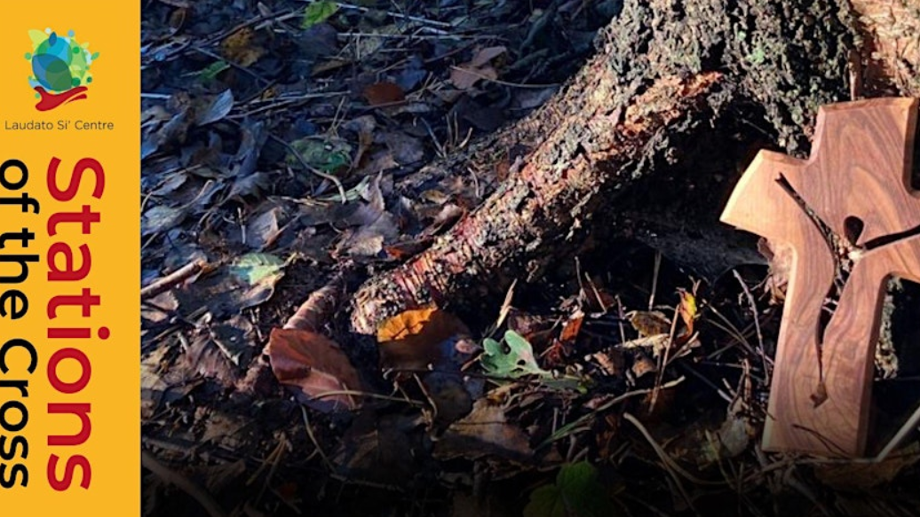

Slide 7


Slide 8

School / Centre
Activities – New focus
Each month a new activity email will be sent
Focus on national and world environmental or ecological days
Information about the theme – links to websites and video clips
Activity suggestions
Email any pictures to the LSC

Slide 9
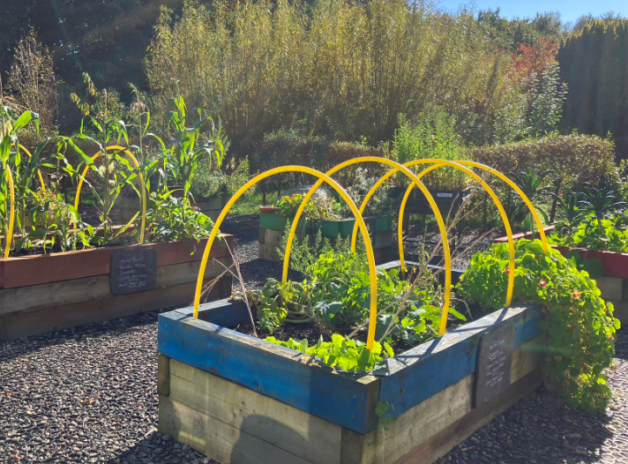
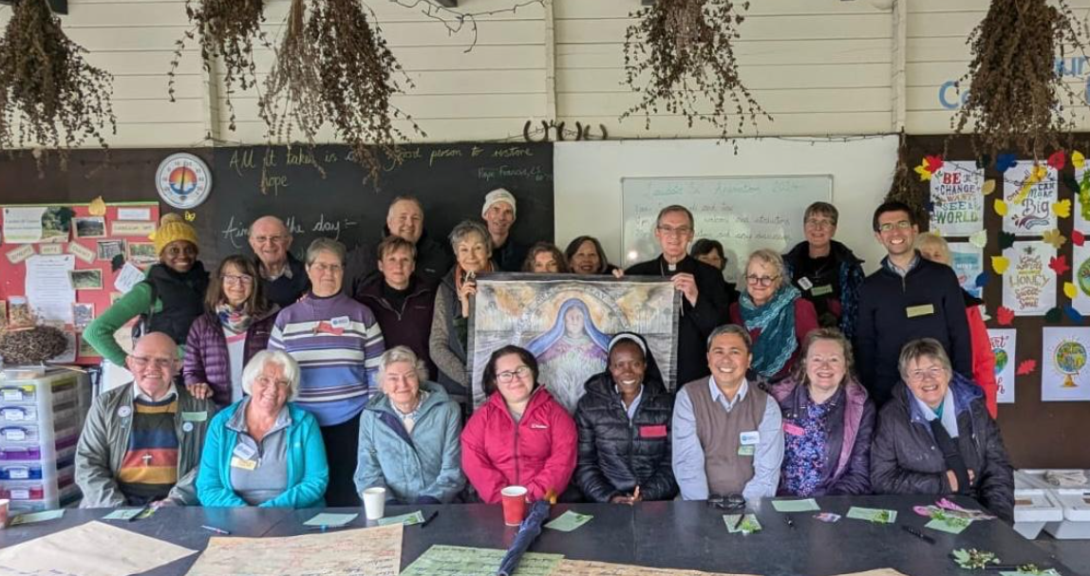
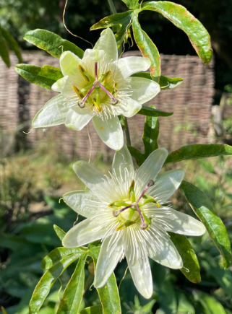
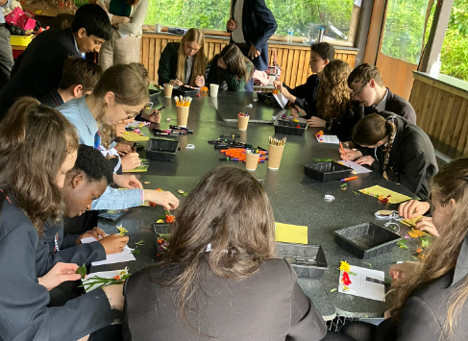
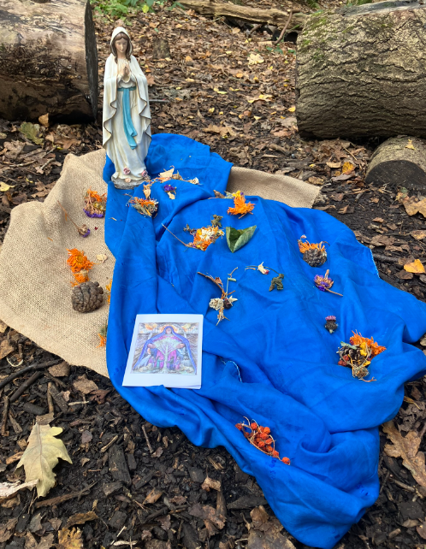
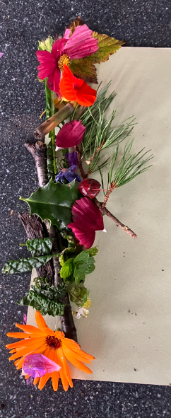
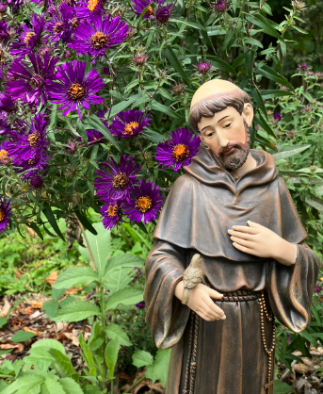
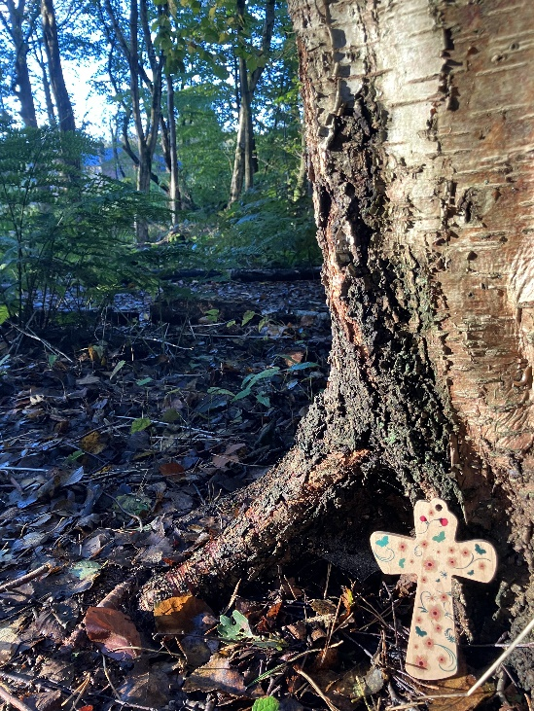
Retreats
Liturgical
Sacramental
Saints
Environment
School visits
Awards
22nd May 2026
Assemblies
Twilight / Staff INSET
Curriculum days

Slide 10
Bookings for Autumn 2026
Waiting list for the rest of this academic year.
Brochure:
laudatosicentre.org.uk/wp-content/uploads/2024/09/Laudato-Si-Centre-brochure-web.pdf

Slide 11


The Laudato Si Centre Events - 9 Upcoming Activities and Tickets | Eventbrite
@laudatosicentre

Slide 12
…may the hope that saw us as pilgrims now be transformed into zeal and fervour of active charity.
Pope Leo,
7th January

Slide 13
Emily Cahill
emily.cahill@dioceseofsalford.org.uk
@laudatosicentre

