Slide 1
Heads and Chairs briefing
14th May 2024

Slide 2
Welcome and opening prayer
Let us take a minute to quietly reflect at the start of this meeting
Synod Prayer: (said together)
Loving Father, be with us as we seek new ways of being your people in our Diocese.
May each new day bring us closer to your son Jesus, as we follow his teaching and become disciples of love.
As we continue our Synodal journey, draw us closer to each other. May the truth of your Spirit enlighten us.
Open our hearts, as we listen to each other and reach out in love to your people. Stay with us, Lord, on our journey.
Amen.
Our Lady of Mount Carmel, Pray for Us. St Joseph, Pray for Us.

Slide 3
Agenda
1. Welcome and Opening Remarks
2. CPDF update
3. CAT update
4. CSI update
5. Closing remarks

Slide 4
CPDF update

Slide 5
CAT update
Breakout rooms…

Slide 6
CAT updates
Governor academisation update sessions
Thursday 27th June 4- 6pm Sacred Heart RCPS, Westhoughton
Saturday 6th July 9.30am- 12.30pm St JH Newman RCHS
Notes:
Links on mailchimp which HT will pass on- just before half term / just after

Slide 7
CSI update The story so far…
Inspections 23-4 | Outstanding | Good | RI | Inadequate
CSI | 6 | 22 | 4
Ofsted | 5 | 33 | 6 | 2
Notes:
Key findings- CSI- CW, RE CLM strength
Ofsted- Impact – implementation and intent….key knowledge… break down- what should children remember and do they ? All subjects.
Feedback forms

Slide 8
CSI update
The future…
CSI co-ordinator
18th June – Primary CSI day, Dunkenhalgh hotel
Monday pm “drop ins”
Resources for Year of Prayer-
2025 Pilgrims of Hope Jubilee - Roman Catholic Diocese of Salford
Monthly information sheets for staff on different ways of praying.
Year of Prayer prayer trail – six prayer stations to mark the Year of Prayer to be used in school or for clusters of schools.
2 key changes to CSI handbook…
Pupil interviews
Feedback
Notes:
Martin to be CSI lead
45 next year
Change log
Sent out and on resource centre- Year of Prayer
Recruitment – adding to the team – experienced serving HTs/ RE leads- Secondary…
Increasingly – NW / National inspectors- better they don’t know

Slide 9
Secondary RE Summer Term 2024
Secondary RE Conference - ‘Implementing the RED’
June 19th Met Hotel Leeds 10am -3.30pm (£75)
For all Heads of RE from North West and North East Dioceses
Keynote speakers: Professor Bob Bowie
Dr Margaret Carswell
Dr Nancy Walbank
Notes:
Ongoing CPD programmes- Catherine and anna

Slide 10
Knowledge
Life
Worship
Religious Education
Catholic life and mission
Prayer and Liturgy

Slide 11
For I received from the Lord what I also passed on to you: The Lord Jesus, on the night he was betrayed, took bread, and when he had given thanks, he broke it and said, ‘This is my body, which is for you; do this in remembrance of me.’ In the same way, after supper he took the cup, saying, ‘This cup is the new covenant in my blood; do this, whenever you drink it, in remembrance of me.’ For whenever you eat this bread and drink this cup, you proclaim the Lord’s death until he comes.
1 Cor 11:23-26
Notes:
Your first task is the formation of your Catholic children in their own faith – they have a right to be initiated into the faith into which they were baptised. We need to ensure that in our faithful handing on of our liturgical heritage we enable our Catholic pupils to feel at home whenever they enter a Catholic Church, and whenever they find themselves celebrating the mysteries along with people from every corner of the earth.

Slide 12
The importance of context
The communities from which pupils, staff and governors or directors are drawn are culturally, ethnically, religiously and socio-economically diverse to a greater or lesser extent. The local circumstances of each school will influence the manner in which this Directory is received and adopted.
p7

Slide 13
Expectations of leaders in relation to the PLD
It it important that those with overall responsibility for prayer and liturgy engage with the whole document. An understanding of the key principles presented in section 3 (‘Understanding prayer and liturgy) is essential background to understanding the more detailed examination of prayer and liturgy which follows in subsequent sections.
p5
Who?
The prayer and liturgy coordinator:
The head teacher
Another senior leader
The school chaplain
Notes:
2025 implementation date….

Slide 14
Policy
‘…it is the duty of governors of Catholic schools and colleges, and directors of academies, to direct the promotion, monitoring, and evaluation of prayer and liturgy through the following:
Agreeing a specific prayer and liturgy policy which reflects the Catholic life and mission of the school.
Undertaking the periodic review of the policy and implementing any necessary amendments.’
p.16

Slide 15
Policy
To check:
Does the school have a specific prayer and liturgy policy?
Has it been approved by the governors?
Do the governors periodically review it?
Was the review based on a review of its impact in the time between its last review and now?
To evaluate:
How well formulated is it?
How accessible and useful is it to those staff who will use it?
How well has it taken into account the unique context of the school and the people who work and study in it?

Slide 16
Policy
To check:
Does the policy ensure that:
The school fulfils its statutory duties in relation to worship?
Pupils experience a range or prayer and liturgical experiences?
Pupils have a shared repertoire of prayers and music?

Slide 17
Policy
To check:
Does the policy ensure that:
The school fulfils its statutory duties in relation to worship?
Pupils experience a range or prayer and liturgical experiences?
Pupils have a shared repertoire of prayers and music?

Slide 18
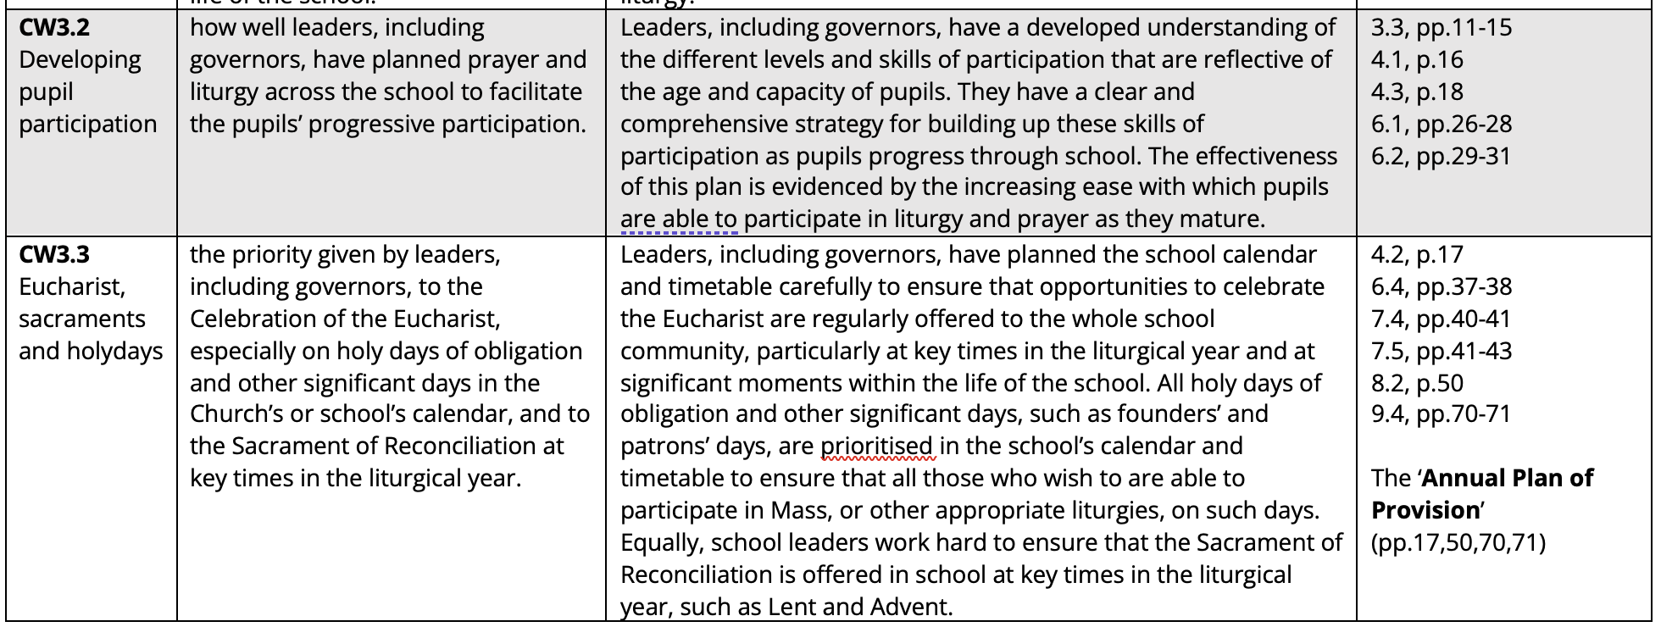
Annual Plan of Provision

Slide 19
Annual Plan of Provision
The prayer and liturgy coordinator is responsible for producing the Annual Plan of Provision (p.17)
Long-term planning requires a strategic approach to the planning of prayer and liturgy, which should be reflected in the Annual Plan of Provision (p.50)

Slide 20
Annual Plan of Provision
The Annual Plan of Provision potentially has three levels:
Level one – a strategic overview of the prayer and liturgical life of the school over the coming year
Level two – a progressive plan, with age-appropriate steps for each year group, for the formation of all pupils to enable them to engage and participate fully, consciously and actively in the prayer and liturgical life of the school
Level three – a progressive plan, with age-appropriate steps to form those pupils who will exercise ministries in school

Slide 21
Annual Plan of Provision – Level 1
An overview of the year that includes (p.50):
Plan for embedding and refreshing the music repertoire (and for ensuring a continuity between school and parishes).
The number and timing of Masses to be celebrated during the year, including the plan for any holydays of obligation that fall within the school term.
When the opportunity for receiving the Sacrament of Reconciliation will be offered.

Slide 22
Annual Plan of Provision – Level 1
An overview of the year that includes (p.50):
Identifying any other significant days (such as a patronal feast)and key events and how these will be celebrated in the prayer and liturgy of the school.
Engagement with wider Church initiatives (such as the Year of Mercy)
Developing a strategy for improving a particular aspect of the prayer and liturgical life of the school

Slide 23
Annual Plan of Provision – Level 1
It will also include (p.71):
Actions that need to be undertaken
Dates by when they must be completed
Person responsible for their completion
And, perhaps, contingency arrangements (such as if a priest is needed, but is not available)

Slide 24
Annual Plan of Provision – Level 2
To check:
Does the school have a plan, with age-appropriate steps, to ensure that pupils are formed to engage and participate in the prayer and liturgical life of the school?
To evaluate:
How well does this part of the plan form pupils to engage and participate in the prayer and liturgical life of the school?

Slide 25
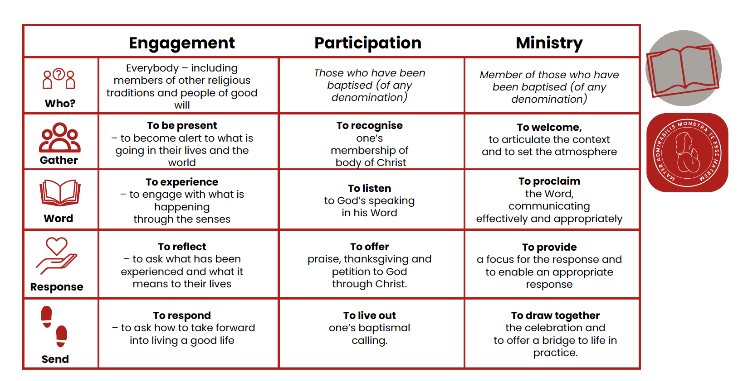
Engagement, participation and ministry
In Celebrations of the Word

Slide 26
Annual Plan of Provision – Level 3
To check:
Does the school have a plan, with age-appropriate steps, to ensure that those pupils who are able to exercise ministries during prayer and liturgy are formed to do so?
To evaluate:
How does the school identify those who are to be prepared for ministry in a way that is sensitive and not exclusionary?

Slide 27
Daily patterns of prayer
‘Communal prayer takes place, for example, at the beginning or end of the school day, in the classroom, or at a staff meeting…There is virtue in variety and also great scope for creativity.’ (pp.7-8)

Slide 28
Daily patterns of prayer: beginning and end of the day
‘To begin and end each school day in prayer helps to put the whole day into perspective. There are three basic models of prayer. Each usually begins and ends with the sign of the cross and includes a pause for silence. Always consider the current liturgical season and how it might affect the prayer. (p.45)

Slide 29
Daily patterns of prayer: beginning and end of the day
‘’The three basic models are:
A single prayer, suitable for the time of day (such as the Morning Offering)
A simple structured pattern of prayer, with perhaps a short reading or psalm verse, prayer for others and a concluding prayer.
A time of prayer which has some more spontaneous elements, such as improvised prayers or intercessions.’ (p.45)

Slide 30
Daily pattern of prayer
To check:
Is there an established daily pattern of prayer?
How is it planned?
How is variety ensured?
To evaluate:
How well formed are pupils to engage and participate in these daily pattern of prayer?
To what extent does the daily pattern of prayer reflect the Catholic identity of the school and at the same time allow for the widest possible engagement and participation of all those present in the school?

Slide 31
Daily pattern of prayer
To check:
Does the provision include opportunities to experience the breadth and richness of the Catholic liturgical tradition?
To evaluate:
How well does the school ensure pupils are able to experience positive and engaging experiences of prayer and liturgical opportunities intended to reflect the breadth and richness of the Catholic liturgical tradition?

Slide 32
Frequency of different models of prayer
Everyday | Every week | Every term | Every year
Daily prayer – beginning and end, before and after meals.
Celebrations of the Word
Mass
Sacrament of Reconciliation
Other liturgies and devotions

Slide 33
Participation (p.11)
Fully – the whole gathered community is involved and the whole person: body, mind and spirit.
Consciously – appreciation of the meaning and a glimpse of the mystery (therefore, appropriate to age and capacity)
Actively – an openness to transformation to be changed by the liturgy…’leaving nobody the same.’

Slide 34
Participation and elements of liturgy
The importance of shared ritual
Symbol - understanding the role and importance of symbols
Silence and attentiveness
Movement, posture, gesture
Music and singing

Slide 35
Participation
To check:
Is there a plan for how pupils are formed to be able to fully, consciously and actively engage in prayer and liturgy?
To evaluate:
How well do pupils engage and participate in the prayer and liturgy the school offers.

Slide 36
Formation for ministry
All should be able to engage
All should be invited to participate (with their consent and understanding)
Some (a minority) should minister
The point of ministry is to aid engagement and participation for everyone else
‘For those who assist to lead/pray/sing/serve worthily and well, they will require not only immediate preparation for the task in hand, but also longer-term formation to undertake these roles. A key dimension of the role of a liturgical minister is to help engage the participation of the liturgical assembly, that is, all those who are gathered to celebrate.’ (p.12)

Slide 37
Formation for ministry (p.14)
‘Good formation has three dimensions:
Fostering an age-appropriate appreciation of the liturgy and especially of the elements involved in a person’s particular role.
Developing the necessary technical skills to perform that role.
Encouraging a person’s understanding of service and prayerful engagement for their role in the liturgy.’
Notes:
A school should have a plan for identifying who will be involved in lioturgicla mnistires and how they will be formed. And, of course, staff need to be formed as ministers too – not just pupils.

Slide 38
Formation for ministry
To check:
Is there a plan for the ministerial formation of pupils and staff?
How have those who will perform different ministries been selected?
To evaluate:
How well does formation for ministry respect liturgical norms and facilitate the widest possible representation of the school community?

Slide 39
Engagement with the parish and with families
The school needs to know its community and needs to talk to them about its prayer and liturgy.
The school needs to do all it can to ensure a continuity of practice between school prayer and liturgy and that of the parish – for example, connecting with the parish in the formation of pupils for liturgical ministry.

Slide 40
Engagement with the parish and families
To check:
Is there a formal and planned mechanism to open dialogue with parents about the prayer and liturgy that happens in the school?
Has the school worked with those of other faiths and none to inform the prayer and liturgy they offer?
Has the school worked with its parish communities to facilitate the participation of pupils in the wider life of the Church?
To evaluate:
To what extent do families feel included in the school’s prayer and liturgy?
Do parents and families feel that their own confessional distinctiveness is respected?
How effective is the school partnership with the local Church?

Slide 41
Closing remarks

