Slide 1
Heads and Chairs Briefing
November 2025

Slide 2


A Prayer for Catholic Schools.
Almighty God,
You sent forth your Son
as a beacon of hope for all people.
As a Teacher, He has given us the prime example
of the importance of education.
As disciples, we look to him
for inspiration and strength.
Thank you for the many people
who have dedicated their lives
in service to our Catholic Schools.
Thank you for the teachers and administrators
who sustain our schools.
Jubilee of the World of Education
October 31 - November 2, 2025.
Notes:
A number of Jubilee Days throughout 2025 have been designated by Holy See to recognize and celebrate distinct groups of people within the Church and various ministries in the Church. The Jubilee of the World of Education was held from October 31 through November 2, 2025 as we pray the prayer from that celebration we pray for the members of our own school communities.

Slide 3


Slide 4
Diocesan Protocols 2025
Circulated in October (Wednesday email)
Use them for initial enquiries or questions
They are all based on CES models and are adjusted to reflect the diocesan sovereignty of the bishop
Key areas: Governance – admissions – buildings and estate – appointments

Slide 5
Governance in schools that are academies
Key information: Applications
Foundation governors are still appointed by the Bishop
Application forms from governors should be emailed to the diocese,
not the trust

Slide 6
Governance in schools that are academies
Key information: DBS clearance
Responsibility for DBS checks for foundation governors now with the diocese
The DBS check must take place before they can be formally appointed as a foundation governor
The process and formal appointment as a foundation governor takes 6-8 weeks
DBS checks undertaken every three years

Slide 7
Governance in maintained schools and academies
Second or third terms of office
Foundation governors must re-apply by completing the foundation governor application form and obtain a faith reference from the PP where they go to Mass, in good time before their term of office expires (8 weeks)
On the anniversary of a governor’s fourth year of office, they are no longer a governor and may not continue in that role
May do so from the date of a formal letter of appointment

Slide 8
Diocesan Protocols 2025
Please familarise your selves with the section on governance:
Key information: Changes as a result of diocesan protocols for effective governance
Maximum of three consecutive terms of office from January 2026
Associate governors may not be appointed without written permission from the diocese (the starting point is they may not be appointed)
Foundation governors should elect the chair from their number where this is possible

Slide 9
Model Policy for Admissions 2027
Admissions Code compliant: legally tested and except for oversubscription criteria, should not be amended.
CATs should delegate admissions to local boards: anchored in the parish community
Admission numbers: early discussion with LA, CAT, before the department, who will seek, if in agreement, the permission from trustees to amend the PAN. Governing boards/CATs are ‘occupiers of the site’

Slide 10
Overview of OFSTED Framework commencing this week
Principle 1
Gather evidence to celebrate strength, validate leaders’ priorities and highlight where improvement needed considering how pupils
Achieve ,Belong ,Thrive
Principle 2
Leadership and inclusion and positive safeguarding culture
Principle 3
Expected Standard is the starting point in the toolkit

Slide 11
Five point scale in the toolkit
Exceptional
Strong Standard
Expected Standard
Needs Attention
Urgent Improvement
Secure fit (meets all points)rather than a best fit
Exceptional NOT outstanding and Needs Attention is NOT Requires Improvement

Slide 12
Categories
Safeguarding –met / not met
Inclusion
Curriculum and Teaching
Achievement
Attendance and Behaviour
Personal Development and Well-Being
Leadership and governance
EY
Post 16

Slide 13
Schools with a religious character
Voluntary Aided with religious character -do not inspect RE or collective worship
However, will not stop inspectors from gathering evidence from any aspect of school’s work to evaluate Personal Development and Well-Being or Attendance and Behaviour including RE lessons and assemblies
Will check date of S48 and when next due to be included in report card

Slide 14
Telephone call
Between 9.30 and 10am
Nominee- school nominate to work closely with inspectors (optional training available)
Agree planning call (90 mins not recorded) –usually video with Senior leaders and nominee if chosen
Professional discussion –top level view 3 parts introduction, school context, planning timetable of day 1
If school offers before/after school for own pupils, must consider provision as part of school inspection

Slide 15
Understanding context and priorities
Looking at:
Changes since last inspection – maintain and improve standards
Evaluation of strengths and priorities –where leaders believe they are on the 5 point scale
Leaders approach to inclusion: do they identify/support/curriculum organisation

Slide 16
During inspection meetings with:
DSL
SENDCo
Those responsible for Governance
DLAC
Staff
Parents
Diocese
LA
CEO
Chair of Board of trustees (as many trustees as available) –oversight of s/g behaviour and curriculum.

Slide 17
Day 1 split into 2 parts :Part 1
HT at start of day
Meet staff ,SCR, sample list
Meet with SENDCo and DSL
Learning walks with leaders
Discussion with pupils at start of day and social times
Consider in detail experience of sample pupils
Late morning meeting Team and SLT–reflect on evidence so far focusing on toolkit expected standard
Discuss areas to explore in more details in Part 2

Slide 18
Part 2
Focused leadership meeting
Lesson visits /learning walks
Planned discussion with pupils
Meetings with staff
Case sampling

Slide 19
Learning walks agreed focus with leaders
Leadership- an opportunity to demonstrate how priorities and actions taken are realised – looking at a broad sample of lessons to discuss impact of leaders’ work
Inclusion: typically with SENDCo/ Inclusion lead – outcomes and experience for SEND PP etc
Curriculum: establish how well pupils are learning intended curriculum
Despite being focused learning walks they are also an opportunity to gather evidence for other areas eg PD/WB etc
During or soon after inspectors will share summary of evaluations with leaders

Slide 20
Reflection meetings: HT, CEO/Delegate, Nominee
Ongoing reflective conversations with leaders through learning walks
Ongoing reflection around lunchtime day 1
End of day 1 reflection
Ongoing reflection start of day 2
Ongoing reflection lunchtime day 2
Grading Meeting end day 2 (determined on a secure fit)

Slide 21
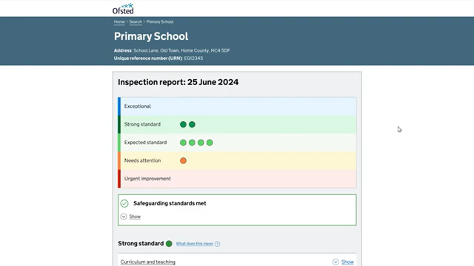
Report Cards
New style report card has been developed

Slide 22
Monitoring Visits
Schools that are in a category of concern or have any evaluation area graded ‘needs attention’ will be subject to a monitoring programme.
HMI allocated to a schools and will most likely be the lead inspector on the monitoring visit
Only the evaluation areas graded as ‘urgent improvement’ or ‘needs attention’ will be monitored.
Monitoring inspections can improve the grade for evaluation areas identified as ‘urgent improvement’ or ‘needs attention’. In these cases, an updated report card will be published

Slide 23
Needs Attention monitoring
Schools with evaluation areas graded as ‘needs attention’ will normally have a monitoring inspection no later than 24 months after the publication of the report card.
Introductory monitoring call – marks the start of contact with designated HMI. Typically, 3 months of publication of report and can be on any day before 10am
Ongoing monitoring calls- used to check in on progress and evaluate readiness for the on-site monitoring inspection
Notification and planning calls – to set up individual monitoring inspections in the programme
On-site monitoring inspection – notified 5 working days before inspection

Slide 24
Inspection Handbook Updates
Version 4.0 – September 2025

Slide 25
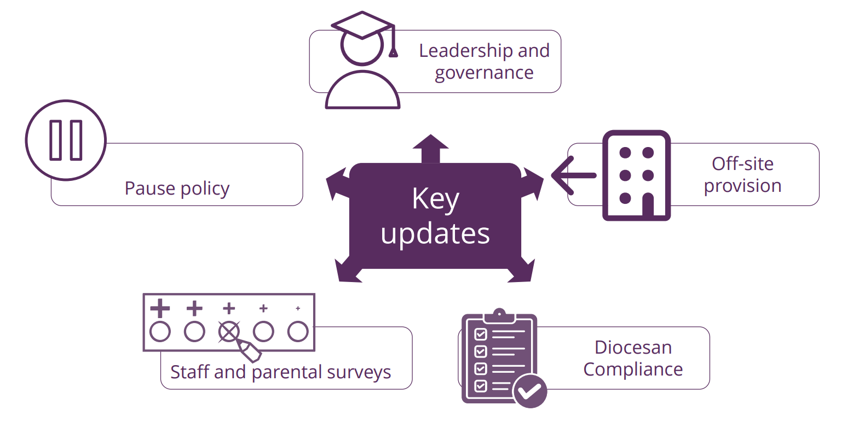

Slide 26
1. Leadership and Governance
Reflects new structures: Executive Headteachers and CSELs in Multi-Academy Trusts (MATs)
Executive HT (most senior person) informed of inspection (and named with HoS on report)
Lead inspector should contact CSEL (or their nominee) before inspection:
  Inform them and gather leadership/governance evidence
  Record discussion on Evidence Form (EF)
CSELs copied into notification and receive report
Deferral requests: must come from headteacher, not CSEL

Slide 27
2. Off-Site Provision
Some pupils educated at other sites (MATs or local authority)
Inspectors not expected to visit, but must include off-site pupils in evidence
Schools must demonstrate parity of Catholic education and outcomes
Paragraph 24 updated to ensure inspectors check equality of provision

Slide 28
3. Diocesan Compliance
Appendix 7.2: All dioceses to promulgate directives during 2025–26
All additional requirements replaced by September 2026
Interim expectations:
  Requirements clearly set out
  Properly consulted upon
  Communicated to schools in good time

Slide 29
4. Staff and Parental Surveys
Survey adapts based on staff role and inspection history
New questions:
  Whether school has been inspected before & whether the person completing the survey was a member of staff when the school or college was last inspected
  Branching added to reveal some questions only to those people who were present in the school or college when it was last inspected.
  Whether respondent teaches RE & branching added to reveal some questions only to those who teach RE.
Likert scale responses (strongly disagree - strongly agree) re-ordered so that results will display in a more intuitive way.
Likert scale responses amended to absorb 'don't know/not applicable' into the neutral category, so that responses to questions can be more easily compared at a glance.

Slide 30
5. Pause Policy (Appendix 6.1)
Appendix renamed: 'Deferral and Pause Policy'
Definitions:
  Deferral: reschedule before inspection begins
  Pause: temporary halt once inspection has started
Once begun, inspection must complete within 10 working days
Reasons to pause (exceptional circumstances, and only for very serious reasons):
  To protect the safety, or mental health and wellbeing of the school leader, or other member of staff.
  To protect the safety, or mental health and wellbeing of members of the inspection team.
  Major incident affecting school or inspection
Requests go to diocesan authority using Template 05

Slide 31
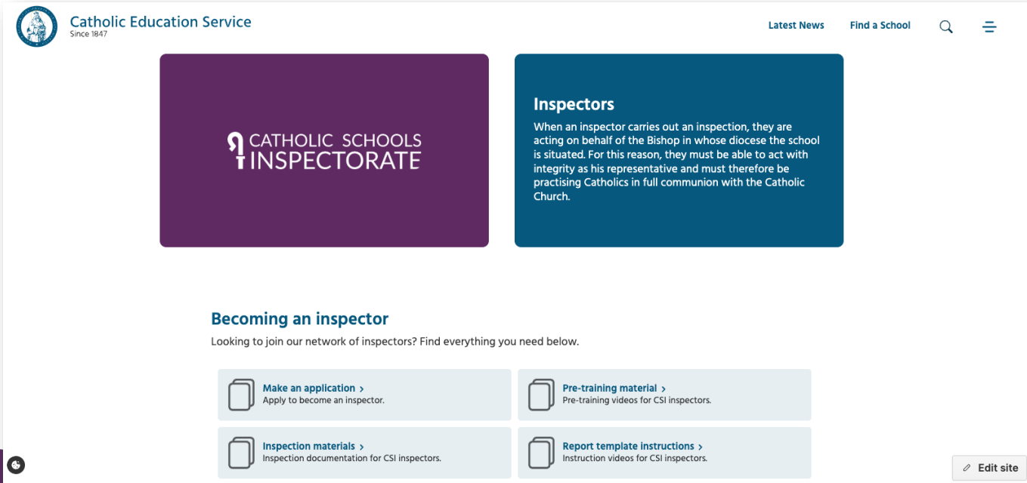
6. Other Administrative Updates
Introduction of new CSI website
New CSI email accounts will be introduced for inspectors
Report template revision – electronic - from January 2026

Slide 32
2026-2027 Diocese of Salford
6 inspections during Au1 term:
Grade 1: 4
Grade 2: 2

Slide 33
Thank you!

