Slide 1
CSI update
20th & 21st November 2024
RE Leader briefings

Slide 2
CSED
Working document - evidenced in governor minutes, reports etc. All own it.
Your format, your length.
Context – telling the story of your setting & journey
So what?
Grades that match next steps.
Next steps match action plans / SIDP
Evidence trail thinking – what do I need to support judgements?

Slide 3
Typicality
Typicality is central to inspection
What is the experience for most of the year, for most pupils?
Inspectors apply THE framework and do not bring an expectation linked to what they have experienced elsewhere for that grade.

Slide 4
Consider
How is your school’s journey towards PLD / RED progressing?
Is CLM everyone’s responsibility and in all things?
How are governors involved strategically?

Slide 5
CSI window clarification
The term is not prescribed
Pre pandemic – 8 year & 5 year cycles
Post pandemic – 5 year & 3 year cycles
Last inspection 2016-2017 | Good or better 2024-2025 | Requires Improvement
2017-2018 | 2025-2026
2018-2019 | 2026-2027
2019-2020 | 2027-2028 | 2024-2025

Slide 6
Framework updates:
Key updates September 2024, v3.1
Update to safeguarding procedures for inspectors who witness and incident or receive a disclosure – follow school policy, complete CSI Safeguarding Disclosure/Incident Form and inform CSI coordinator.

Slide 7
Confidentiality
Paragraph 66:
…school leaders may also share inspection outcomes, in confidence, with others who are not involved with the school. This may include leaders’ colleagues, family members, medical advisers and/or their wider support group. However, the information should not be made public or shared with parents.
Notes:
This was updated in last year’s editions, but we really need to stress its importance

Slide 8
Inspection window
No inspections scheduled:
First two full working weeks of the Autumn term
The first full working week of the spring term
The last full working week of the summer term
Notes:
Paragraph 12

Slide 9
Initial meeting with the headteacher
Paragraph 17:
A convenient time for the lead and headteacher to speak at length should be established at this point. This longer conversation can be a phonecall or an online video call

Slide 10
Roles of different kinds of inspector
Lead inspector is responsible for:
Preparing joining instructions for the team
Pre-inspection analysis
Writing the report
Notes:
Paragraph 18

Slide 11
Roles of different kinds of inspector
Team inspector is responsible for:
Carrying out agreed inspection activities during inspection
Maintaining their own EFs accurately
Contributing to team KIT meetings

Slide 12
Roles of lead and team
Inspectors who are shadowing should be included in the team by:
Taking part in a wide variety of inspection activities, for example, accompanying a member of the team, including meetings with the head and leadership team, governors, pupils.
Being present for team discussions, including asking questions for clarification.
Completing practice evidence forms.
Notes:
Paragraph 37 of Management of inspector handbook

Slide 13
Roles of lead and team
An inspector who is shadowing must not:
Undertake inspection activities alone.
Be part of the decision-making process, although they would be there to observe it.
Submit their evidence forms as part of the evidence base, although these should be part of the QA of evidence forms process during the inspection so that the new inspectors can improve in writing evaluative evidence forms.
Notes:
Paragraph 37 of Management of inspector handbook

Slide 14
Compliance update
Overall effectiveness descriptor, p.29:
Notes:
PR

Slide 15
Compliance update
Overall effectiveness descriptor, p.29:
⁸ Catholic Bishops Conference of England and Wales (2023), To Know you More Clearly, the Religious Education Directory for Catholic Schools, Academies and Colleges in England and Wales, ‘Section 1.2: General Norms’.
Notes:
PR

Slide 16
Compliance update
⁹ In due course these will be expressed as formally promulgated directives in all dioceses. For these dioceses that have already formally promulgate directives, this is what is meant by ‘additional requirements.’ For those dioceses that have not yet issued such directives, these requirements will be codified in another form.
Overall effectiveness descriptor, p.29:
Notes:
PR

Slide 17
Compliance update
Overall effectiveness descriptor, p.29:
Notes:
PR

Slide 18
Compliance update
Compliance determined by the INSPECTION TEAM
DURING inspection
By reviewing:
Curriculum time
Curriculum content
Notes:
PR

Slide 19
Compliance update
Overall effectiveness descriptor, p.29:
Notes:
PR

Slide 20
Compliance update
Compliance determined by the DIOCESE
PRIOR to the inspection and communicated to the inspection team
Notes:
PR

Slide 21
Compliance update
The school should know before the inspection team arrives whether or not they comply with diocesan requirements – it is not an area for debate or discussion during the inspection itself

Slide 22
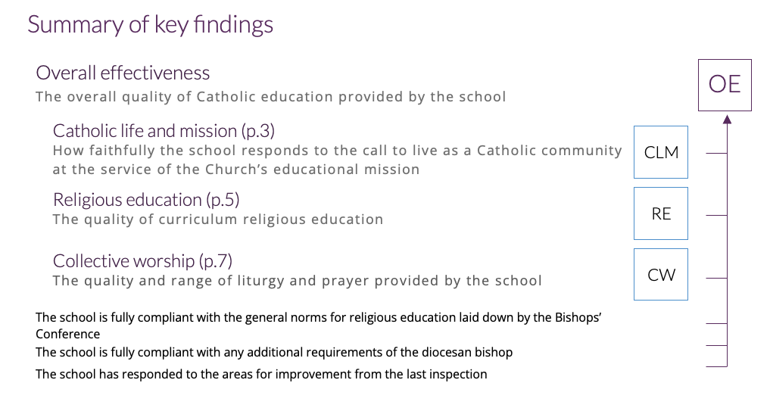

Slide 28
Compliance update
If the school has responded to all of the relevant AfIs from the last inspection.
It can still be given even if some of the AfIs have not been fully completed
EXCEPT if a previous AfI was related to curriculum time.
For a school to be GOOD or OUTSTANDING, the ‘Fully’ option must be selected.

Slide 29
Compliance update
If the school has responded to only some of the relevant AfIs from the last inspection.
OR if a school has not met an AfI that required them to move to the required percentage of curriculum time for religious education.
If a school has only ‘Partially’ met its AfIs it can be no better than RI

Slide 30
Compliance update
If the school has failed to respond to any of the relevant AfIs from the last inspection.
OR if a school has failed to respond to one or more AfI that has been given in more than one previous inspection.
If a school falls into this category, it will be graded as inadequate.

Slide 31
Compliance update
If the AfIs from a previous inspection are not relevant in the current framework.
If the school has not received a denominational inspection before.
If a school was historically not set any AfIs
In this case the compliance check has no bearing on the overall effectiveness judgement.

Slide 32
Inspection team prayer
Find a private space and time for the whole inspection team at the beginning of each inspection day.
Take a moment to be still in God’s presence.
Use the Inspection prayer provided for the beginning of each day and adapt it to your own circumstance.
It is modelled on the prayer of the Church.

Slide 33
KITs and HUMs
Keeping in touch (KIT) meetings is how we refer to the meetings of the inspection team
These should be included in the planning of the inspection timetable
Notes:
24. Although it is appreciated that the timetable for inspection activities will be organised with the support of school leaders, inspectors reserve the right to gather evidence from anywhere in the school during the period of the inspection.
The programme for the inspection is the responsibility of the lead inspector and should include:
observation of learning – including joint observations with key school staff (if agreed: see paragraph 43).
observation of prayer and liturgy.
discussions with pupils.
scrutiny of pupils’ work.
scrutiny of parent/carer, and staff surveys.
meetings with headteacher, link governor, head of sixth form, subject leader of religious education, chaplain and/or priest.
regular keeping in touch meetings with the inspection team (KITs).
regular head teacher update meetings.

Slide 34
KITs and HUMs
Headteacher update meetings (HUMs) are the formal update meetings between the lead inspector and the headteacher
At least:
Twice in the first day
At the end of the first day
Morning of the second day
Notes:
63. The inspection findings should not come as a surprise to the headteacher at the end of the inspection. The headteacher should be kept abreast of the emerging judgements through regular headteacher update meetings. The lead inspector must arrange to meet the headteacher to share emerging judgements at least twice in the first day, at the end of the first day (see Template 9.1), and again on the morning of the second day. At these headteacher update meetings and throughout the inspection, the lead must also ensure that the school is happy with the conduct of the inspection and should specifically ask for confirmation at the final feedback. These headteacher update meetings should be recorded on EFs and include confirmation that the headteacher is happy with the conduct of the inspection. Conversations following joint observations with school leaders should not replace these regular headteacher update meetings. Prior to the final feedback, it is expected that the inspector will have discussed the findings with the headteacher, even if this delays the formal feedback at the end of the inspection.

Slide 35
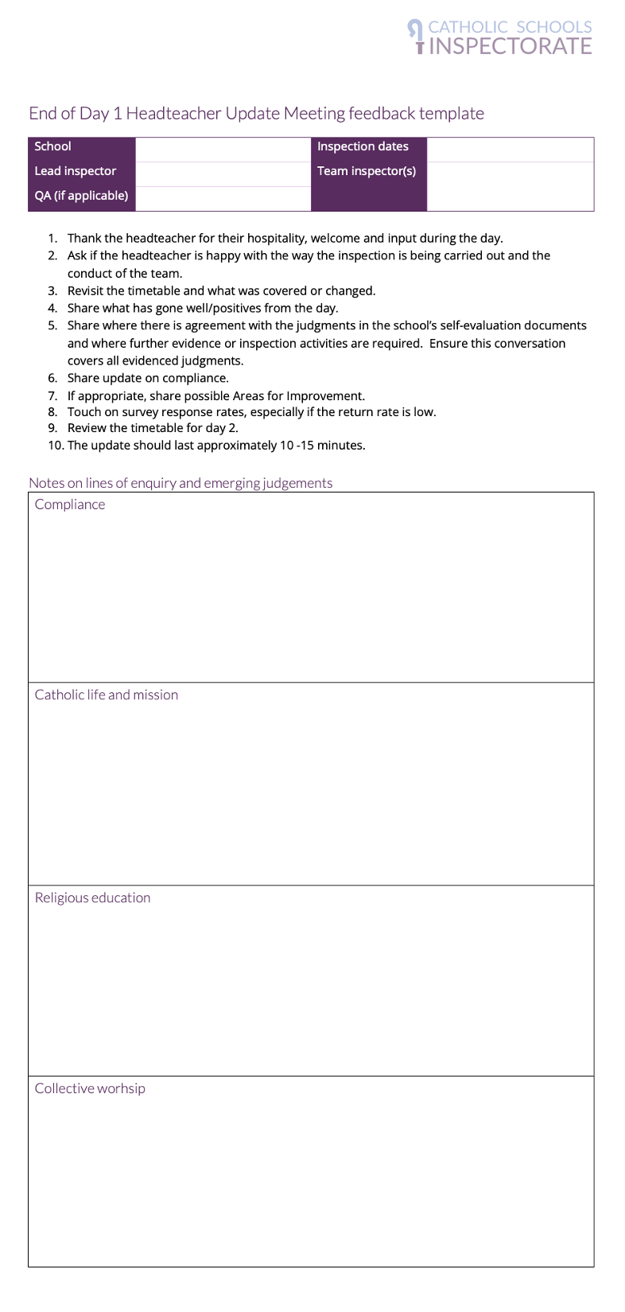
KITs and HUMs
Template 9.1 End of Day 1 feedback template
Notes:
Template 09.1 End of day 1 feedback template

Slide 36
KITs and HUMs
Template 9.1 End of Day 1 feedback template
Notes:
Template 09.1 End of day 1 feedback template

Slide 37
KITs and HUMs
Template 9.1 End of Day 1 feedback template
Notes:
Template 09.1 End of day 1 feedback template

Slide 38
KITs and HUMs
Template 9.1 End of Day 1 feedback template
Notes:
Template 09.1 End of day 1 feedback template

Slide 39
KITs and HUMs
Template 9.1 End of Day 1 feedback template
Notes:
Template 09.1 End of day 1 feedback template

Slide 40
KITs and HUMs
Template 9.1 End of Day 1 feedback template
HUMs must be distinguished from the formal discussions with the headteacher as evidence-gathering activities
The lead inspector must ensure that the headteacher is always clear about which kind of meeting is taking place
Notes:
53. The lead inspector should make clear to the headteacher that there is a distinction between the regular headteacher update meetings (see paragraph 63) and the formal discussions with the headteacher as evidence-gathering activities. For these evidence-gathering discussions, the school’s record of self-evaluation, and the issues and hypotheses from the pre-inspection notes, will form the main focus of the discussions. The purpose should be to permit the headteacher to indicate where further evidence relating to the issues may be found, and to provide his/her own perspective on them.

Slide 41
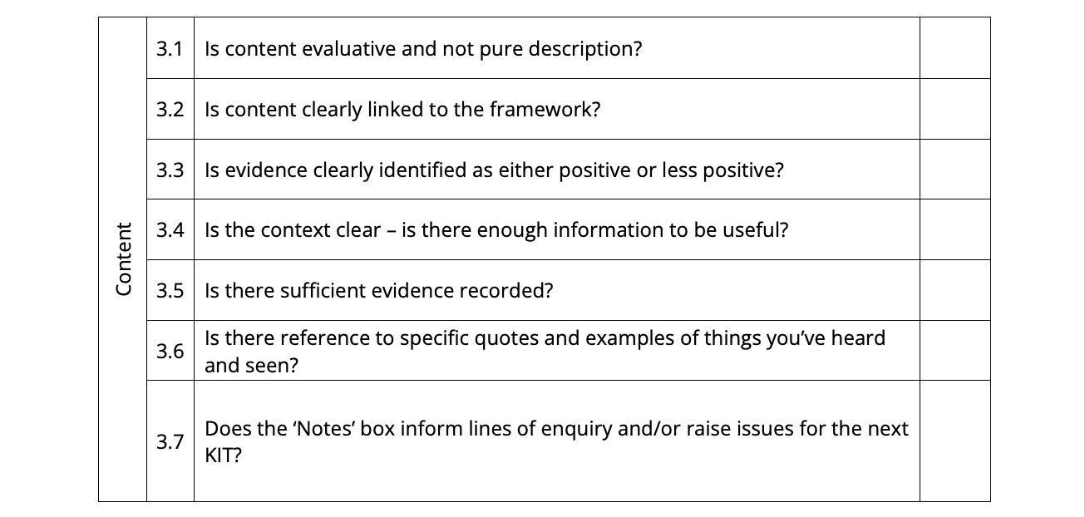
Initial QA of team inspector EFs
Paragraph 36:
The lead inspector must quality assure the EFs of the team inspectors early in the inspection process, to ensure that they are evaluatively written and that judgements are consistent across the inspection team (see Template 7.4 – EF QA checklist for lead inspectors).

Slide 42
Writing EFs evaluatively
Some helpful conventions:
For example, using + and – at the beginning of sentences to indicate strengths or areas for improvement are quick to scribble and easy to identify in the text of an EF.

Slide 43
Writing EFs evaluatively
Some helpful conventions:
Impact can be indicated by the use of an arrow. Using the arrow moves the evidence gatherer beyond simply recording what is seen to recording the impact this is having on the things the framework requires us to evaluate

Slide 44
Trust employees
Paragraph 62:
Trust employees who have a role in the day-to-day operational life of the school, even if they have responsibilities at other schools, should be treated as members of staff for the purpose of inspection. Other trust employees whose role is strategic and not school based (e.g. CEOs) would only be included in the strategic governance level of evidence gathering.

Slide 45
Style guide update
Children
In early years
In the rest of primary school
In secondary school and sixth form colleges
Pupils
Students
Notes:
Appendix 10, paragraph 42
In general, refer to ‘children’ in early years settings, ‘pupils’ in the rest of primary school inspections, ‘students’ in secondary school and sixth form college inspections. However, if this is contrary to the nomenclature the school itself uses, then the inspector should defer to the school’s usage in writing the report.

Slide 46
Style guide update
Children
However, if this is contrary to the nomenclature the school itself uses, then the inspector should defer to the school’s usage in writing the report.
Pupils
Students
Notes:
Appendix 10, paragraph 42
In general, refer to ‘children’ in early years settings, ‘pupils’ in the rest of primary school inspections, ‘students’ in secondary school and sixth form college inspections. However, if this is contrary to the nomenclature the school itself uses, then the inspector should defer to the school’s usage in writing the report.

Slide 47
Live QA & Data Pack
CPDF
Previous inspections including S48 & Ofsted
FFT Aspire
Live & National QA

