Slide 1
Preparing for First Holy Communion
Welcome!

Slide 2
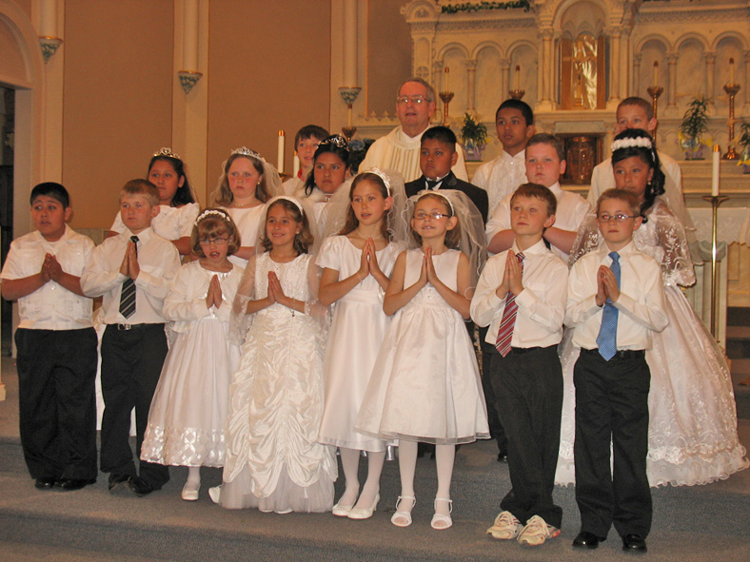
Preparing for First Holy Communion
Soon we will be starting to prepare another group of children from our parish to receive Jesus in Holy Communion for the first time.
They will also be preparing to celebrate the Sacrament of Reconciliation (Confession).
This is a really important moment in their lives as members of God’s family – the Church.
As families and as a parish community, we want to help the children prepare in the best possible way.

Slide 3
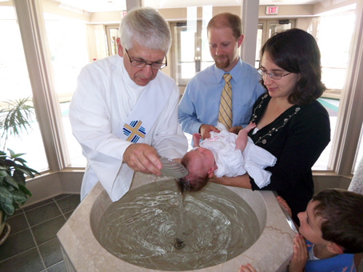
Do you remember when you brought your child for Baptism?
As parents, you accepted the responsibility of training your child in the practice of the Catholic Faith.
You promised to bring them up to keep God’s commandments by loving God and our neighbour.
The Godparents promised to help you in your duty as Christian parents.
The parish community and the Church (through the priest) promised to support you in these duties.

Slide 4
At Baptism people made promises and commitments
How have you tried to fulfil your promise to raise you child in the practice of the Faith?
At home?
Teaching them to love God and neighbour.
Praying with them.
Passing on the Christian story
Other things?

Slide 5
At Baptism people made promises and commitments
How have you tried to fulfil your promise to raise you child in the practice of the Faith?
In the parish community?
Regularly taking your child to Mass.
Joining in other parish activities.
Other things?

Slide 6
At Baptism people made promises and commitments
How has the parish community supported you in your duty as Christian parents?
Through the Catholic School?
Children’s liturgies and other events?
Other groups within the parish?
The opportunity now to help you prepare your child for 1st Communion.

Slide 7
Preparing for First Holy Communion
What is involved in this preparation?
What commitment is required from parents and from the children?

Slide 8
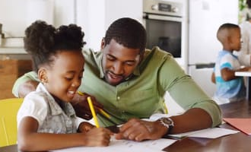
Preparing for First Holy Communion
A series of preparation sessions for children and parents
Associated celebrations in the church or home
Encouragement, prayer and preparation in the home
Religious education in the school (or parish)

Slide 9
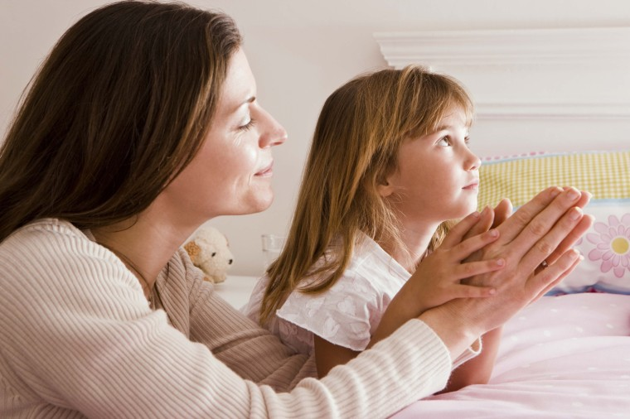
Preparing for First Holy Communion
Commitment is required from:
Parents/Carers
Children
Parish
School

Slide 10
(Normal) expectations for a child to celebrate First Communion in the Diocese of Salford
Parent(s) and children will be regularly attending Sunday Mass
Children will attend all sessions with catechists in the parish (unless there is good reason for missing)
Parent(s) will attend any sessions arranged for them in the parish and work with children at home

Slide 11
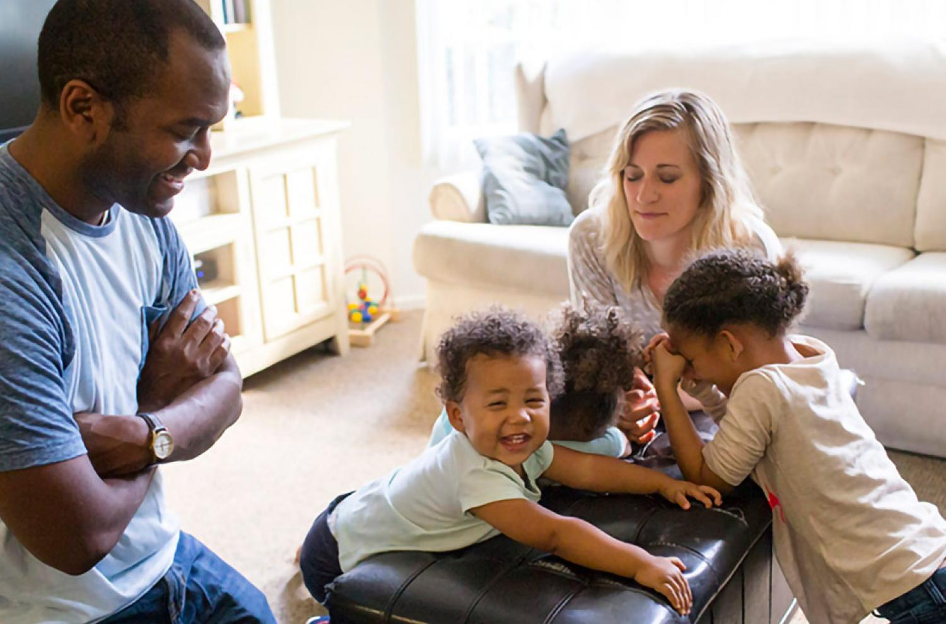
Realistic expectations for the current pendemic situation
Weekly attendance at Mass is not possible for everyone because of restrictions
Workbooks for each session will often be started in school, but need to completed by children and parents together at home
Prayer and ‘worship’ in the home and family are especially important at this time

Slide 12
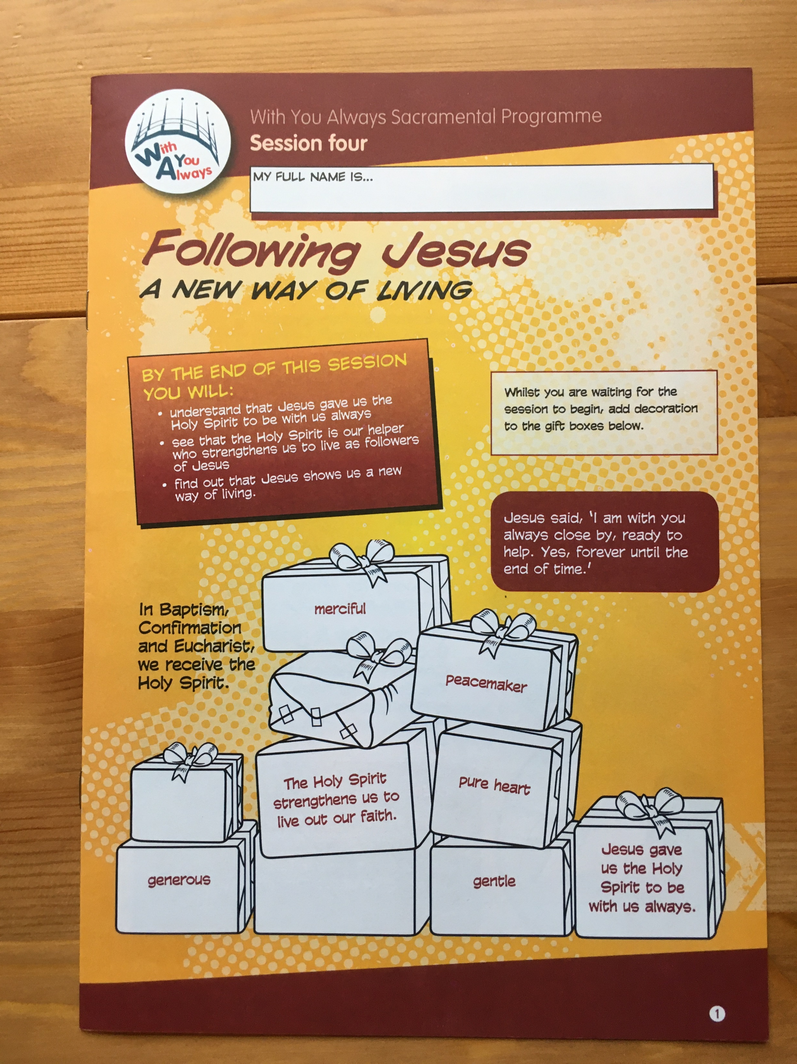

Slide 13
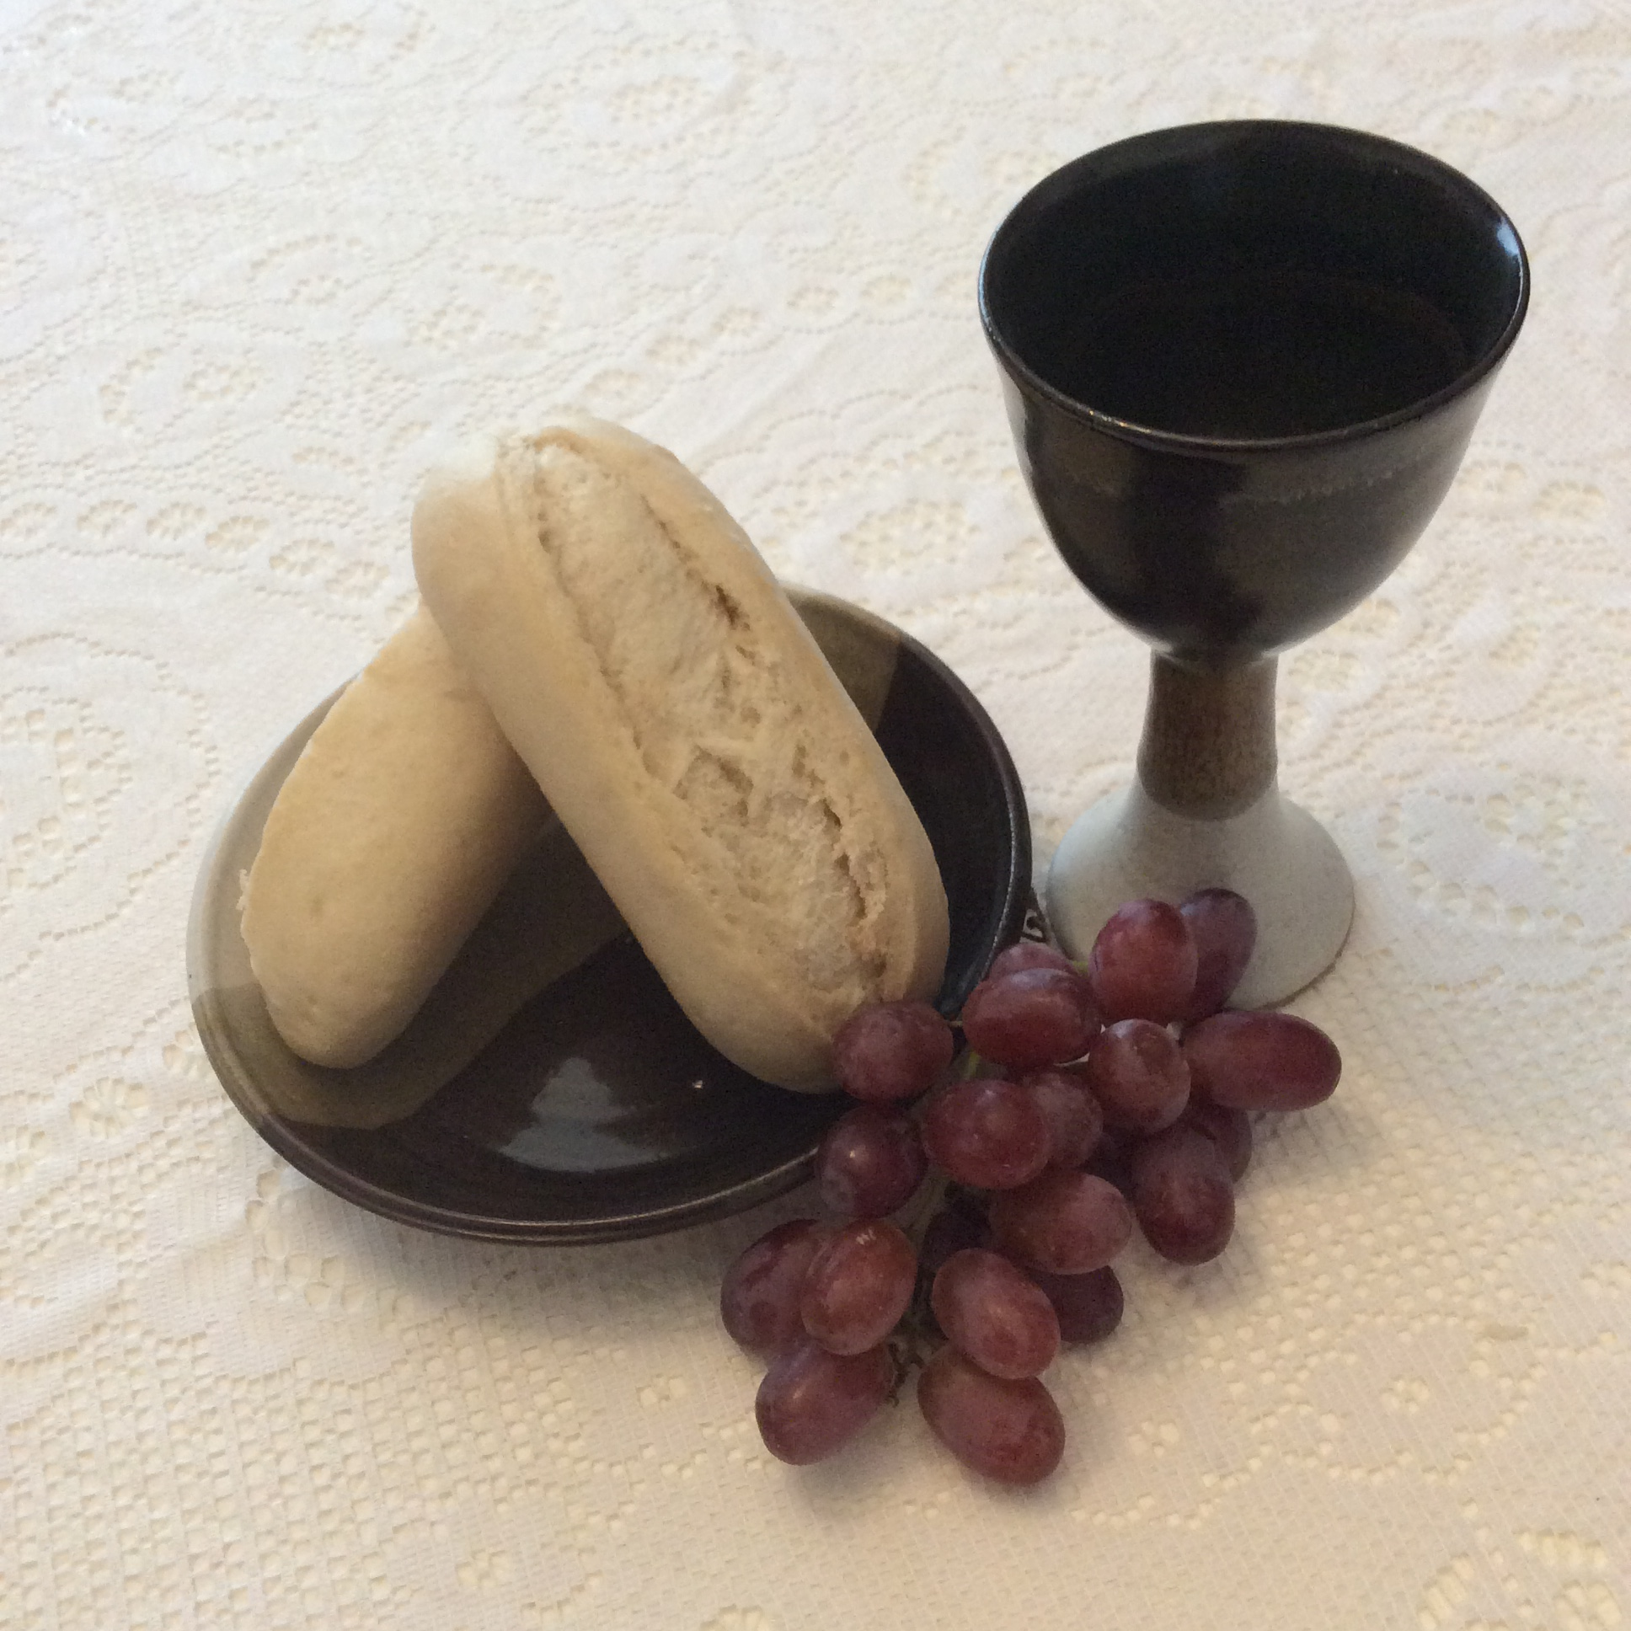
We will also be offering:
Ideas for celebrations in the home to accompany the various units
Suggestions for the different seasons (Advent, Christmas, Lent , Easter)
Ideas for keeping Sunday as a family when we cannot get to Mass
Some short videos with tips and ideas for parents
Additional support for parents of children who are not in a Catholic school

Slide 14
We will also be offering:
Additional support for parents of children who are not in a Catholic school
Prayer Partners – parishioners who promise to pray daily for one of the children and their family
Email and telephone support (not 24/7!) for parents and families

