Slide 1
GIFTS OF HOLY SPIRIT
The Rite of Confirmation

Slide 2
CONGRATULATIONS
You have completed the eight sessions on the Gifts and Fruits of the Holy Spirit but in our faith, there is always more to learn, each day of our lives.
In this session we will look around the practicalities of the Confirmation itself especially during these current circumstances. We will make sure you have arranged a sponsor, chosen a confirmation name, you know who is going to be involved and you are clear on the date, time and location of your confirmation and know the number of people allowed to attend.

Slide 3
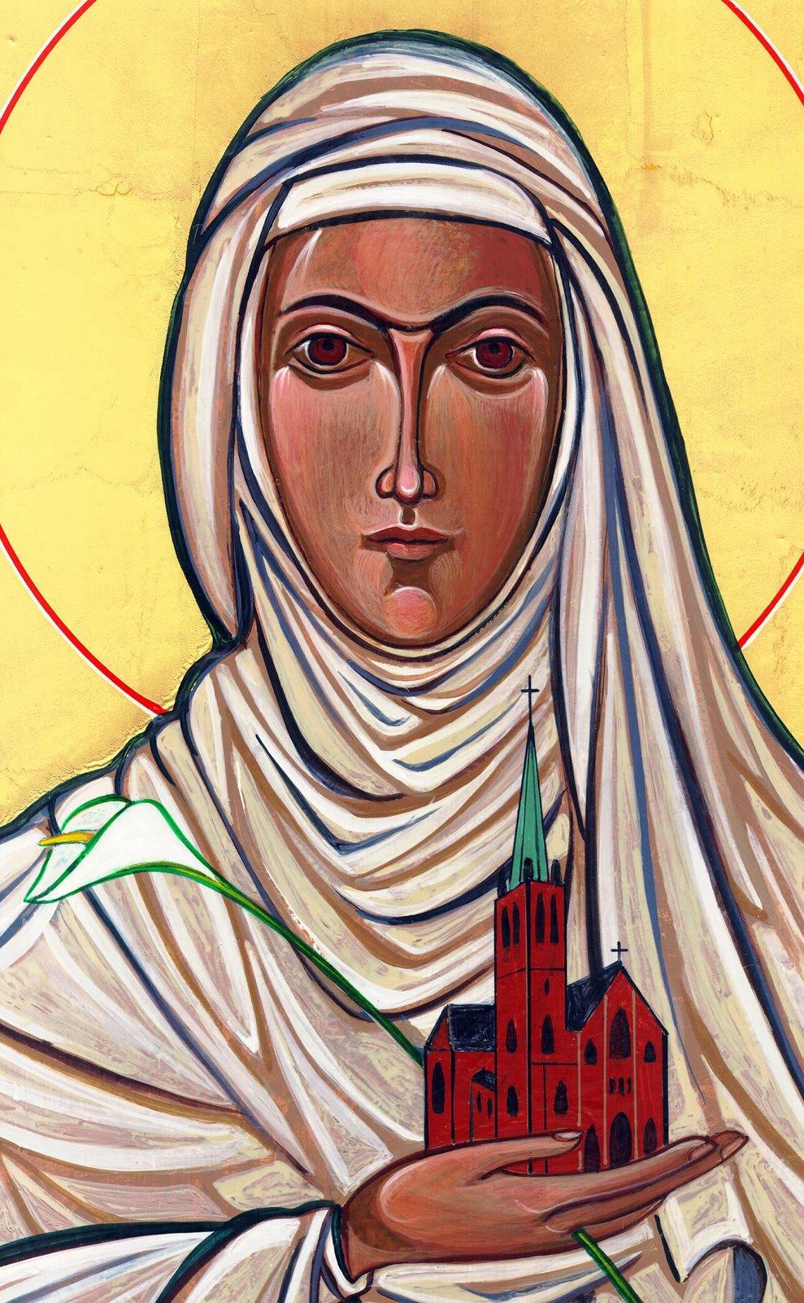
Opening Prayer
Lord Jesus, bless us as we gather together as young people from the Diocese. We are one in your name. May your light burn brightly within us as we celebrate Your love for us.
Inspire us with your Holy Spirit. Help us to take Your light and Your love out to the whole world. Show us how to use our gifts and talents to become who You have called us to be. Amen
St Catherine of Siena, Pray for us.

Slide 4
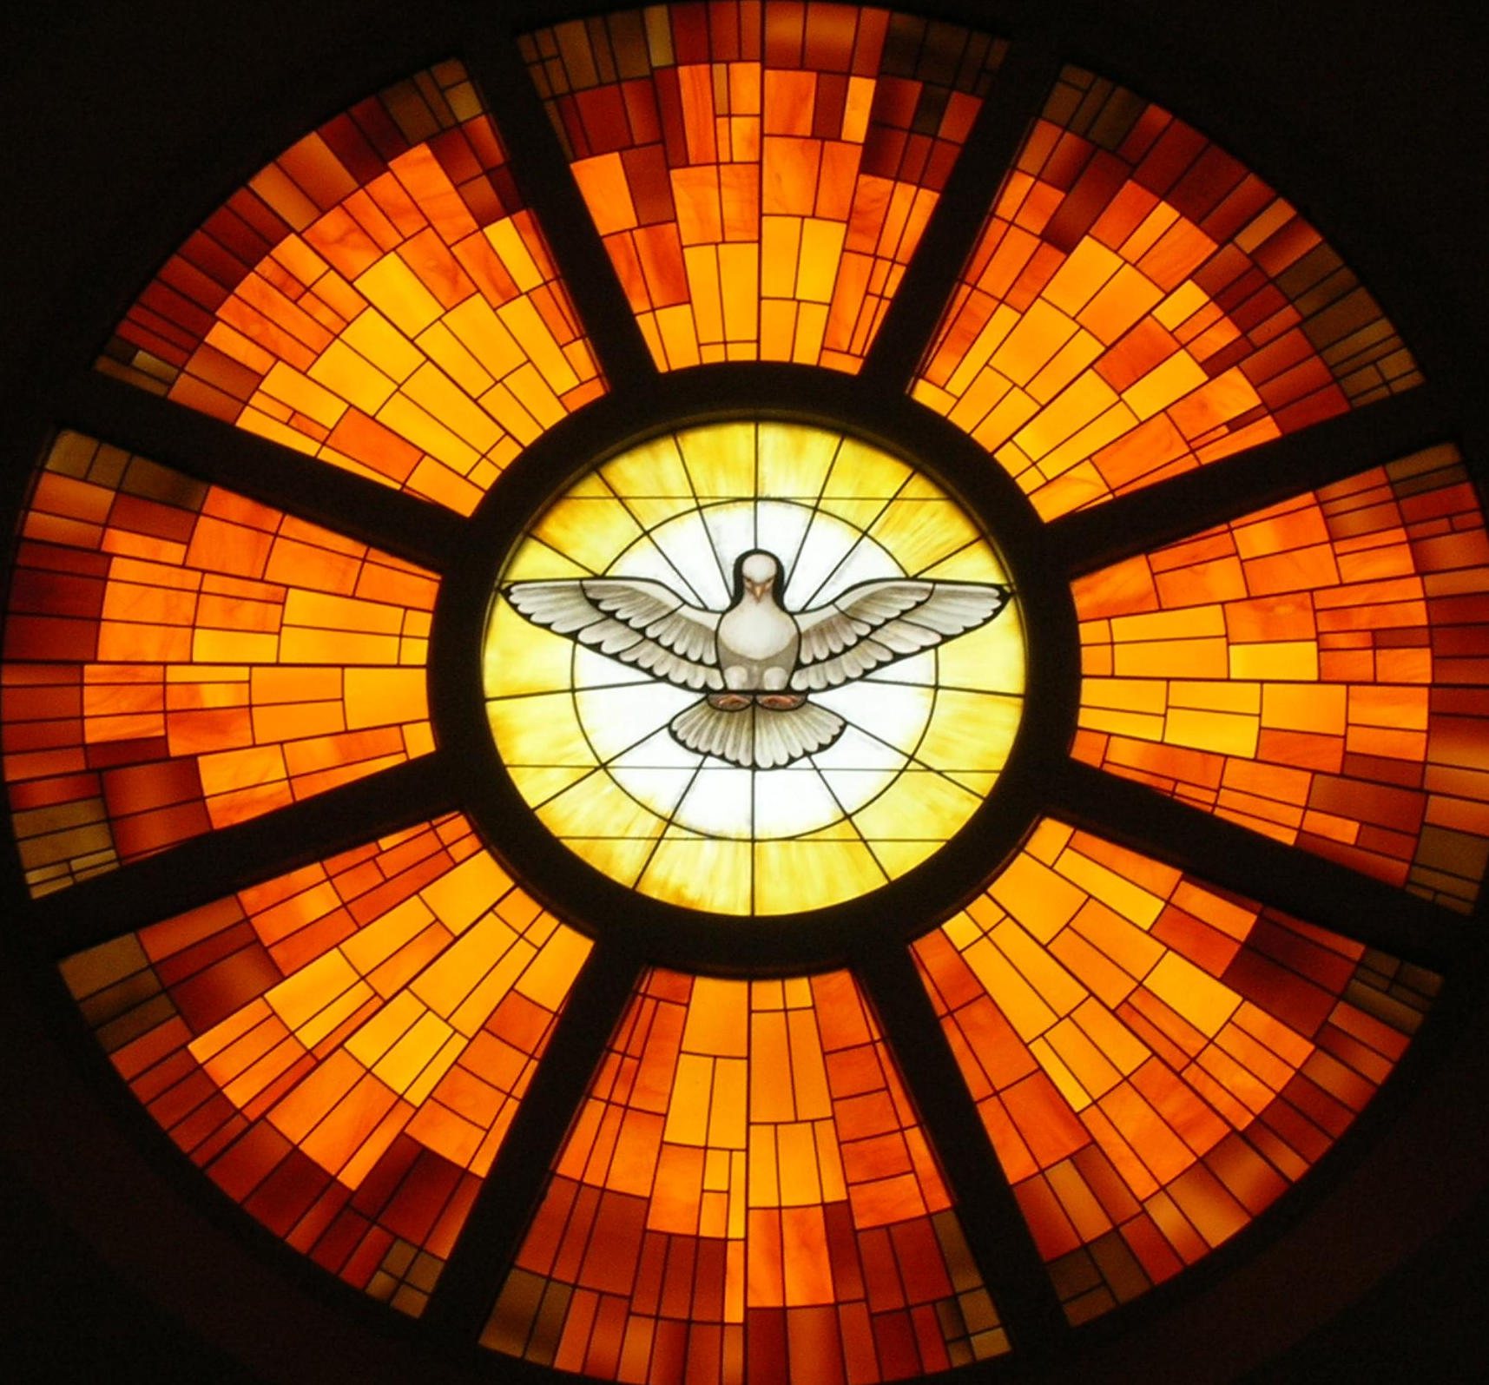
Lets see what you remember…
Fill in the blanks
The 7 Gifts of the Holy Spirit are:
W_ _ _ _ _
U _ _ _ _ _ _ _ _ _ _ _ _
K _ _ _ _ _ _ _ _
C _ _ _ _ _ _
F _ _ _ _ _ _ _ _
P _ _ _ _
A _ _

Slide 5
Lets see what you remember…
Fill in the blanks
The 12 Fruits of the Holy Spirit are:
K _ _ _ _ _ _ _
G _ _ _ _ _ _ _ _ _
J _ _
C _ _ _ _ _ _
S _ _ _ - _ _ _ _ _ _ _
F _ _ _ _ _ _ _ _ _ _
G _ _ _ _ _ _ _ _ _
G _ _ _ _ _ _ _
C _ _ _ _ _ _ _
P _ _ _ _
P _ _ _ _ _ _ _
M _ _ _ _ _ _

Slide 6
The Sacrament of Confirmation

Slide 7
The Structure of the Rite
Over the next few slides we will look at the Structure of your Confirmation Mass so you know what to expect so you can get the most out of its rich symbolism.
Gathering & Opening Rites
Liturgy of the Word
Homily
Prayers of Intercession
The Role of the Sponsor
Laying on of Hands, Anointing with the oil of Chrism & The Sign of Peace
Concluding Rites & Dismissal

Slide 8
1. Gathering & Opening Rites
Fr Richard, one of our Diocesan Youth Chaplains, speaks about the importance of gathering as a community for the celebration and about how we get ourselves ready together for the sacraments.

Slide 9
Practical Questions
Do you know …
The date, time and location of your Confirmation?
Do you know how many people can come with you?

Slide 10
Prayer
Here is a prayer you can say each day to prepare for your special day. You may wish to write it down and make a special prayer card
Prayer to the Holy Spirit
Come Holy Spirit, fill the hearts of your faithful and kindle in them the fire of your love. Send forth your Spirit and they shall be created. And You shall renew the face of the earth.
O, God, who by the light of the Holy Spirit, did instruct the hearts of the faithful, grant that by the same Holy Spirit we may be truly wise and ever enjoy His consolations,
Through Christ Our Lord,
Amen.

Slide 11
2. Liturgy of the Word
Fr Mark, one of our Diocesan Youth Chaplains, speaks about the importance of the Liturgy of the Word

Slide 12
Scripture
Here is the story of Pentecost. You may wish to take down the bible reference so you can look it up online or in your bible or ask your leader to print this off for you as you prepare.
The Story of Pentecost - Acts 2:1-12
When Pentecost day came round, they had all met in one room, when
suddenly they heard what sounded like a powerful wind from heaven,
the noise of which filled the entire house in which they were sitting;
and something appeared to them that seemed like tongues of fire;
these separated and came to rest on the head of each of them. They
were all filled with the Holy Spirit, and began to speak foreign
languages as the Spirit gave them the gift of speech.
Now there were devout men living in Jerusalem from every nation
under heaven, and at this sound they all assembled, each one
bewildered to hear these men speaking his own language. They were
amazed and astonished. ‘Surely’ they said ‘all these men speaking are
Galileans? How does it happen that each of us hears them in his own
native language? Parthians, Medes and Elamites; people from
Mesopotamia, Judaea and Cappadocia, Pontus and Asia, Phrygia and
Pamphylia, Egypt and the parts of Libya round Cyrene; as well as
visitors from Rome – Jews and proselytes alike – Cretans and Arabs; we
hear them preaching in our own language about the marvels of God.’

Slide 13
3. The Homily
The priest will then share a few words about the Sacrament of Confirmation, listen carefully to what he has to say. Here is what Bishop Barron from the USA says at his Confirmation Masses.

Slide 14
4. Prayers of Intercession
We then bring before God the needs of the World asking Him to hear our prayer.

Slide 15
5. The Role of the Sponsor
Your Confirmation Sponsor should be someone who accompanies you on your faith journey. They should pray for you and challenge you to be the best version of yourself and grow closer to God.

Slide 16
5. The Role of the Sponsor
Have you chosen your confirmation sponsor and do they know the details of the Confirmation itself (date, time, location)?
Remember they must be:
Someone other than your parent
Over 16
A confirmed Catholic who will support
you in the faith

Slide 17
6. Laying on of Hands, Anointing with the oil of Chrism & The Sign of Peace
The Bishop or priest will pray that you are filled with the Holy Spirit by stretching out his hands, then you will be anointed with the oil of Chrism which is blessed at the Cathedral each year then will give you the sign of peace.

Slide 18
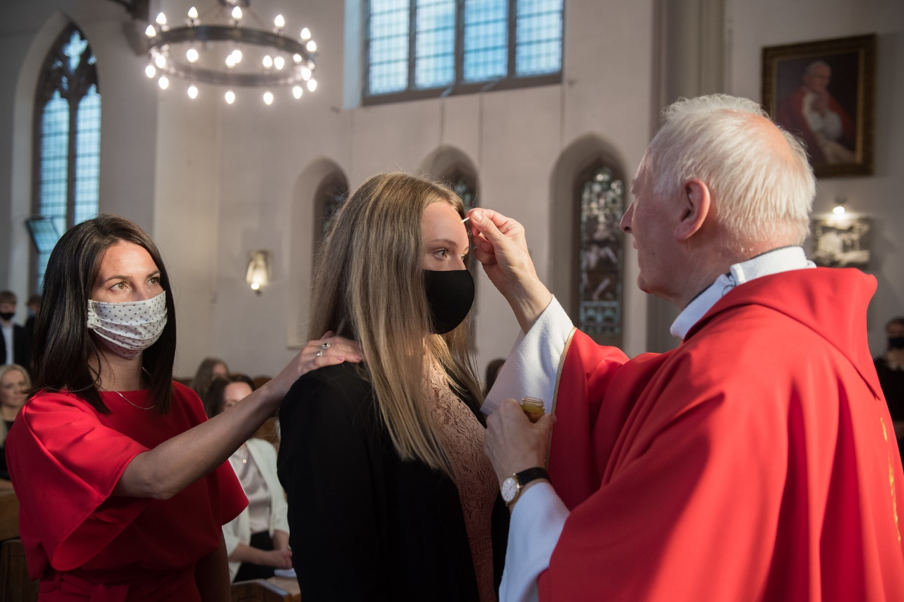
6. Laying on of Hands, Anointing with the oil of Chrism & The Sign of Peace
With the current restrictions this may be done differently this year but the same blessings will be received.
© Mazur/cbcew.org.uk

Slide 19
Choosing a Confirmation Name
Have you chosen your Confirmation name?
Have you researched into the life of the saint you have chosen and asked them to pray for you?

Slide 20
7. Concluding Rites & Dismissal

Slide 21
Opportunity
for Questions

Slide 22
A Time of Prayer
As you listen to this Taize chant, give thanks to God for all you have learnt and in anticipation for receiving the Holy Spirit soon.
Prayer
Glory be to the Father, and to the Son and to the Holy Spirit.
Amen

Slide 23
“Jesus said to them again:
Peace be with you. As the Father sent me, so I am sending you’
JOHN 20:21

Slide 24
Rock, Paper, Scissors
In pairs, play Rock, Paper, Scissors
– the winner stays on

Slide 25
GIFTS OF HOLY SPIRIT
The Rite of Confirmation

