Slide 1
GIFTS OF HOLY SPIRIT
Session 7 - Awe

Slide 2
The 7 Gifts of the Holy Spirit
Wisdom
Understanding
Fortitude
Knowledge
Piety
Counsel
Fear of the Lord/
Wonder & Awe
Through Jesus, these are the Gifts we will receive at Confirmation!

Slide 3
Introduction
The aim of this unit is to help you understand the abiding presence of Jesus in the sacraments which are key moments of encounter with God for us.
This is why participating in the celebration of the sacraments is important.
Confirmation is one of the seven sacraments that help us on our faith journey.
The Gift of Awe helps us ponder the mystery that God comes to meet us in this close way.
© JPPC

Slide 4
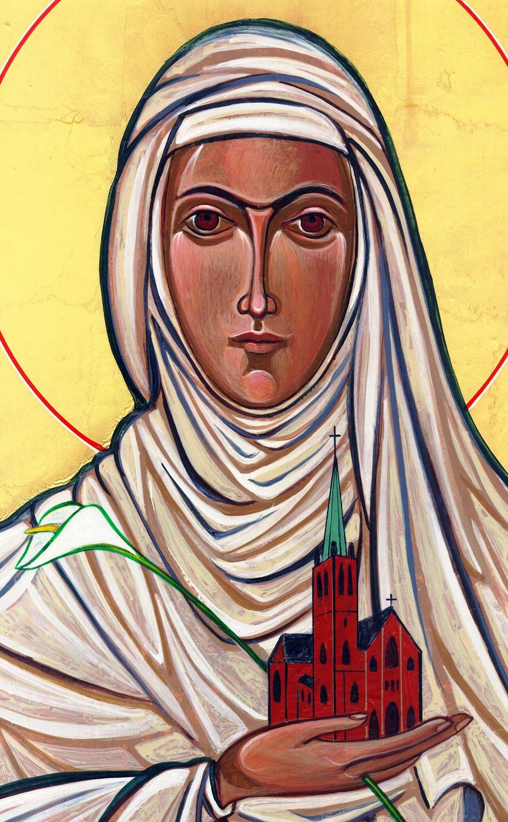
Opening Prayer
Lord Jesus, bless us as we gather together as young people from the Diocese. We are one in your name. May your light burn brightly within us as we celebrate Your love for us.
Inspire us with your Holy Spirit. Help us to take Your light and Your love out to the whole world. Show us how to use our gifts and talents to become who You have called us to be. Amen
St Catherine of Siena, Pray for us.

Slide 5
Scattergories Game
Going around the group, using groups of seven (e.g. days of week) you have to try and choose something linked with seven that no one else chooses!
Make sense? Lets go …

Slide 6
What are the Sacraments and why do we need them?
We are a physical people. We like to be able to touch, smell, taste and see things. God knew this when He gave us the Sacraments. They are a outward sign of an inward reality and help us to think about things we can’t see.

Slide 7
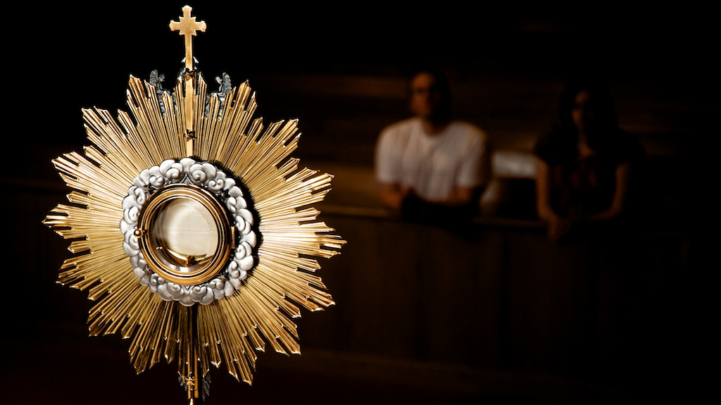
Scripture Reading – Matthew 28:16-20
Now the eleven disciples went to Galilee, to the mountain to which Jesus had directed them. And when they saw him they worshiped him, but some doubted. And Jesus came and said to them, “All authority in heaven and on earth has been given to me. Go therefore and make disciples of all nations, baptising them in the name of the Father and of the Son and of the Holy Spirit, teaching them to observe all that I have commanded you. And know,
I am with you always, to the end of time.”

Slide 8
Jesus comes to meet us
“You didn’t want Heaven without us so Jesus you brought Heaven down”

Slide 9
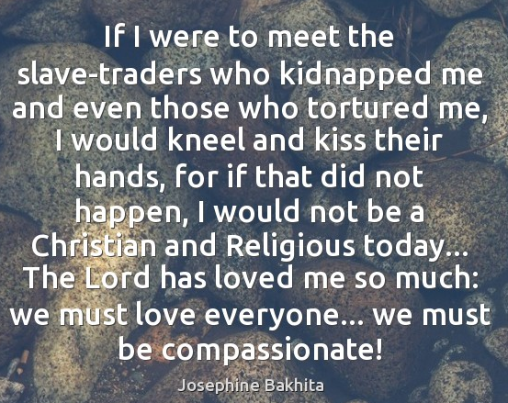
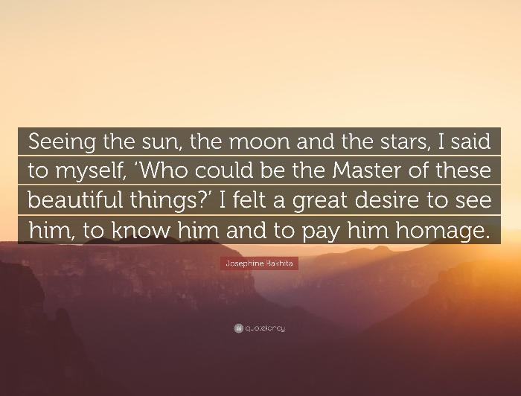
Hero of our Faith
St Josephine Bakhita
Let us pray for victims of human trafficking around the world and pray for a change of heart from those who inflict it.

Slide 10
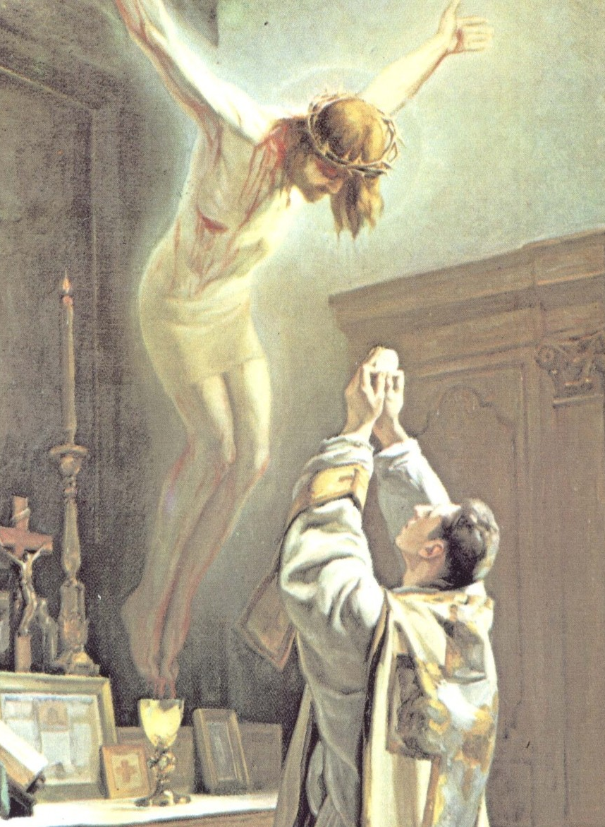
The Holy Mass – the source & summit of our Faith
“I am the bread of life. Those who come to me shall never hunger and whoever believes in me will never thirst”
John 3:35

Slide 11
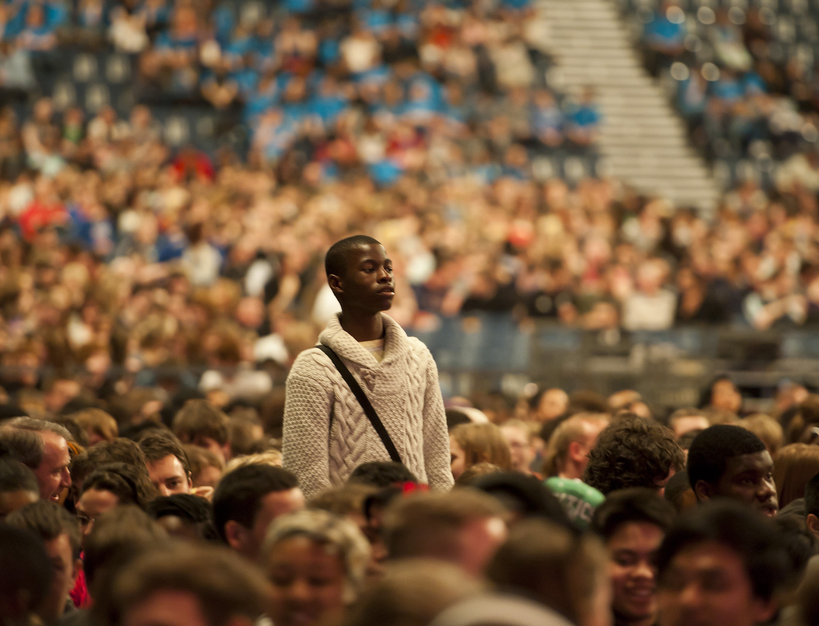
Situation
One of your friends says that there is no point going to Mass.
Based on what you have heard and learnt so far today how could you respond to that?
© Mazur/catholicnews.org.uk

Slide 12
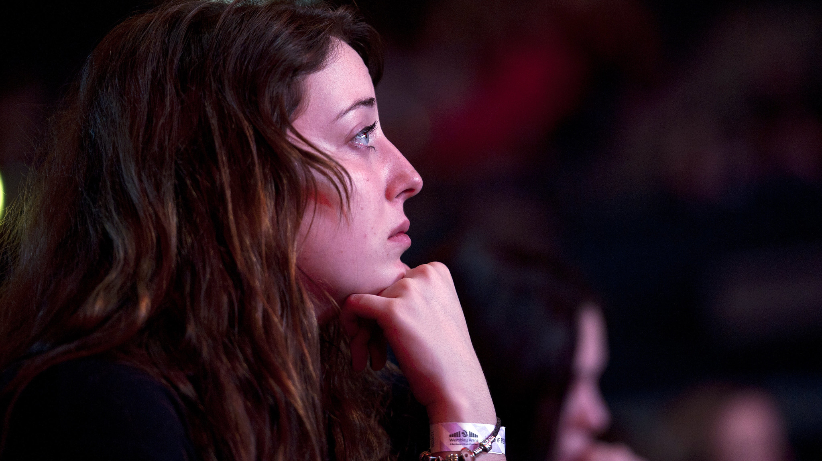
Discussion
What helps you participate in the sacraments especially coming to Mass?
What makes it difficult?
What could you do to make the difference?
© Mazur/catholicnews.org.uk

Slide 13
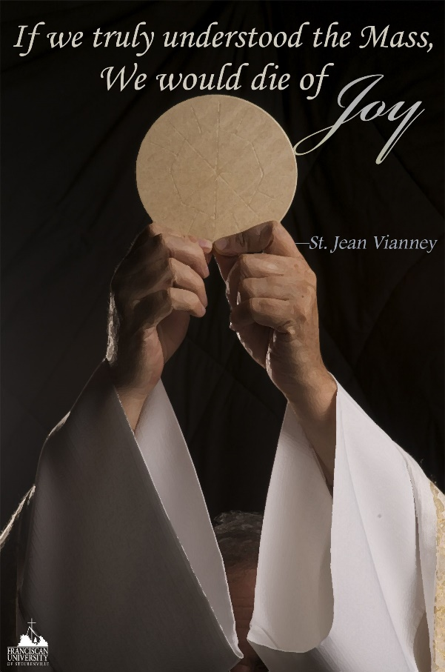
“We need sacraments in order to outgrow our petty human life and to become like Jesus through Jesus: children of God in freedom and glory. In Baptism fallen children become cherished children of God; through Confirmation the weak become strong, committed Christians; through Penance the guilty are reconciled; through the Eucharist the hungry become bread for others; through Matrimony and Holy Orders individualists become servants of love; through the Anointing of the Sick the despairing become people of confidence. The sacrament in all the sacraments is Christ himself. In him we, lost in selfishness, grow and mature into the true Life that has no end.
YOUCAT 173

Slide 14
Where to find out more…
Sycamore video on the Sacraments
Mass Readings & Prayers of the Church
universalis.com/

Slide 15
The Empty Chair – A calming guided meditation
Prayer
Glory be to the Father, and to the Son and to the Holy Spirit, Amen

Slide 16
“Jesus said to them again:
Peace be with you. As the Father sent me, so I am sending you’
JOHN 20:21

Slide 17
Quiz
You will need paper and a pen.
There are 20 questions.
The questions are on the next two slides and the answers are on the slides after that.
Good luck…

Slide 18
1. How many years are there in a millennium?
2. What is a baby goat called?
3. What magical item does Aladdin use to fly around on?
4. What is the name of the snowman in Frozen?
5. What is the name of the painting technique that uses small dots of colour to create patterns and then an image?
6. Where does the UK prime minister live?
7. What were the names of Christopher Columbus' three ships?
8. Which travels faster, light or sound?
9. What’s the name of the cowboy in Toy Story?
10. Who is the Prime Minister of Britain?
Quiz

Slide 19
Quiz
11. How many wives did Henry VIII have?
12. What is the name of the world’s largest reef system?
13. What famous islands were extensively studied by Charles Darwin?
14. What is the name of the third Harry Potter book?
15. Which one of these is not a type of penguin? Emperor, Royal, King and Jack
16. What is the Gruffalo scared of?
17. Which city has the largest population on Earth?
18. How many sides does an octagon have?
19. What kind of fish is Nemo from the Finding Nemo film?
20. Who was behind the Gunpowder Plot on the Houses of Parliament in 1605 - remembered every year on Bonfire Night?

Slide 20
Answers
1. 1,000
2. a kid
3. a carpet
4. Olaf
5. Pointillism
6. 10 Downing Street
7. Niña, Pinta and Santa Maria
8. Light
9. Woody
10. Boris Johnson

Slide 21
Answers
11. Six
12. Great Barrier Reef
13. Galapagos Islands
14. Harry Potter and the Prisoner of Azkaban
15. Jack
16. A mouse
17. Tokyo
18. Eight
19. Clownfish
20. Guy Fawkes

Slide 22
GIFTS OF HOLY SPIRIT
Session 7 - Awe

