Slide 1

GIFTS OF HOLY SPIRIT
Session 6 - Piety

Slide 2
The 7 Gifts of the Holy Spirit
Wisdom
Understanding
Fortitude
Knowledge
Piety
Counsel
Fear of the Lord
Through Jesus, these are the Gifts we will receive at Confirmation!

Slide 3
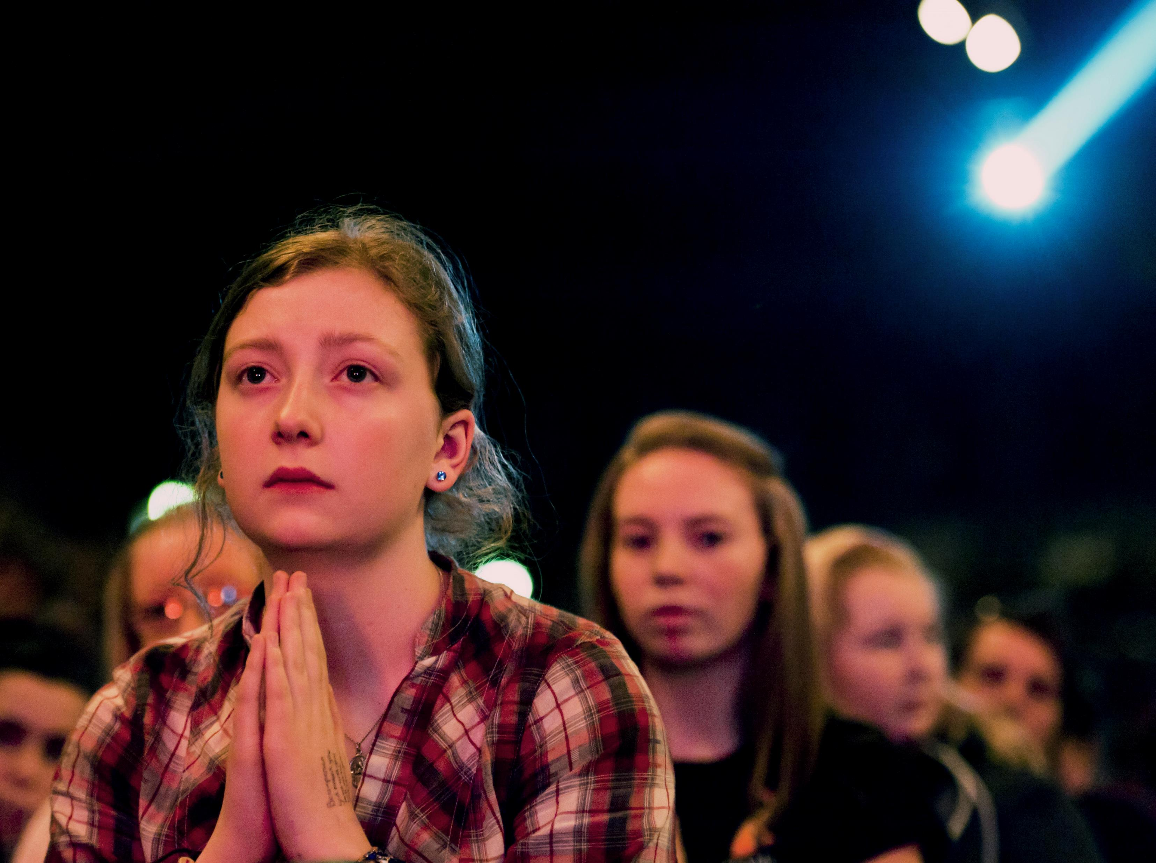
Introduction
In this unit we look at the gift of Piety. Piety is being reverent before God through prayer.
Prayer is an important part of our relationship with God and the call to holiness, to be a saint!
We will look at different ways of praying and how we can make prayer part of our daily lives.
© Mazur/catholicnews.org.uk

Slide 4
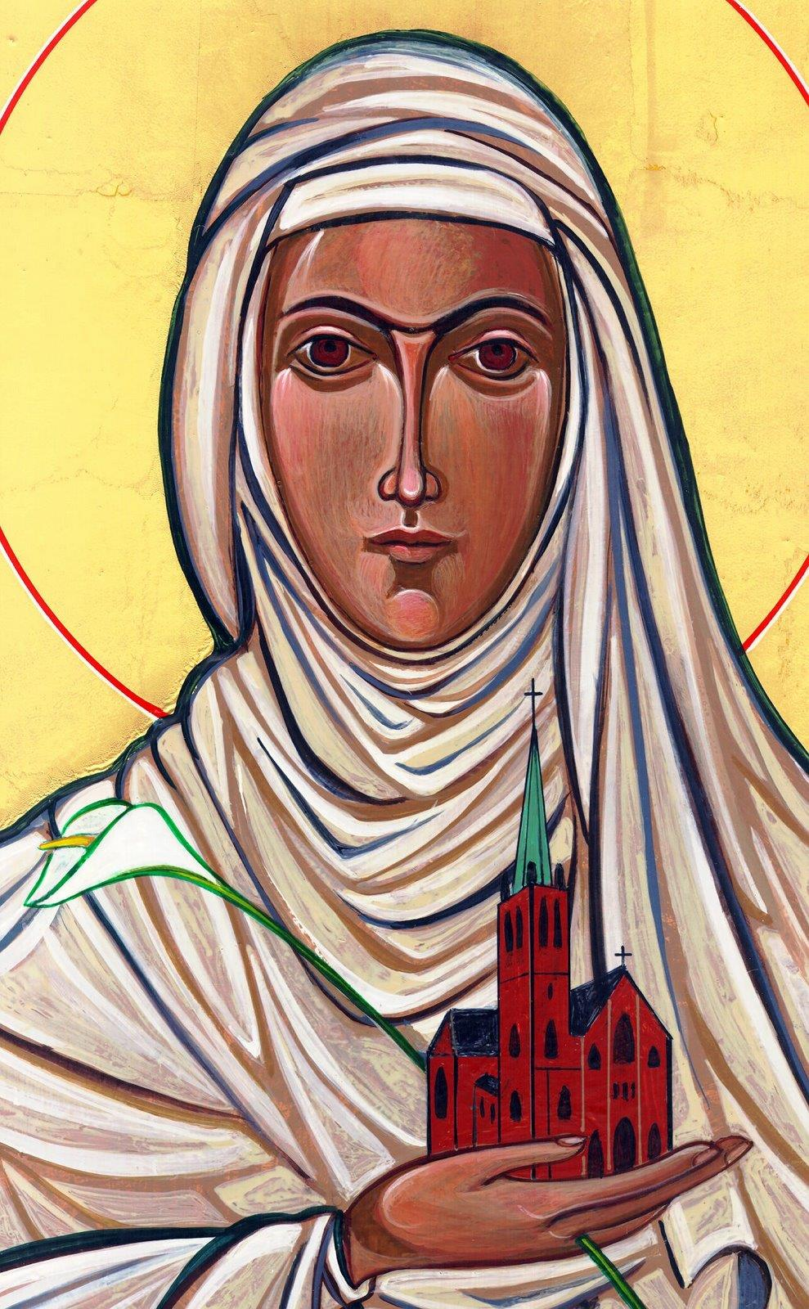
Opening Prayer
Lord Jesus, bless us as we gather together as young people from the Diocese. We are one in your name.
May your light burn brightly within us as we celebrate Your love for us.
Inspire us with your Holy Spirit.
Help us to take Your light and Your love out to the whole world. Show us how to use our gifts and talents to become who You have called us to be. Amen
St Catherine of Siena, Pray for us.

Slide 5

Communications Game
This game will test your listening skills.
One person starts and say’s an interesting fact about themselves and then randomly picks someone to carry on the game.
Hopefully the chosen person has been listening carefully because they need to thank the person for choosing them, comment on what they just said and add their own fact before choosing someone else.
Make sense? Lets go …

Slide 6
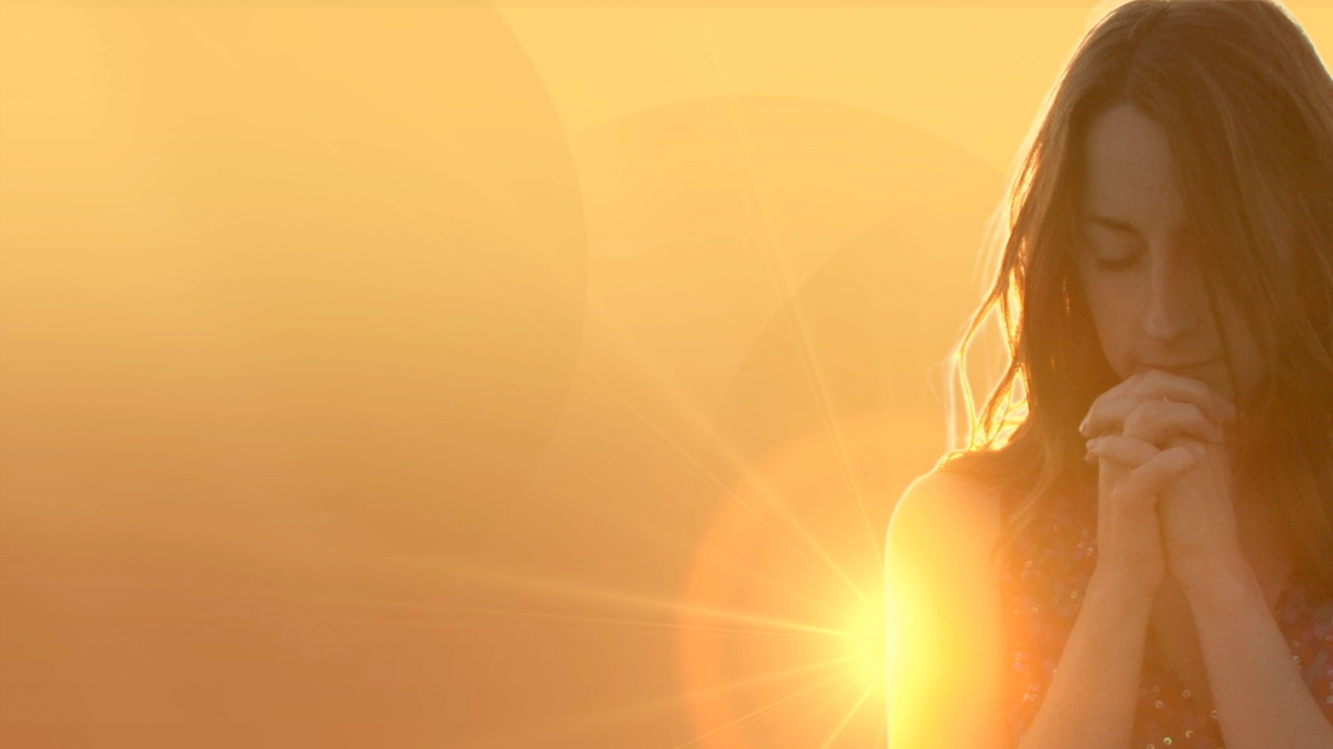

The Power of Prayer
“The Holy Spirit helps us in our weakness. For we do not know what to pray for as we ought, but the Spirit himself intercedes for us with groanings too deep for words.”
Romans 8:26-27

Slide 7
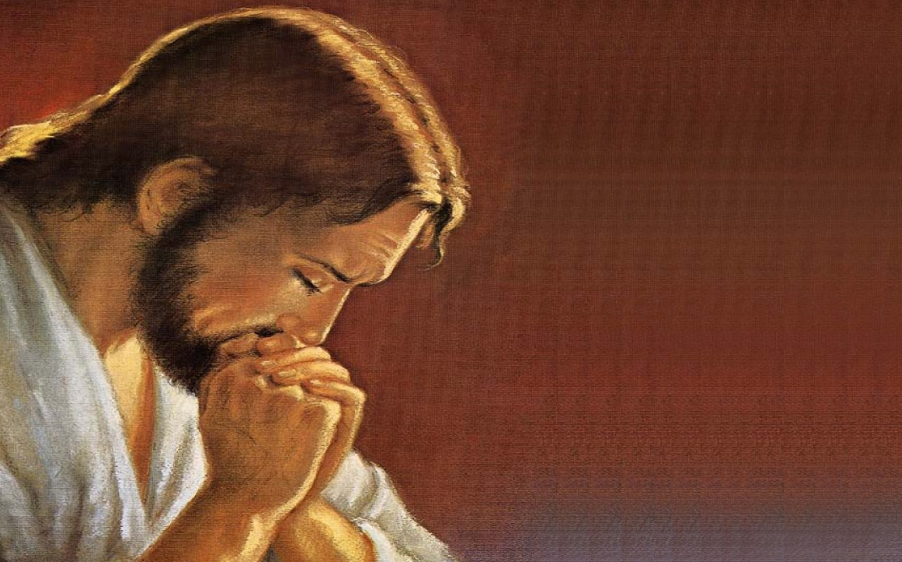
Scripture Reading – Matthew 6:5-15
And when you pray, do not be like the hypocrites, for they love to pray standing in the synagogues and on the street corners to be seen by others. Truly I tell you, they have received their reward in full. But when you pray, go into your room, close the door and pray to your Father, who is unseen. Then your Father, who sees what is done in secret, will reward you. And when you pray, do not keep on babbling like pagans, for they think they will be heard because of their many words. Do not be like them, for your Father knows what you need before you ask him.
“This, then, is how you should pray:
“‘Our Father in heaven,
hallowed be your name,
your kingdom come,
your will be done,
on earth as it is in heaven.
Give us today our daily bread.
And forgive us our debts,
as we also have forgiven our debtors.
And lead us not into temptation,
but deliver us from the evil one.
For if you forgive other people when they sin against you, your heavenly Father will also forgive you. But if you do not forgive others their sins, your Father will not forgive your sins.

Slide 8

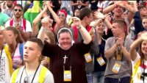
Prayer through song
There are many ways we can pray. Praying through song is a powerful way. St Augustine said ‘those who sing pray twice’. Watch this video of millions of young people singing ‘Jesus Christ you are my life’ at World Youth Day Poland 2016.
Can you make this your prayer too?

Slide 9
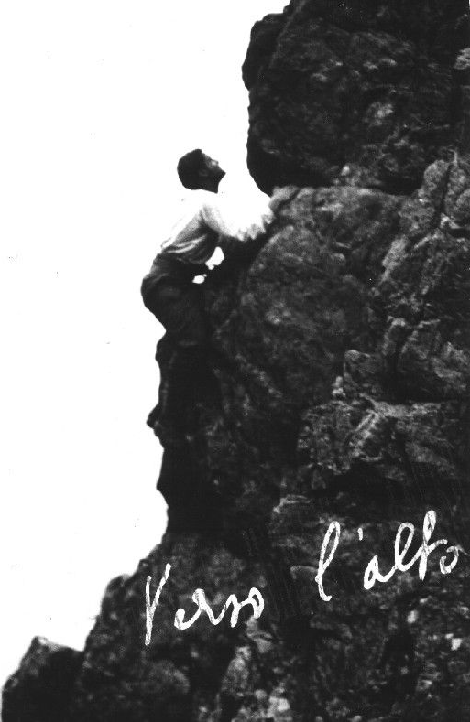
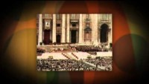
Hero of our Faith
Blessed Pier Giorgio Frassati - Pray for us
“The higher we go, the better we
shall hear the voice of Christ”

Slide 10
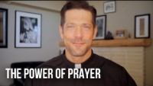
The Importance of Prayer in our Lives
“Whatever you ask in prayer, believe that you receive it, and you will”
Mark 11:24

Slide 11
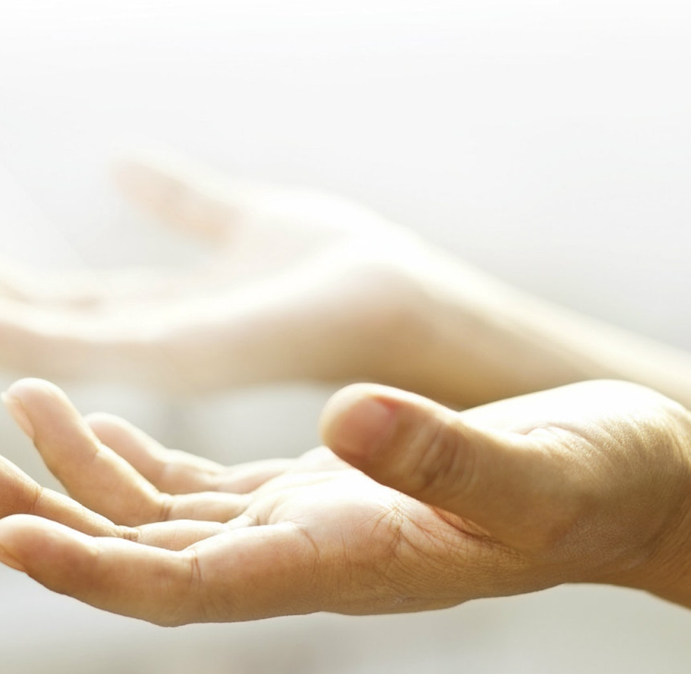
Different way of praying
There are so many ways to pray. Find the way which works for you. Remember, pray how you can not how you can’t. Here are just some ways…
In silence
Through traditional prayers and prayers of the Church (Mass, rosary, morning/evening prayers)
Using scripture
Through music
In creation
Throughout the day in your mind
Help others
Contemplating/imagination
Studying the faith
Watching faith videos

Slide 12
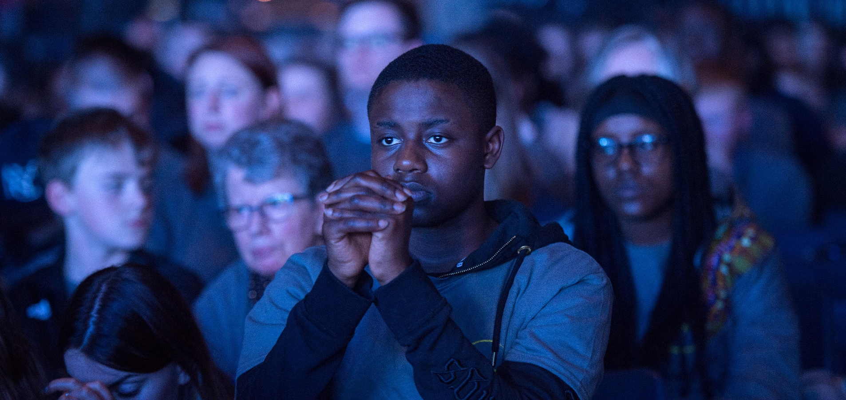
Situation
A friend of yours says that prayer is a waste of time.
Based on what you have heard and learnt so far in this unit how could you answer them?

Slide 13
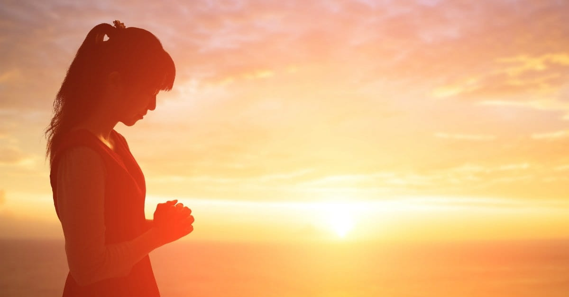
Discussion
What helps you to pray?
What makes it difficult to pray?
What way could you make prayer
more part of your life?

Slide 14


“Prayer is turning the heart toward God. When a person prays, they enter into a living relationship with God. We pray because we are full of an infinite longing and God has created us all for himself: “Our hearts are restless until they rest in you” (St. Augustine). But we pray also because we need to: Mother Teresa says, “Because I cannot rely on myself, I rely on him, twenty-four hours a day.”
YOUCAT 469-470
"Prayer is the oxygen of the soul.“
St Padre Pio

Slide 15




Where to find out more…
Sycamore YouTube Channel with lots of videos on prayer
www.youtube.com/c/SycamoreSeek/videos
Pray as you go
www.pray-as-you-go.org
Father’s love letter
www.youtube.com/watch?v=vCoDTUXHMeg
Jesuits Prayer App with the Daily Examen
(App Store/Google Play)

Slide 16
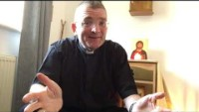
Time of Prayer
Many of us worry about the future but we can trust God that He has our futures sorted. Watch this mediation from Fr Chris and remember this simple prayer which you can say each day.
Prayer
Lord give me your peace and the gifts and graces that I need for today.
Amen

Slide 17
“Jesus said to them again:
Peace be with you.
As the Father sent me, so I am sending you’
JOHN 20:21

Slide 18

Game
This game will test your visual communication skills.
The leader chooses a person to go first.
The first person chooses a word from todays session and must draw a visual representation of the word for the rest of the group to guess.
You can not include words, numbers or symbols.

Slide 19
GIFTS OF HOLY SPIRIT
Session 6 - Piety

