Slide 1

GIFTS OF HOLY SPIRIT
Session 5 - Fortitude

Slide 2
The 7 Gifts of the Holy Spirit
Wisdom
Understanding
Fortitude
Knowledge
Piety
Counsel
Fear of the Lord
Through Jesus, these are the Gifts we will receive at Confirmation!

Slide 3
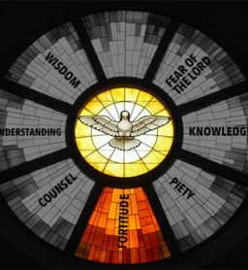
Introduction
In this unit we consider that in life we have a choice between right and wrong and there is pressure on us when we make these decisions.
The Holy Spirit and the gift of Fortitude helps us to make the right choices and be brave enough to make the right choices.
Sometimes there is peer pressure from friends and society to take the easy road but the Church and the Saints show us a better way, the road less travelled which leads to true happiness and everlasting life.

Slide 4
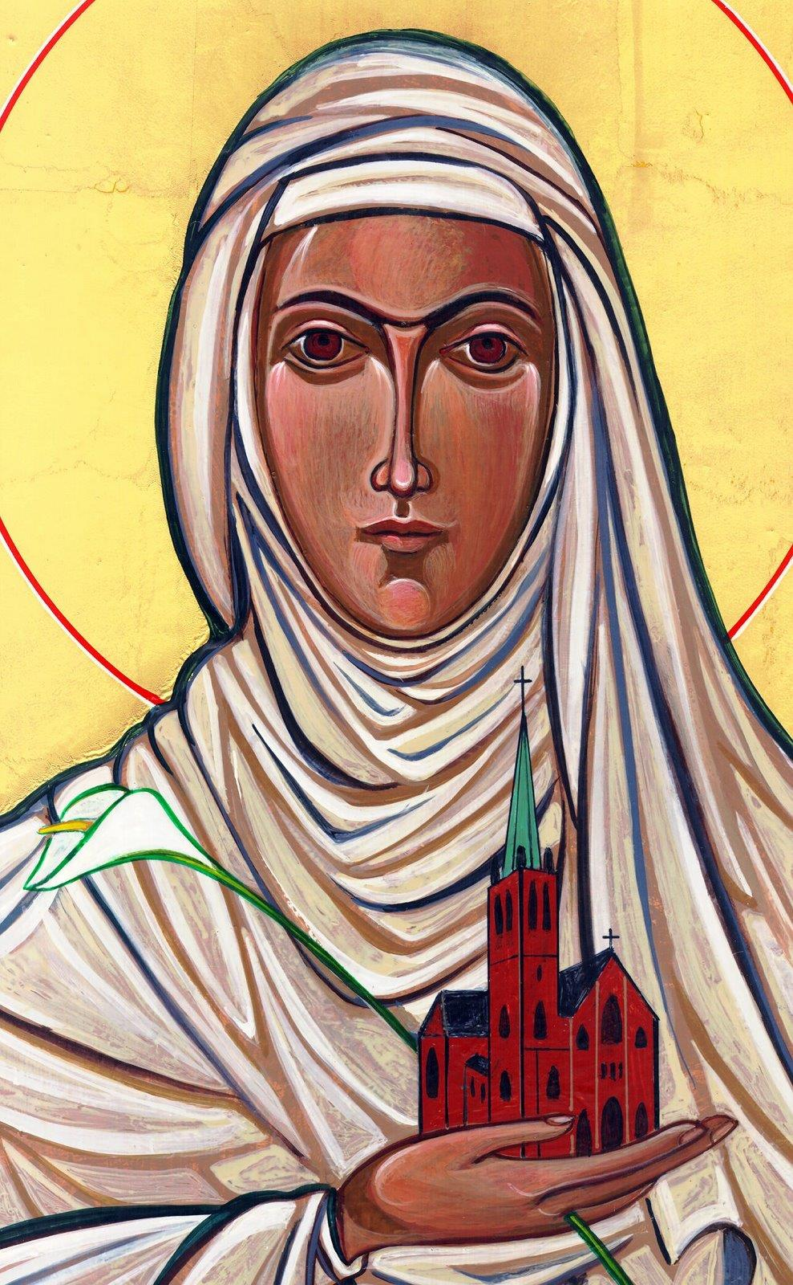
Opening Prayer
Lord Jesus, bless us as we gather together as young people from the Diocese. We are one in your name.
May your light burn brightly within us as we celebrate Your love for us.
Inspire us with your Holy Spirit.
Help us to take Your light and Your love out to the whole world. Show us how to use our gifts and talents to become who You have called us to be. Amen
St Catherine of Siena, Pray for us.

Slide 5

Ice breaker
You need to make a choice between option 1(raise you left hand) or option 2 (raise your right hand)

Slide 6
Option 1 (left hand)
Option 2 (right hand)
Would you rather spend the evening…
Watching TV
Reading a book

Slide 7
Option 1 (left hand)
Option 2 (right hand)
Would you rather…
Dance
Sing

Slide 8
Option 1 (left hand)
Option 2 (right hand)
Would you rather live somewhere…
Cold
Hot

Slide 9
Option 1 (left hand)
Option 2 (right hand)
Would you rather live …
On a tropical island
In a busy city

Slide 10

Decisions, decisions, decisions
Life is full of choices. Sometimes it is clear which is the best option.
Sometimes we know when something is bad and something is good and we make the right choice.
Other times we are not too sure.
The Holy Spirit and the gift of Fortitude helps us to choose good and keep choosing good no matter what.

Slide 11
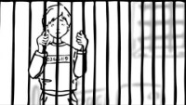
The Holy Spirit helps us to choose wisely
“You have a choice between life and death; you will get whichever you choose”
Sirach 15:17

Slide 12
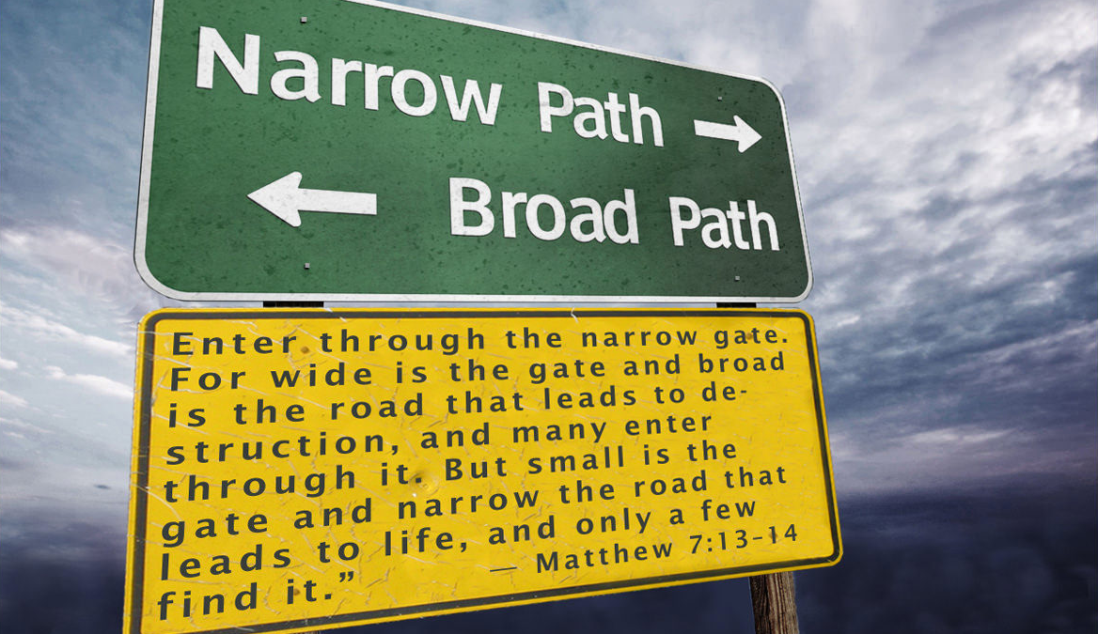
Scripture Reading – Matthew 7:13-14

Slide 13

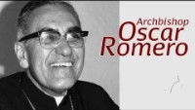
Standing up for those in need
“It is not God’s will for some to have
everything and other to have nothing”
St Oscar Romero

Slide 14
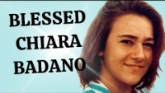
Hero of our Faith – Blessed Chiara Badano
When she was ill she used to say:
‘Jesus, if you want it, I want it too’
Could you make this your prayer too?

Slide 15

Input on the Moral Life and Decision Making
“The ones who have a voice must speak for those who are voiceless”
St Oscar Romero

Slide 16
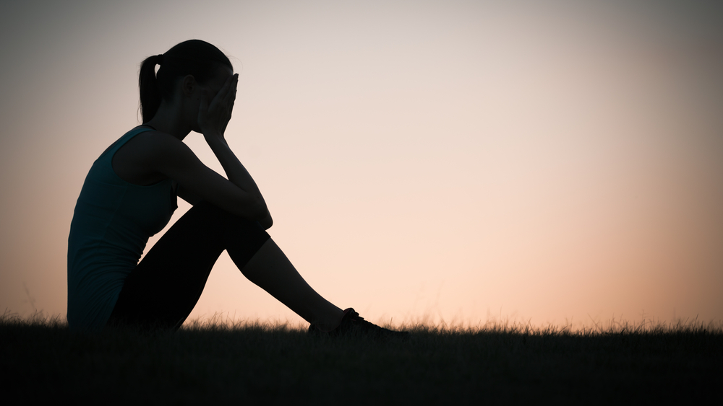
Situation
A friend of yours keeps making bad choices and getting themselves into trouble through peer pressure.
How could you help them based on what we have learnt so far in this session?

Slide 17

Discussion
What are the big decisions that you have to make between right and wrong at the moment and how do you make them?

Slide 18


“We must work at forming our character so that we can freely, joyfully, and easily accomplish what is good. A firm faith in God, in the first place, helps us to do this, but also the practice of the virtues, which means developing within ourselves, with God’s help, firm dispositions, not giving ourselves over to disorderly passions, and directing our faculties of intellect and will more and more consistently toward the good. The most important virtues are: prudence, justice, fortitude, temperance. These are also called the
cardinal virtues”
YOUCAT 300
“Fortitude is the capacity to say no when the world wants to hear ‘yes’”
Erich Fromm

Slide 19




Where to find out more…
Input on the Moral Life and Decision Making
www.youtube.com/watch?v=cXEqd6iyISY
Decision Point Videos
www.dynamiccatholic.com/confirmation/decision-point.html
Ascension Presents
www.youtube.com/channel/UCVdGX3N-WIJ5nUvklBTNhAw
Life Teen
www.youtube.com/user/LifeTeenInc/featured

Slide 20
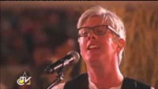
Time of Prayer
As your prayer for this week watch this video of Matt Maher singing Lord I need you on his knees before Jesus present in the Blessed Sacrament. Over 3 million young people joined Pope Francis on Copacabana Beach in Brazil for World Youth Day in 2013 singing this same prayer.
Prayer
Lord I need you, every hour I need you. You’re my one defence, my righteousness, O God how I need you.
Amen

Slide 21
“Jesus said to them again:
Peace be with you.
As the Father sent me, so I am sending you’
JOHN 20:21

Slide 22

Game
Take it in turns to tell two truths and one lie, you shouldn’t lie but it's allowed for this game only, and the rest of the group needs to guess which is the lie. If they get the wrong lie, you win.

Slide 23
GIFTS OF HOLY SPIRIT
Session 5 - Fortitude

