Slide 1
GIFTS OF HOLY SPIRIT
Session 4 - Counsel

Slide 2
The 7 Gifts of the Holy Spirit
Wisdom
Understanding
Fortitude
Knowledge
Piety
Counsel
Fear of the Lord
Through Jesus, these are the Gifts we will receive at Confirmation!

Slide 3
Introduction
In this unit we consider the Gift of Counsel & Vocation. Each one of us has a calling from God, a plan for us, a purpose in life that will bring us true meaning and fulfilment. We are each given different gifts and talents and if we use them for the greater glory of God and the good of others we will discover who God is calling us to be and enjoy a deep sense of joy and peace in our lives.

Slide 4
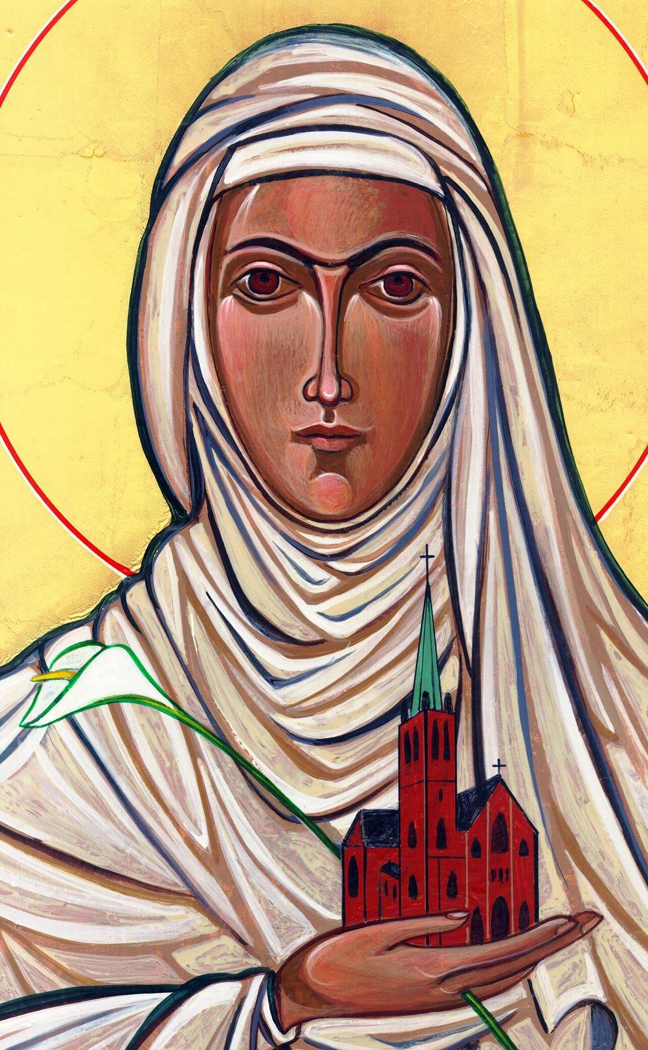
Opening Prayer
Lord Jesus, bless us as we gather together as young people from the Diocese. We are one in your name. May your light burn brightly within us as we celebrate Your love for us.
Inspire us with your Holy Spirit. Help us to take Your light and Your love out to the whole world. Show us how to use our gifts and talents to become who You have called us to be. Amen
St Catherine of Siena, Pray for us.

Slide 5
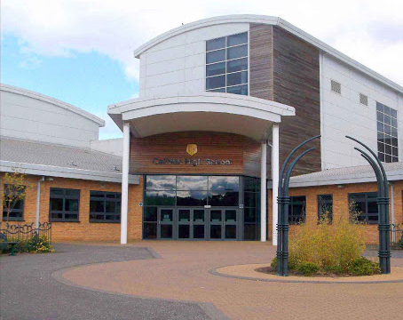
Ice breaker
Think of all the different jobs that are needed to make a school function.
The more we think of the more there are and they are all important.

Slide 6
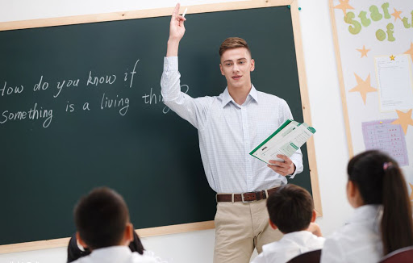
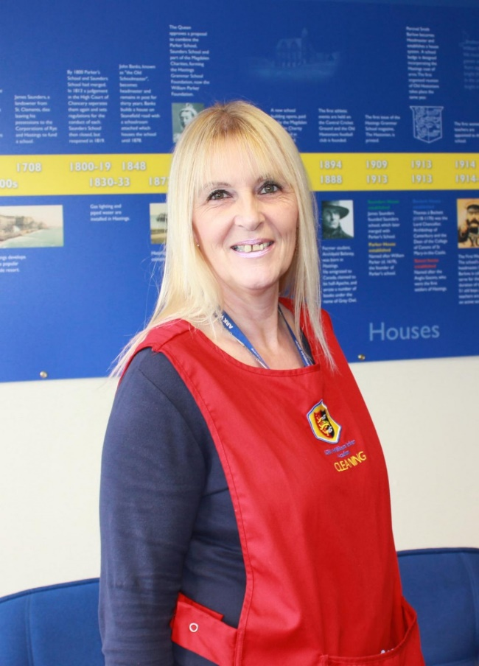
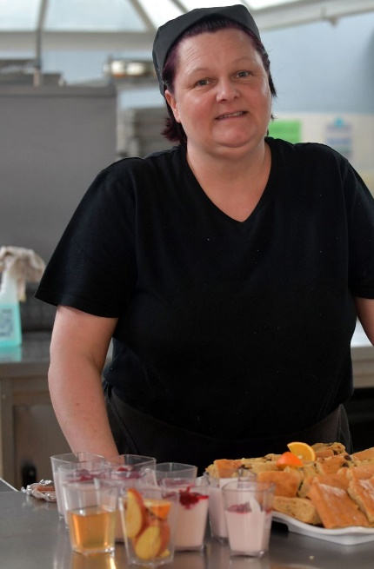
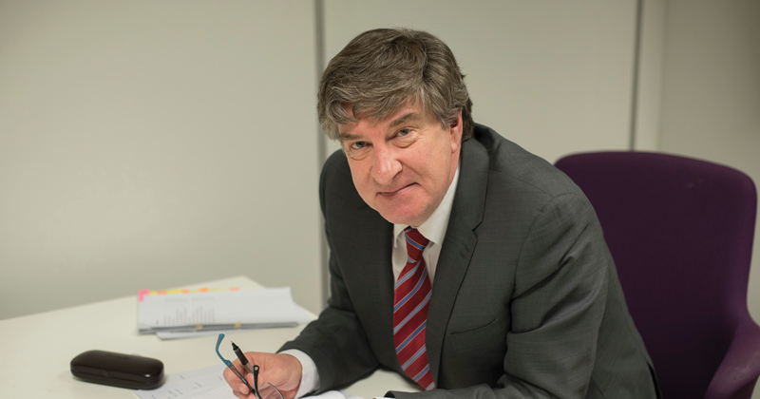
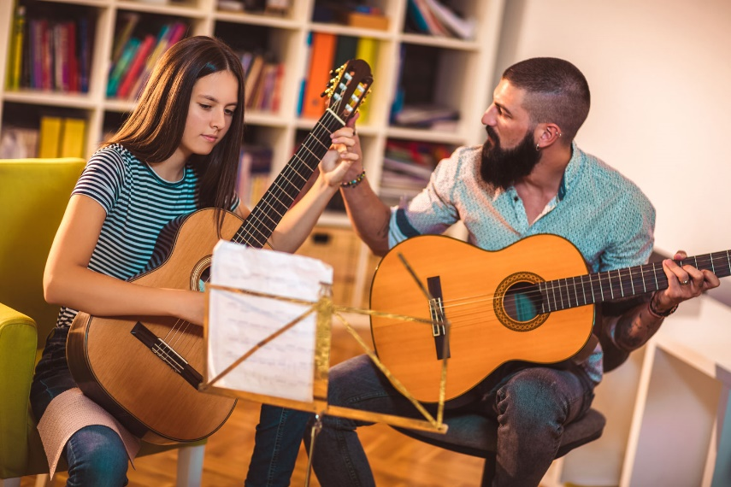

Slide 7
The Holy Spirit can help us discern who God is calling us to be
“Be who God meant you to be and you will set the world on fire!”
St Catherine of Siena

Slide 8
Scripture Reading – John 15:9-18
As the Father has loved me, so have I loved you. Now remain in my love. If you keep my commands, you will remain in my love, just as I have kept my Father’s commands and remain in his love. I have told you this so that my joy may be in you and that your joy may be complete. My command is this: Love each other as I have loved you. Greater love has no one than this: to lay down one’s life for one’s friends. You are my friends if you do what I command. I no longer call you servants, because a servant does not know his master’s business. Instead, I have called you friends, for everything that I learned from my Father I have made known to you.
You did not choose me, but I chose you
and appointed you so that you might go and bear fruit—fruit that will last—and so that whatever you ask in my name the Father will give you.
This is my command: Love each other.

Slide 9
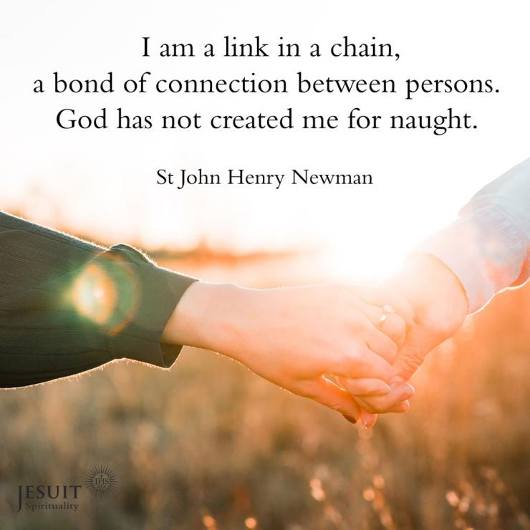
God has created you for Some Definite Service

Slide 10
What is vocation?
Universal Call to Holiness
(We are all called to be Saints)
Priest
Religious Brother or Sister
Married
Single or consecrated
Any job (teacher, care profession, office etc.)
We are all called to holiness, but God may want us to live out that holiness in different states of life. No one vocation is better than another, they are just different ways of giving Glory to God.

Slide 11
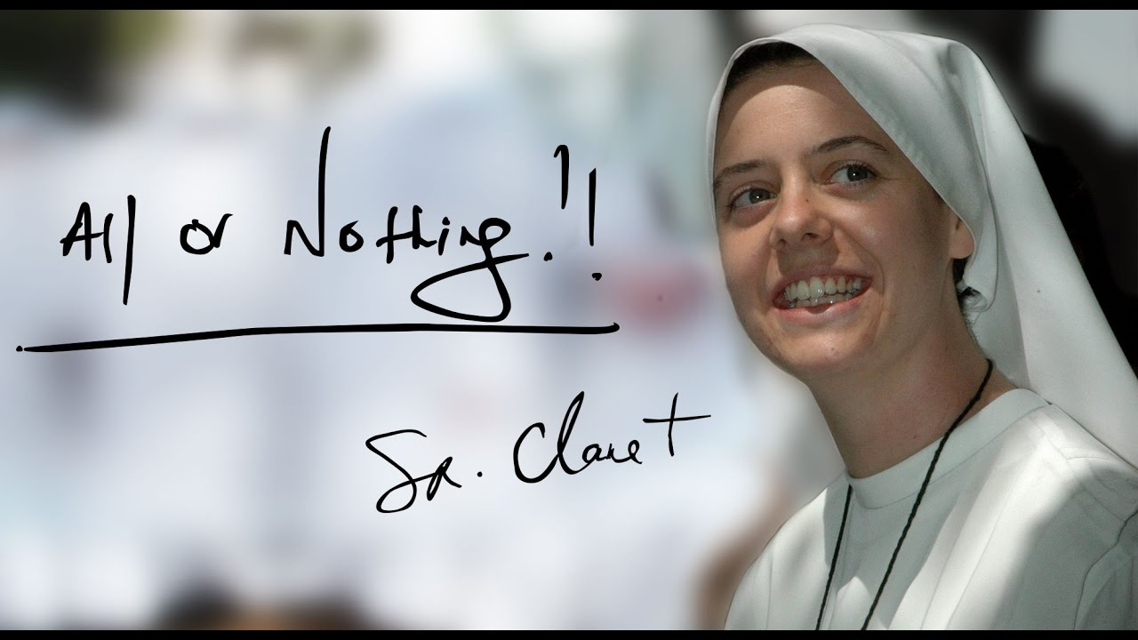
Hero of our Faith – Sr Clare Crockett SHM

Slide 12
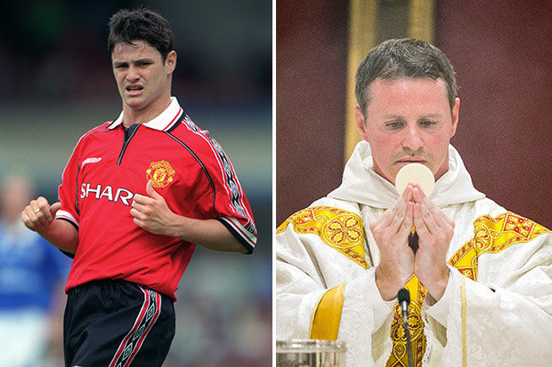
Professional Footballer to Priesthood - Fr. Philip Mulryne OP

Slide 13
Situation
One of your friends thinks they are no good at anything and not worth anything.
How can you encourage them based on what you have learnt so far?

Slide 14
Discussion
What do you think brings true happiness?

Slide 15
Through Baptism Christ has made us into a kingdom of “priests to his God and Father” (Rev 1:6). Through the universal priesthood, every Christian is called to work in the world in God’s name and to bring blessings and grace to it. In the Upper Room during the Last Supper and when he commissioned the Apostles, however, Christ equipped some with a sacred authority to serve the faithful; these ordained priests represent Christ as pastors (shepherds) of his people and as head of his Body, the Church.
YOUCAT 259
“Christ has no hands but ours to do his work today”
St Teresa of Avila

Slide 16
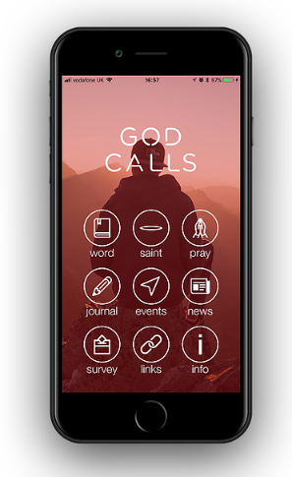
Where to find out more…
Fr Mike Schmitz (Ascension Presents) on Vocation
www.youtube.com/watch?v=vJz9PbakIzY
Diocese of Salford Vocations Office
www.dioceseofsalford.org.uk/faith/vocations/
God Calls app
www.godcalls.co.uk/
National Vocation Office
www.ukvocation.org/

Slide 17
Time of Prayer
As you listen to this song, ask the Holy Spirit to show you what He wants you to do with your life by praying the words “Speak Lord, your servant is listening”

Slide 18
“Jesus said to them again:
Peace be with you. As the Father sent me, so I am sending you’
JOHN 20:21

Slide 19
Acting Game
Each person must act out a certain job/vocation and the rest of the group must guess what it is.
Good luck and enjoy…

Slide 20
GIFTS OF HOLY SPIRIT
Session 4 - Counsel

