Slide 1

GIFTS OF HOLY SPIRIT
Session 3 - Knowledge

Slide 2
The 7 Gifts of the Holy Spirit
Wisdom
Understanding
Fortitude
Knowledge
Piety
Counsel
Fear of the Lord
Through Jesus, these are the Gifts we will receive at Confirmation!

Slide 3
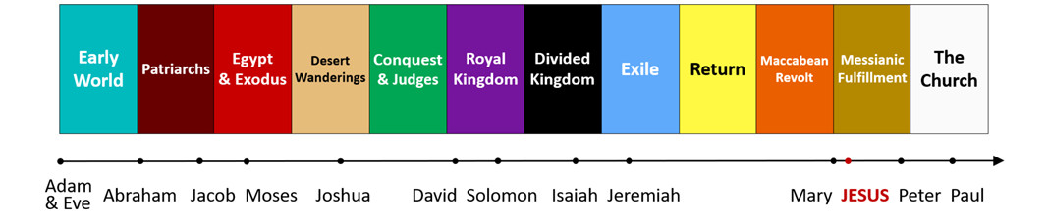
Introduction
In this unit we are looking at the story of Salvation which is our faith story as Roman Catholics that has been handed on from one generation to the next through the Church. It is important that we actually know this story and are able to tell this story ourselves. This is our story of God coming to save us. The Gift of Knowledge helps us to understand this story so we can explain it to others.

Slide 4
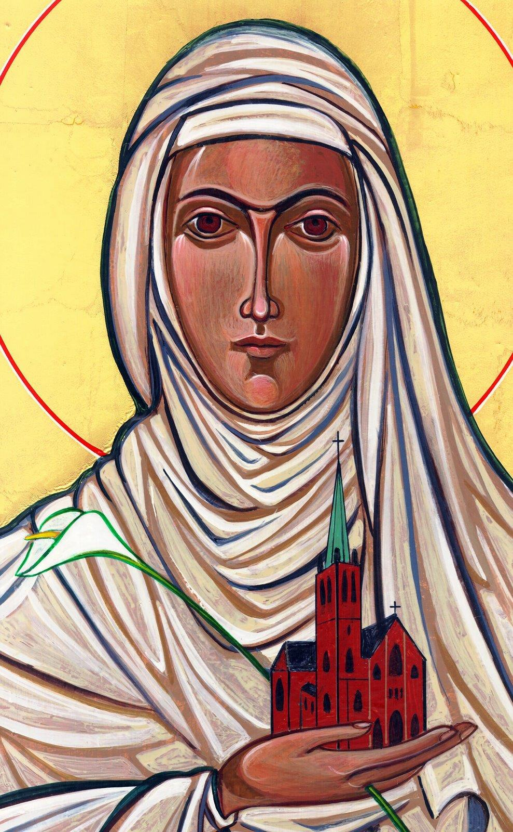
Opening Prayer
Lord Jesus, bless us as we gather together as young people from the Diocese. We are one in your name.
May your light burn brightly within us as we celebrate Your love for us.
Inspire us with your Holy Spirit.
Help us to take Your light and Your love out to the whole world. Show us how to use our gifts and talents to become who You have called us to be. Amen
St Catherine of Siena, Pray for us.

Slide 5
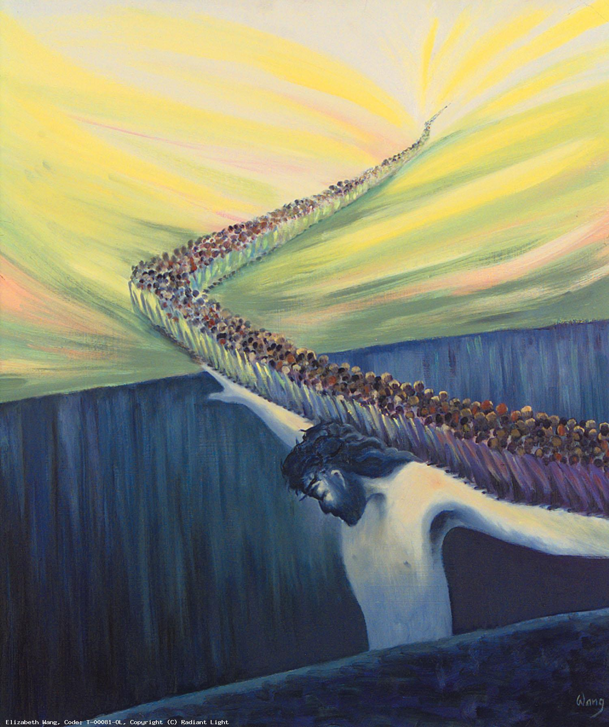
Ice breaker
Look at this painting from Elizabeth Wang.
What do you see?
What do you think is it trying to say?

Slide 6
Ice breaker
The painting is called
‘Christ is our bridge to Heaven’
Due to original sin and our sins a gulf was formed between Heaven and Earth. We were stuck and had no way back to the Father.
Jesus by His cross paid the price for sin. He has reconciled us to the Father and destroyed death forever. By His cross and resurrection we can now enter into eternal life.

Slide 7
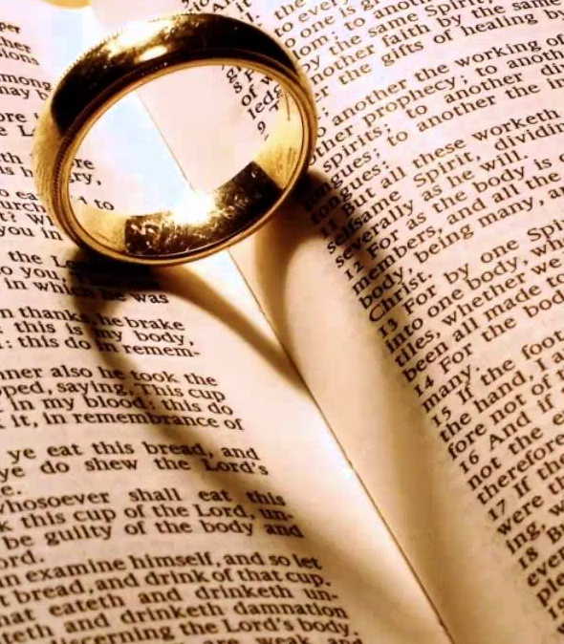
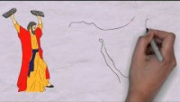
God’s love story with us

Slide 8
Scripture Reading – John 3:16-22
For God so loved the world that he gave his one and only Son,
that whoever believes in him shall not perish but have eternal life.
For God did not send his Son into the world to condemn the world, but to save the world through him. Whoever believes in him is not condemned, but whoever does not believe stands condemned already because they have not believed in the name of God’s one and only Son. This is the verdict: Light has come into the world, but people loved darkness instead of light because their deeds were evil. Everyone who does evil hates the light, and will not come into the light for fear that their deeds will be exposed.
But whoever lives by the truth comes into the light, so that it may be seen plainly that what they have done has been done in the sight of God.

Slide 9
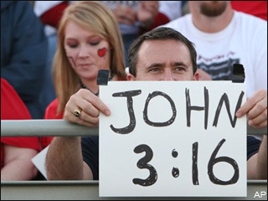
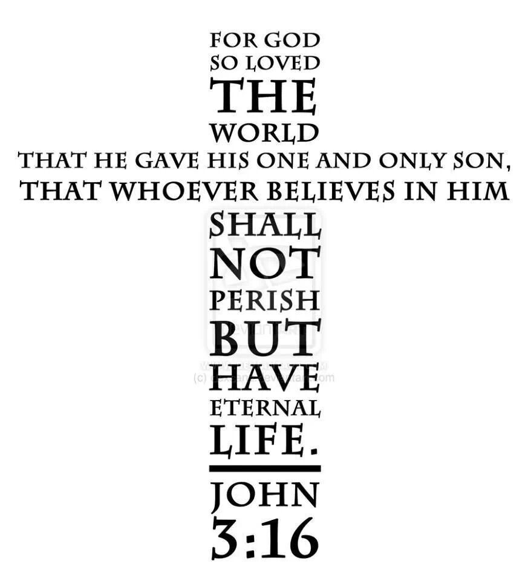
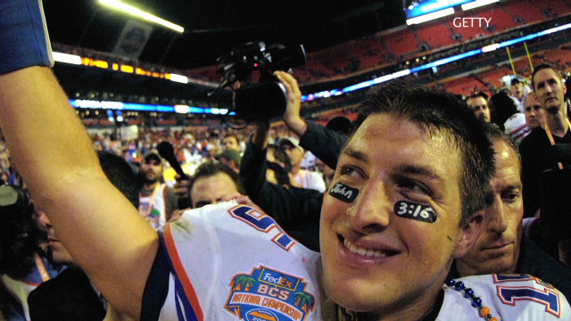
John 3:16 is one of the most quoted bible verses.
You sometimes see it on signs at sports events.
In this one line, our entire faith is summed up.
Reflect on what it means to you that God loved you so much he came to save you so he could be with you forever.

Slide 10
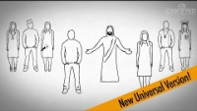
Reflection – Love Chooses You
Hear about the greatest story ever told in 7 minutes!

Slide 11
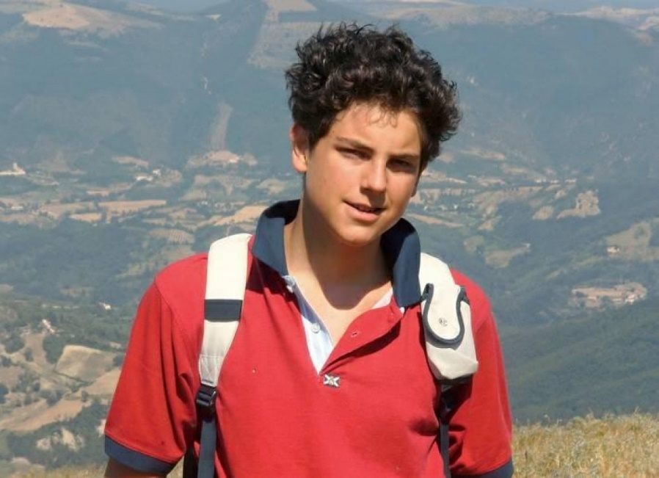

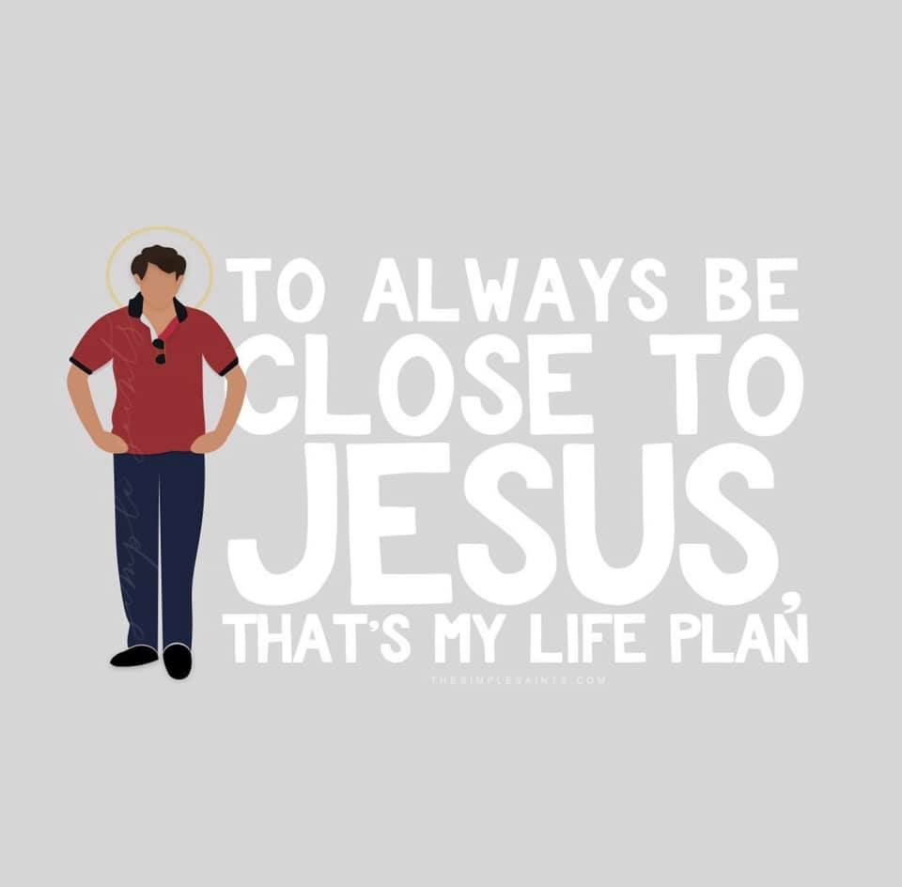
Hero of our Faith – Blessed Carlo Acutis
Listen to the story of Carlo who knew the story of Salvation and became a saint. You can too!

Slide 12

Situation
A friend of yours doesn’t know anything about Christianity and asks you what is it all about?
What could you tell them based on what you have heard so far in this session.

Slide 13
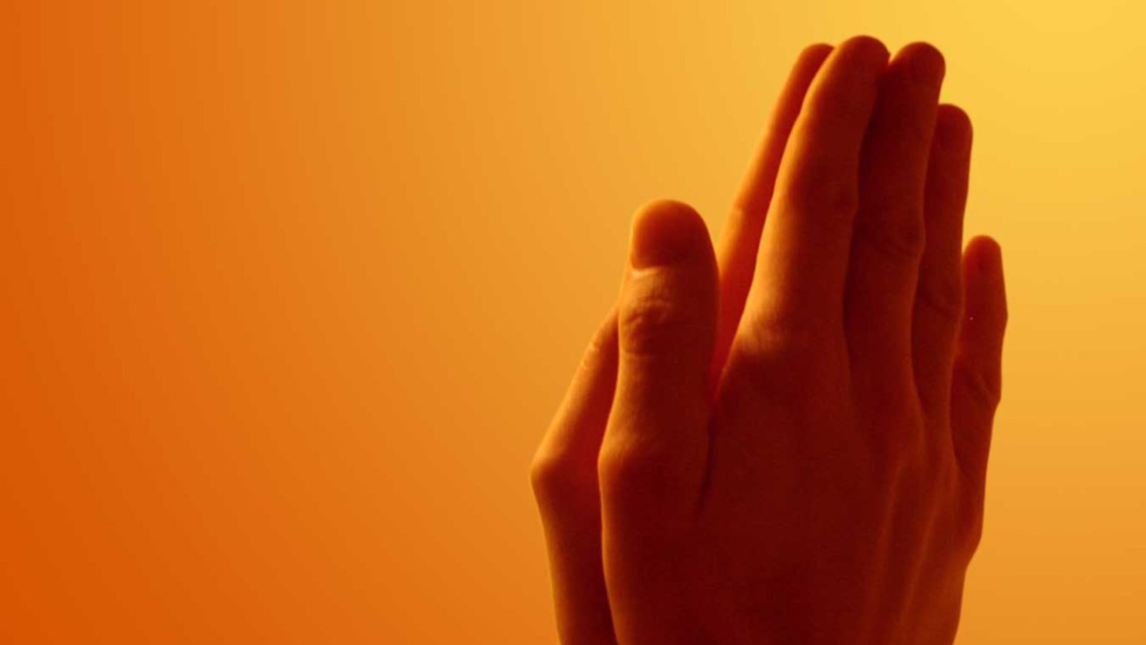
Discussion
Who has handed on the faith to you?
The Church passes on our faith story from generation to generation. We are all called to do this as Missionary Disciples of Jesus.

Slide 14


“We hand on the faith because Jesus commands us: ‘Go therefore and make disciples of all nations’” (Mt 28:19)
YOUCAT 11
“In virtue of their baptism, all the members of the People of God have become Missionary Disciples”
Pope Francis
“You will receive power when the Holy Spirit comes on you; and you will be my witnesses in Jerusalem, and in all Judea and Samaria, and to the ends of the earth.”
Acts 1:8

Slide 15




Where to find out more…
The Bible in one
year app
bibleinoneyear.org/
Pray as you God
pray-as-you-go.org/
The Holy Bible app
youversion.com/the-bible-app/
Mass Readings & Prayers of the Church
universalis.com/

Slide 16

Time of Prayer
Thank you, God, that you have never given up chasing after us.
You have always been faithful even when we haven’t.
Help us to fully understand our story of how you saved us and give us the courage to share it with others.
Amen

Slide 17
“Jesus said to them again:
Peace be with you.
As the Father sent me, so I am sending you’
JOHN 20:21

Slide 18

Shopping Game
This game involves good listening, a good memory and good story telling.
The leader starts by saying:
‘I went to the shop and bought (add item)’
Then going around the squares on the screen, unmute yourself, say all the items which went before and add an item each time, for example
‘I went to the shop and bought some bread, some milk, etc.…’
See if we can get to the end without forgetting anybody's item, Good Luck!

Slide 19
GIFTS OF HOLY SPIRIT
Session 3 - Knowledge

