Slide 1
GIFTS OF HOLY SPIRIT
Session 2 - Understanding

Slide 2
The 7 Gifts of the Holy Spirit
Wisdom
Understanding
Fortitude
Knowledge
Piety
Counsel
Fear of the Lord
Through Jesus, these are the Gifts we will receive at Confirmation!

Slide 3
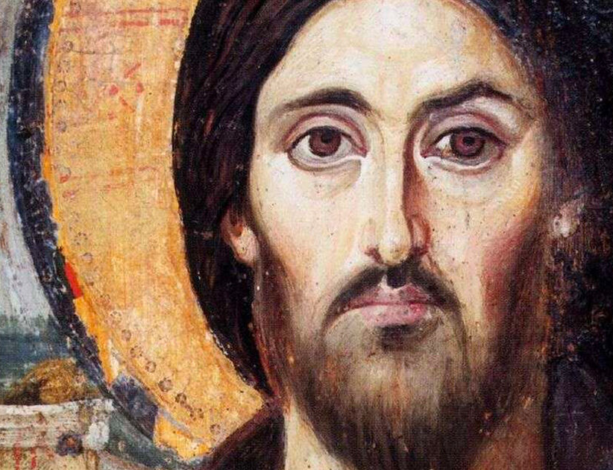
Introduction
Our faith is based on Divine Revelation that reaches its highpoint with Jesus.
This means we are not just making it up to make ourselves feel better. God wants to make Himself known to us.
Mystery in this sense means something is revealed to us, not something that we would ever find out for ourselves.
The Gift of Understanding helps us to understand who we are and who God is.

Slide 4
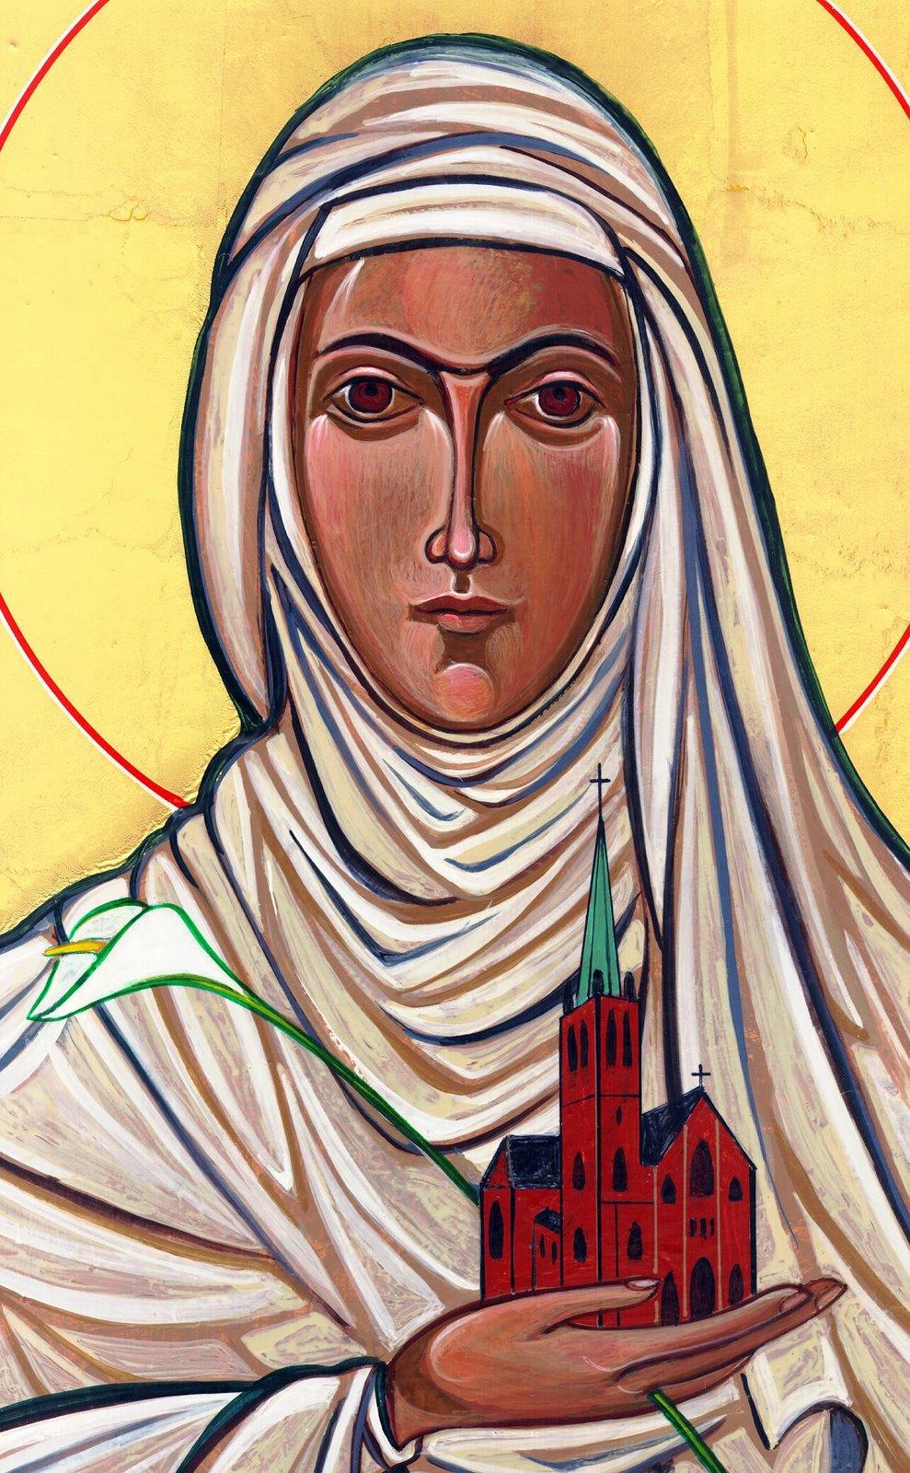
Opening Prayer
Lord Jesus, bless us as we gather together as young people from the Diocese. We are one in your name. May your light burn brightly within us as we celebrate Your love for us.
Inspire us with your Holy Spirit. Help us to take Your light and Your love out to the whole world. Show us how to use our gifts and talents to become who You have called us to be. Amen
St Catherine of Siena, Pray for us.

Slide 5
Guess the Picture Game
The following pictures have been zoomed in.
You have to guess what they are.
The first one to guess them wins.
Are you ready to play?

Slide 6
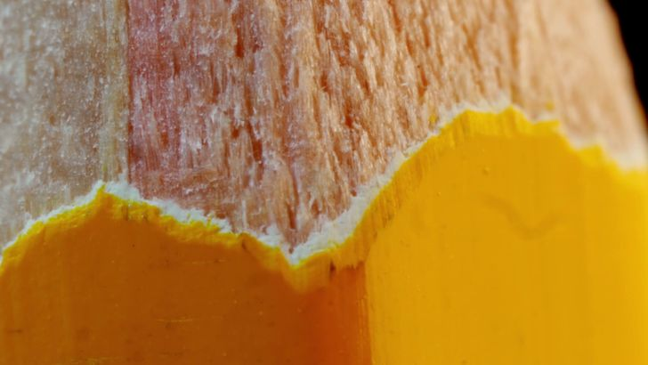
Guess the Picture Game
Any ideas?

Slide 7
Guess the Picture Game
Pencil

Slide 8
Guess the Picture Game
This one is a little more difficult…

Slide 9
Guess the Picture Game
Salford Cathedral

Slide 10
Guess the Picture Game
Extra points if you can get this one …

Slide 11
Guess the Picture Game
The Holy Spirit window in St Peter’s, Rome

Slide 12
What is Divine Revelation?
“God revealed Himself in order to have an intimate relationship with us”

Slide 13
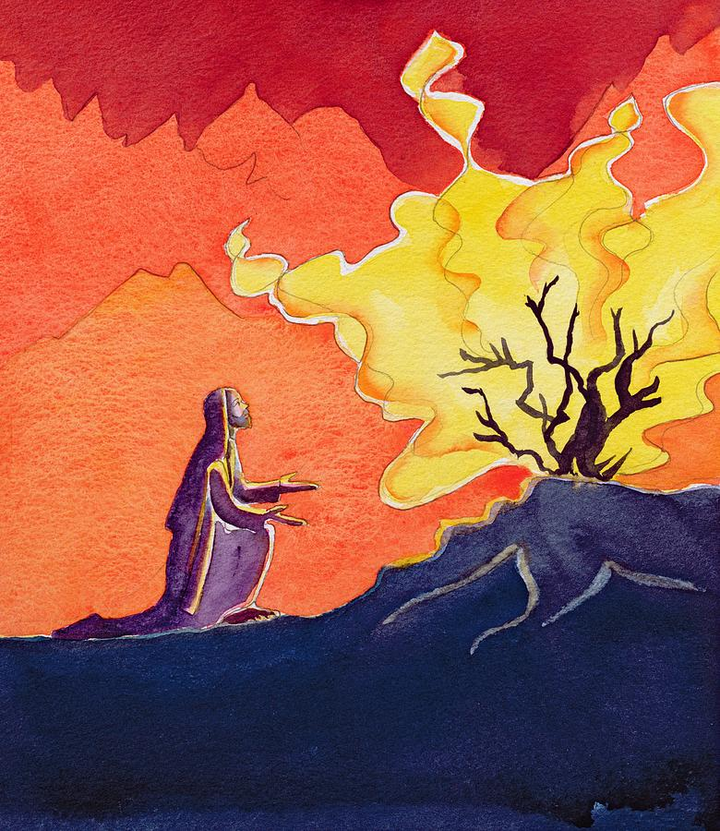
Since the very first day of the World God has been revealing Himself to us. God made us to search for Him so as we search for Him we realize He is already reaching out to us.
He has done this through creation, the Old Testament prophets, the Church and the saints but most importantly in Jesus who is the Word of God!
“You will seek me and find me when you seek me with all your heart.”
Jeremiah 29:13

Slide 14
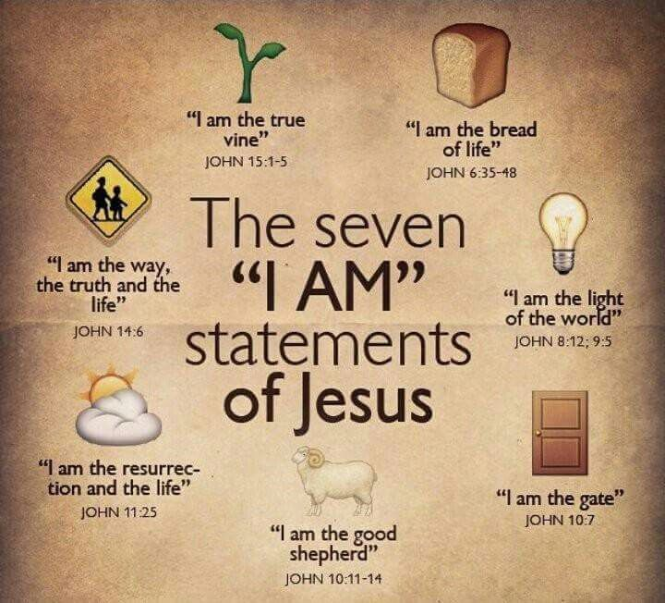
God told Moses His name is
‘I AM’
Jesus continues to tell us who God is in the Gospels
“At various times in the past
and in various different ways,
God spoke to our ancestors through the prophets;
but in our own time, the last days,
he has spoken to us through his Son.”
Hew 1:1-2

Slide 15
Scripture Reading - Matthew 16:13-19
When Jesus came to the region of Caesarea Philippi he put this question to his disciples,
‘Who do people say the Son of Man is?’
And they said, ‘Some say he is John the Baptist, some Elijah,
and others Jeremiah or one of the prophets.’
‘But you,’ he said ‘who do you say I am?’
Then Simon Peter spoke up,
‘You are the Christ,’ he said ‘the Son of the living God.’
Jesus replied, ‘Simon son of Jonah, you are a happy man! Because it was not flesh and blood that revealed this to you but my Father in heaven. So I now say to you: You are Peter and on this rock I will build my Church. And the gates of the underworld can never hold out against it. I will give you the keys of the kingdom of heaven: whatever you bind on earth shall be considered bound in heaven; whatever you loose on earth shall be considered loosed in heaven.’

Slide 16
Reflection
How do you picture God? God revealed His love and mercy in Jesus –
the face of the Father’s Love & Mercy
“Christ is the visible image of the invisible God. He existed before anything was created and is supreme over all creation”
Colossians 1:15

Slide 17
Jesus – the face of the Father’s Love & Mercy

Slide 18
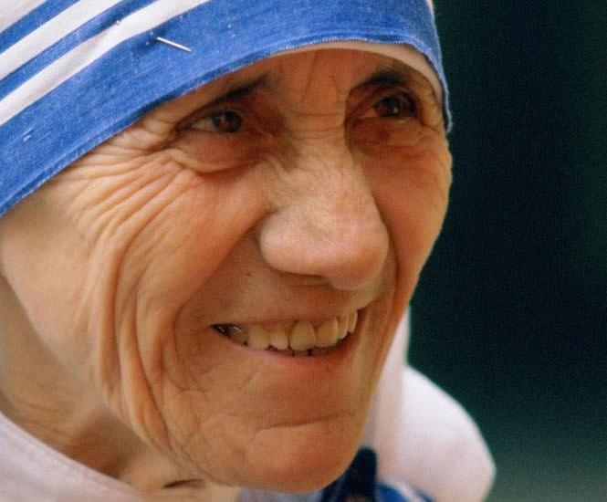
“I have no imagination. I cannot picture God the Father. All that I can see is Jesus”
St Teresa of Calcutta

Slide 19
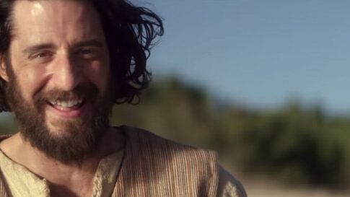
Situation
Based on the scripture reading for today someone says that Jesus was a teacher, a good man but nothing more.
How could we respond based on what we have heard so far today?

Slide 20
Discussion - The Jesus Question…
Reflect on this for a moment. Who do YOU say Jesus is?

Slide 21
“In Jesus Christ, God took on a human face and became our friend and brother”
“The happiness you are seeking, the happiness you have a right to enjoy, has a name and a face: it is Jesus of Nazareth
Pope Benedict XVI
“God would very much like to be known so he has revealed Himself. He remains faithful even when we have fallen away from Him in sin. God shows us in Jesus Christ the full depth of his merciful love. In Jesus, God himself came to earth. He is God’s last Word.”
YOUCAT 7-10

Slide 22
Where to find out more…
Alpha Youth Series: Episode 2 Jesus: Who is He?
https://www.youtube.com/watch?v=4C46_RQtJv0
Sycamore: Session 4 - Who is Jesus
https://www.youtube.com/watch?v=wgjpyWez17o

Slide 23
Time of Prayer
Thank you, God, for revealing Yourself to me.
Thank you, Jesus, for coming to save us and showing us the Father’s love.
Holy Spirit, help us to know who You are and who I am.
Amen

Slide 24
“Jesus said to them again:
Peace be with you. As the Father sent me, so I am sending you’
JOHN 20:21

Slide 25
Game – ‘Go Get’
In a moment we will call out a household item you need to get from somewhere in your house (it can’t be from the same room you are in now).
The first one back wins but please be careful as you get the item.
Are you ready?

Slide 26
Game – ‘Go Get’
Item 1
A book
Go…

Slide 27
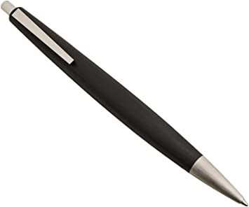
Game – ‘Go Get’
Item 2
A pen
Go…

Slide 28
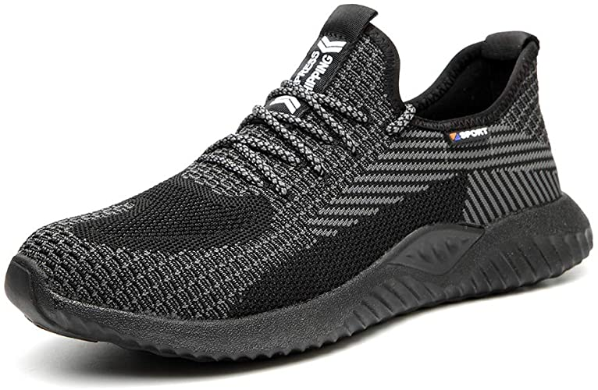
Game – ‘Go Get’
Item3
A shoe
Go…

Slide 29
GIFTS OF HOLY SPIRIT
Session 2 - Understanding

