Slide 1
GIFTS OF HOLY SPIRIT
Session 1 - Wisdom

Slide 2
The 7 Gifts of the Holy Spirit
Wisdom
Understanding
Fortitude
Knowledge
Piety
Counsel
Fear of the Lord
Through Jesus, these are the Gifts we will receive at Confirmation!

Slide 3
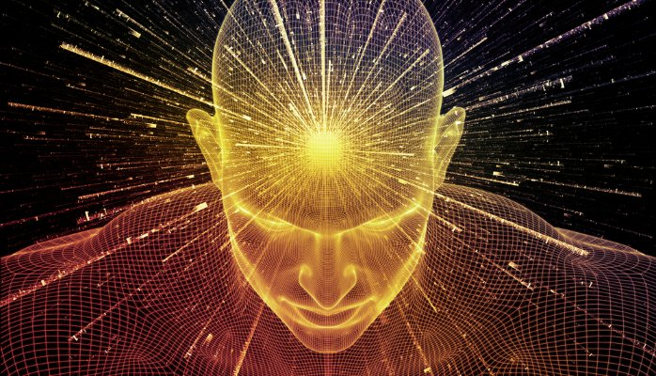
Introduction
In this unit we look at God as creator and that we are part of His creation.
The Gift of Wisdom helps us to do this.
The universe around us is amazing! It is Gods masterpiece and YOU are His best creation
Some people think science and religion are in conflict but they are not.
Science is just our way of trying to work out how God did it!

Slide 4
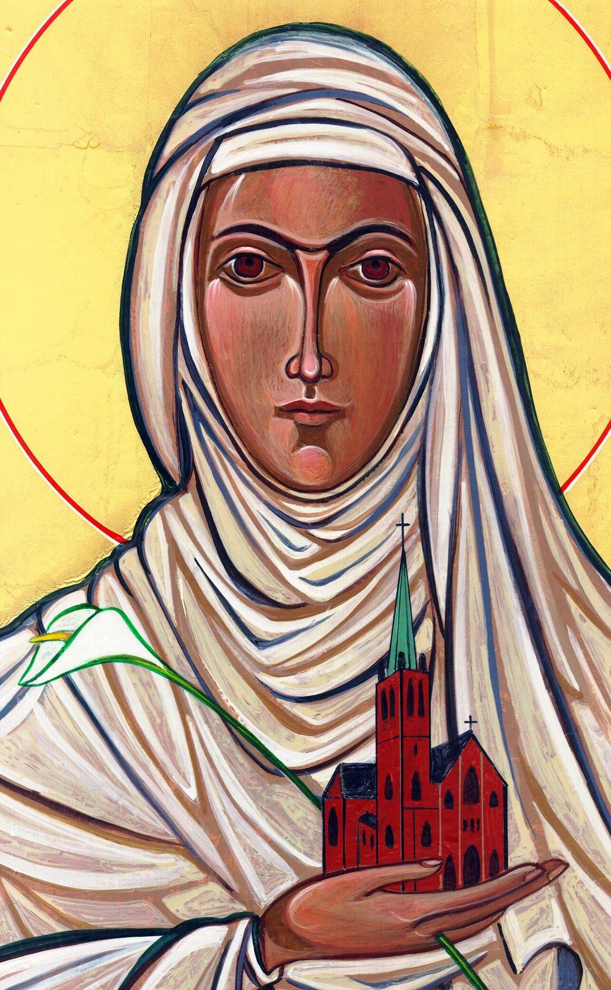
Opening Prayer
Lord Jesus, bless us as we gather together as young people from the Diocese. We are one in your name. May your light burn brightly within us as we celebrate Your love for us.
Inspire us with your Holy Spirit. Help us to take Your light and Your love out to the whole world. Show us how to use our gifts and talents to become who You have called us to be. Amen
St Catherine of Siena, Pray for us.

Slide 5
True or False?
The Catholic Church teaches that the universe is only 6000 years old

Slide 6
False!
The Catholic Church is clear that evolution is currently the best explanation of the origin and diversity of life on earth and that the earth is as old as current scientific orthodoxy suggests (approximately 4.54 billion years old). The Church would say that all existence comes from and depends upon God, whilst evolution expresses scientific truths about the history of the physical universe. Only on the final part of God’s creation did God make man and women in His own image and gave us a soul.

Slide 7
True or False?
The Church teach that God created the universe from nothing

Slide 8
True!
We believe God created the world ‘Ex Nihilo’. Ex nihilo is the theological belief that God created the Universe and the world from nothing. It is an idea that comes from the first three verses of the Old Testament,
‘In the beginning, God created the heavens and the earth. The earth was without form and void, and darkness was over the face of the deep. And the Spirit of God was hovering over the face of the waters. And God said, “Let there be light,” and there was light.’ (Gen 1:1-3). Science supports this belief with ‘the Big Bang theory’.

Slide 9
True or False?
A Catholic priest came up with the ‘Big Bang’ theory

Slide 10
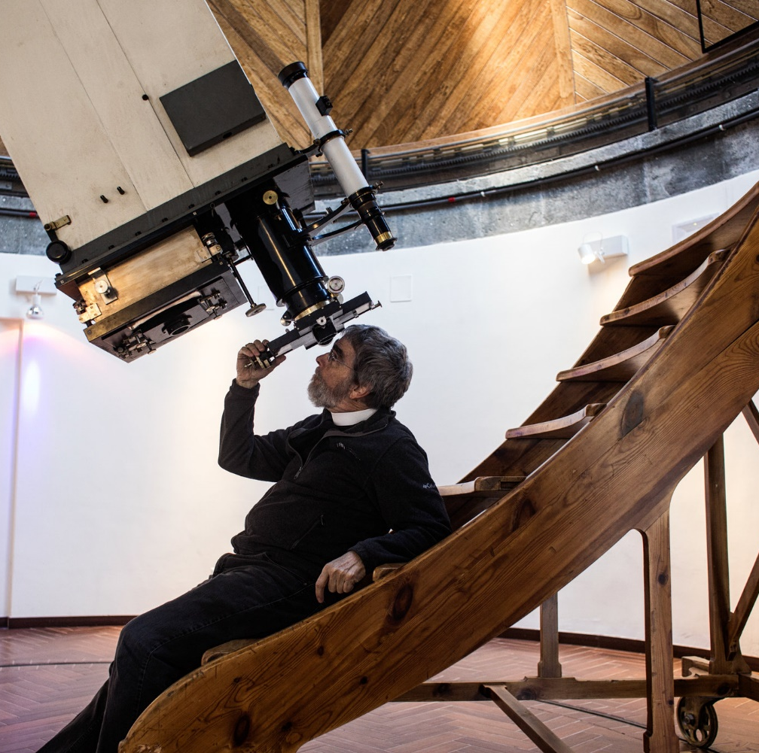
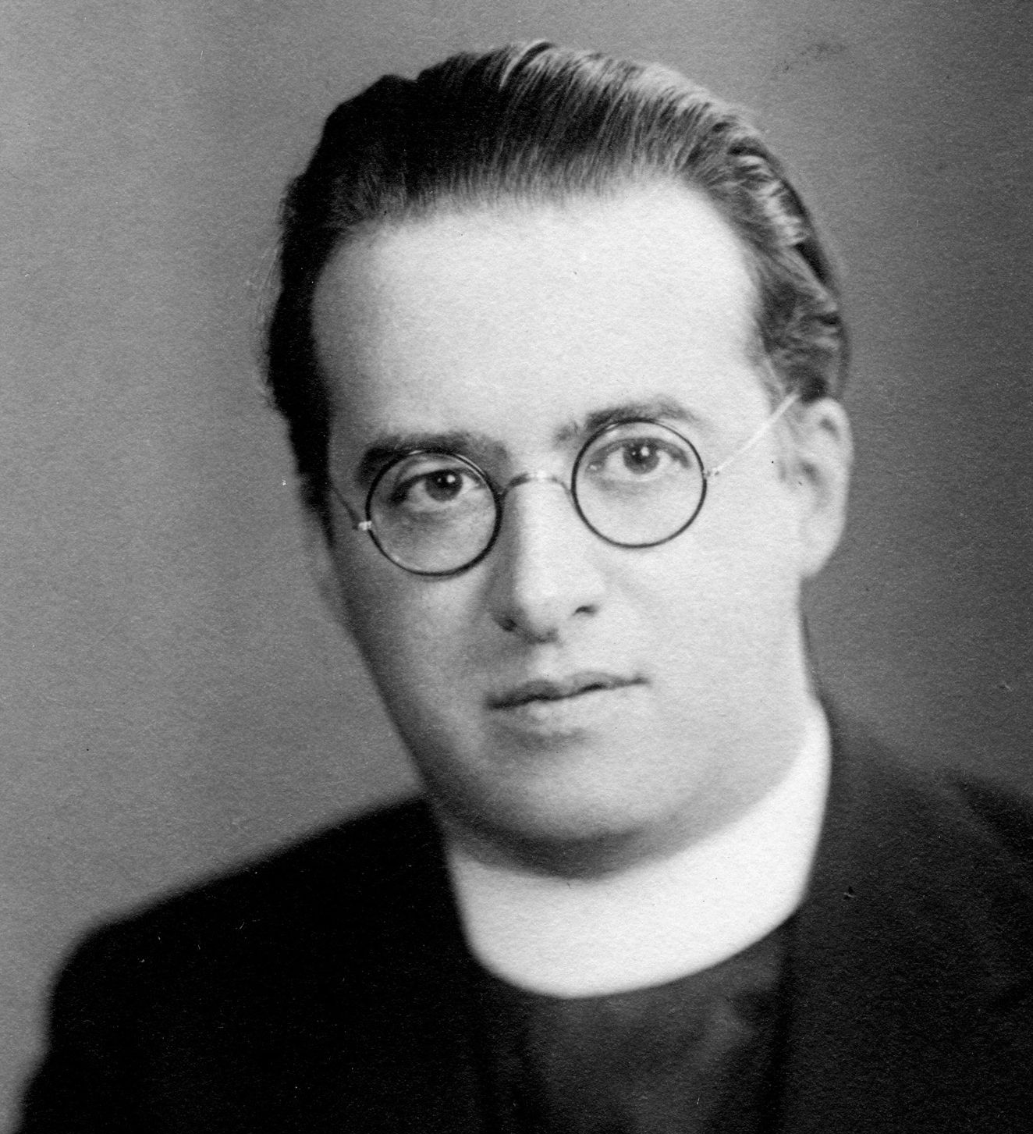
True!
This startling idea first appeared in scientific form in 1931, in a paper by Fr Georges Lemaître, a Belgian cosmologist and Catholic priest. The theory, accepted by nearly all astronomers today, was a radical departure from scientific orthodoxy in the 1930s. In fact, the Vatican has had it’s head in the stars for years with it’s own astronomy telescope.

Slide 11
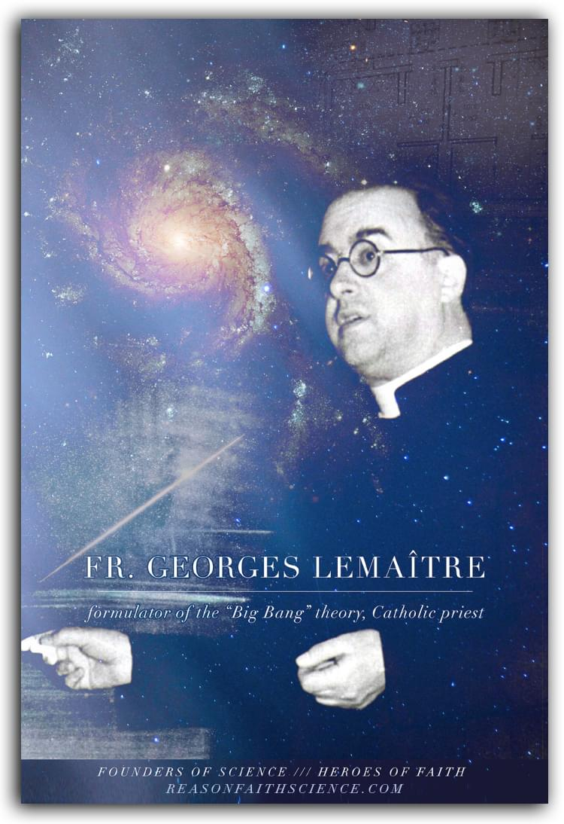
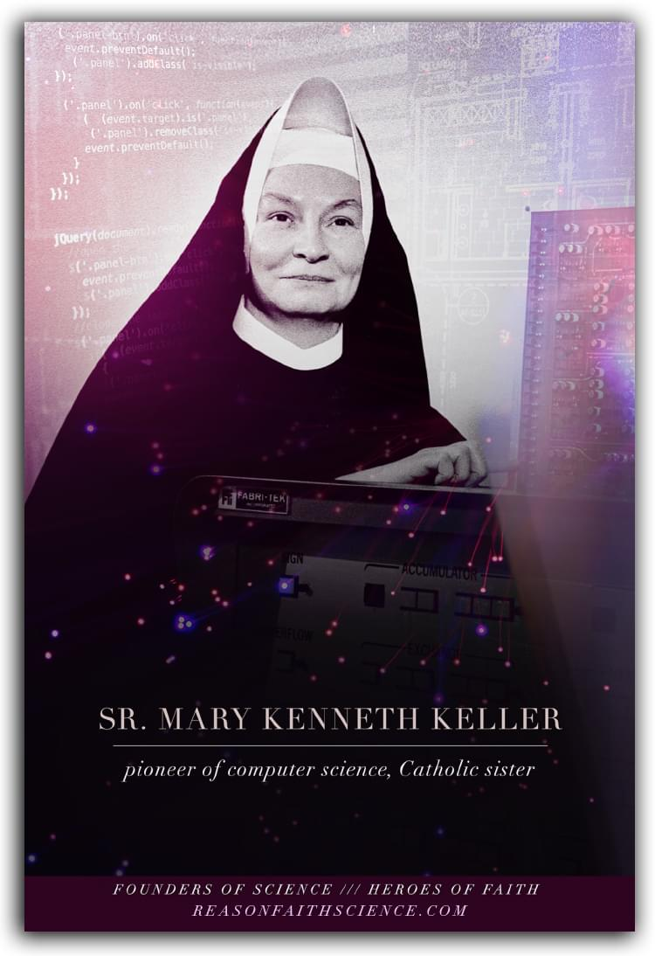
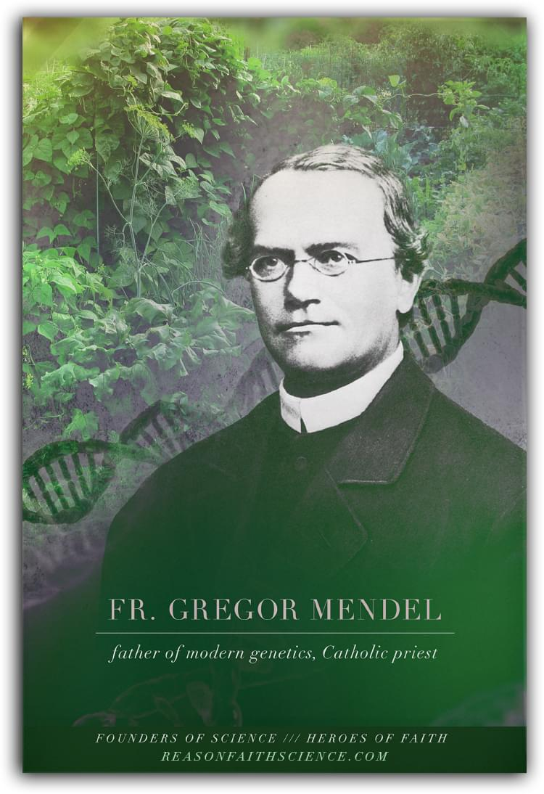
3 Founders of Science & Heroes of Faith

Slide 12
Video from Bishop Barron on Faith & Science

Slide 13
Scripture Reading
In your bible read the creation story (Genesis 1-2:4) or watch this video
“God saw all that he had made, and it was very good.”
Genesis 1:31

Slide 14
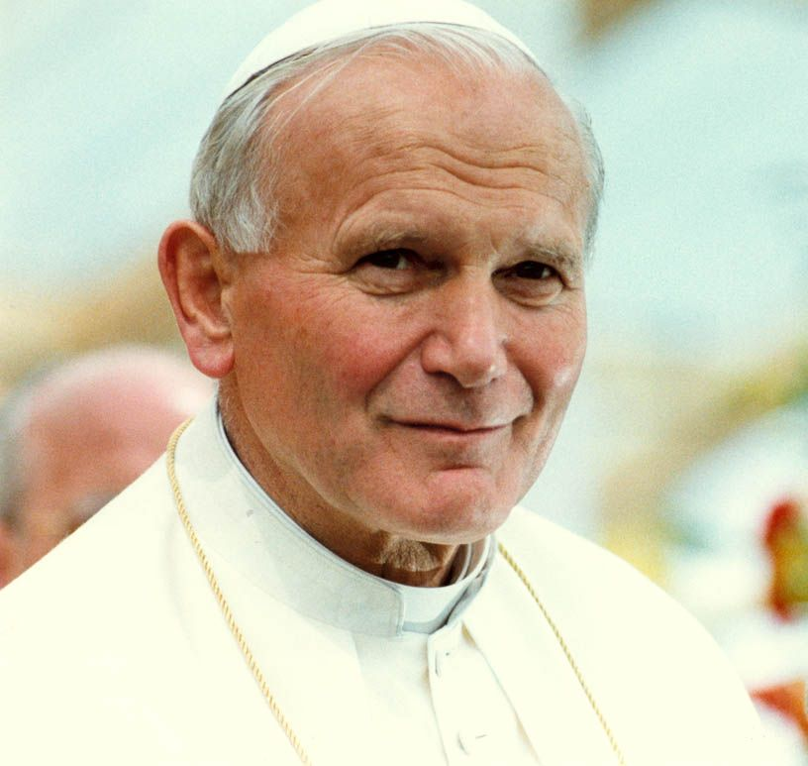
“Faith and reason are like two wings on which the human spirit rises to the contemplation of truth, and God has placed in the human heart a desire to know the truth — in a word, to know himself…”
Pope St. John Paul II, Fides et Ratio

Slide 15
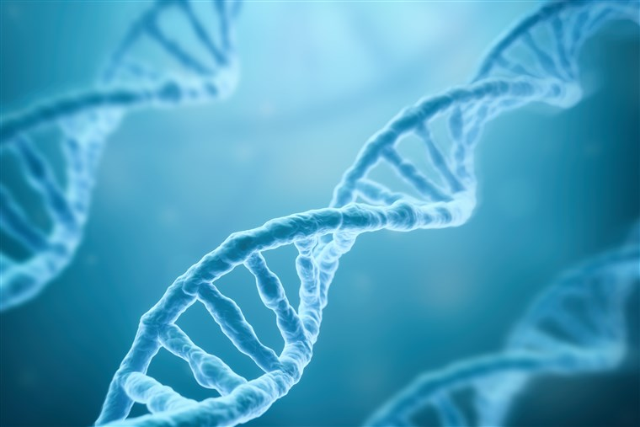
Testimony - Francis Collins – Director of the Human Genome Project

Slide 16
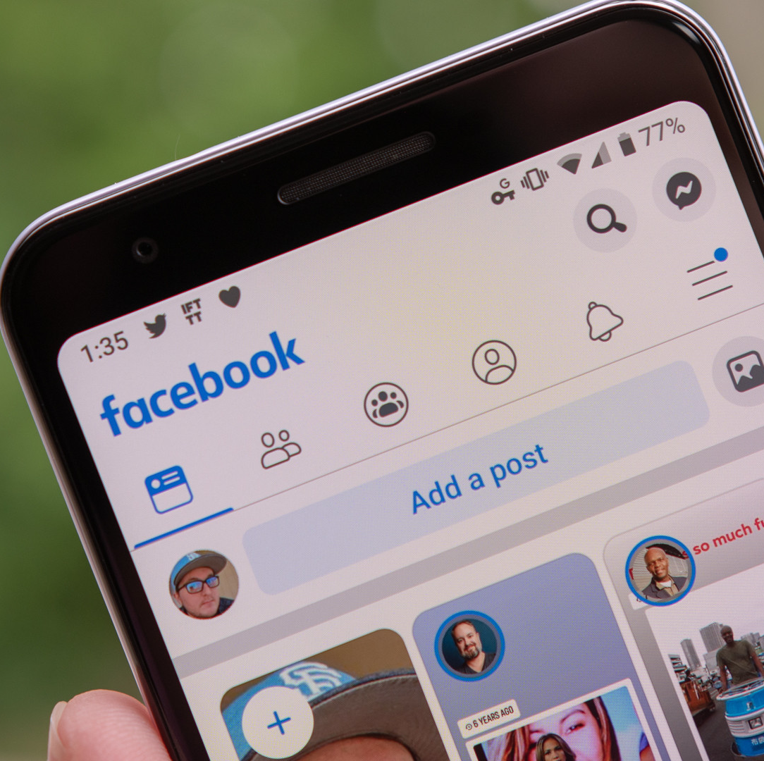
Situation
Your friend dismisses faith because of something they have read on the internet.
How could you respond based on what you have learnt so far today?

Slide 17
Discussion
What do you find challenging in relation to faith and science?

Slide 18
“There is no insoluble contraction between faith and science, because there cannot be two kinds of truth…Faith reminds science that it is supposed to serve creation and not set itself up in place of God”
YOUCAT #23
“Mathematics is the alphabet with which God wrote the world”
Galileo
“I would not believe if I did not realize that it is reasonable to believe”
St Thomas Aquinas

Slide 19
Where to find out more…
alpha.org/youth/
dioceseofsalford.org.uk/youth/
reasonfaithscience.com/

Slide 20
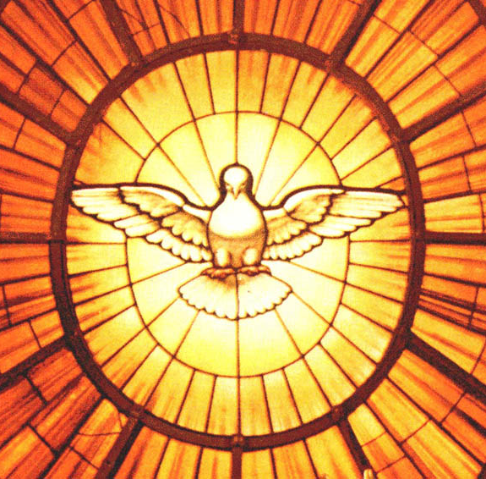
Time of Prayer
Come Holy Spirit, fill the hearts of your faithful and kindle in them the fire of your love. Send forth your Spirit and they shall be created. And You shall renew the face of the earth. Amen

Slide 21
Social Time – Count the seconds.
Everyone closes their eyes (except for the leader). The leader says an amount of time and times it. The young people have to put up their thumbs when they think that amount of time has elapsed. The person whose thumb went up the closest to the time wins a point.

Slide 22
“Jesus said to them again:
Peace be with you. As the Father sent me, so I am sending you’
JOHN 20:21

Slide 23
GIFTS OF HOLY SPIRIT
Session 1 - Wisdom

