Slide 1
GIFTS OF HOLY SPIRIT
Opening Session – The Fruits & Gifts of the Holy Spirit

Slide 2
WELCOME
Welcome to the start of this exciting journey towards the Sacrament of Confirmation where you will receive special gifts from the Holy Spirit.
The more you put into these sessions the more you will get out, so give them a chance!
Each session will have a similar format. There will be some interesting videos, music, stories, games and times of prayer. They will help you get to know more about yourself, each other and God.
Throughout EMPOWERED you will learn about the story of Pentecost, the Sacrament of Confirmation and about the Gifts and Fruits of the Holy Spirit.

Slide 3
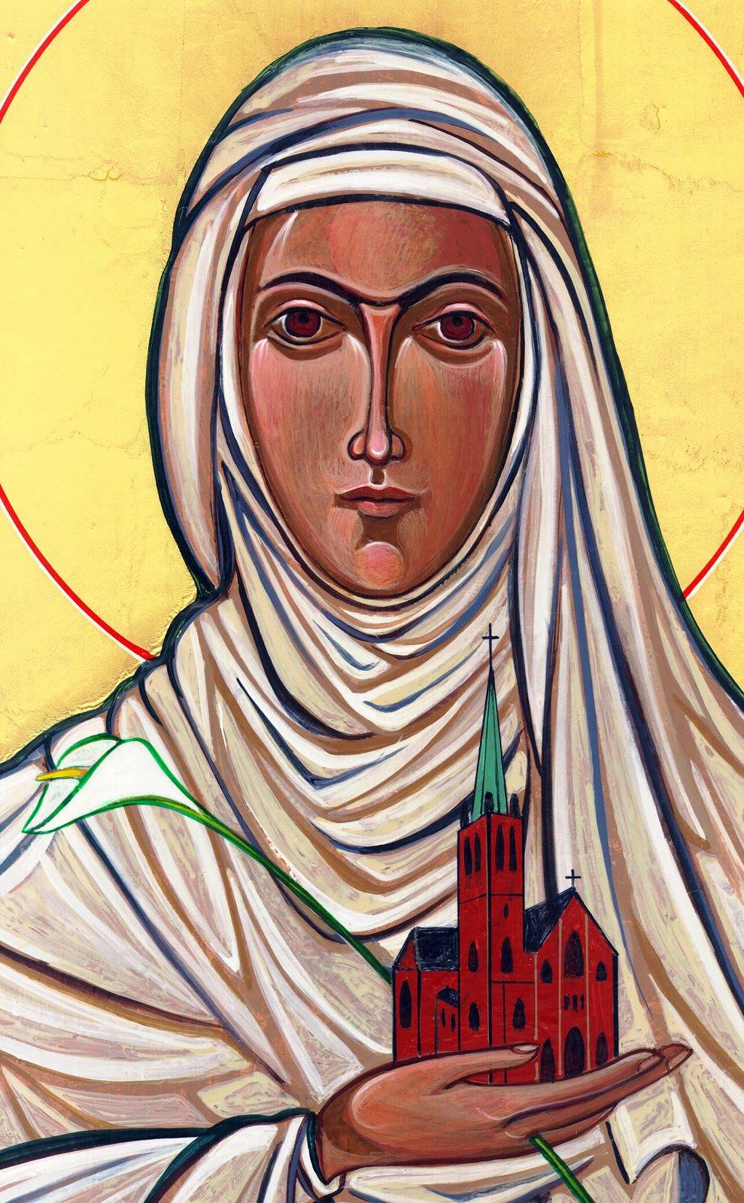
Opening Prayer
Lord Jesus, bless us as we gather together as young people from the Diocese. We are one in your name. May your light burn brightly within us as we celebrate Your love for us.
Inspire us with your Holy Spirit. Help us to take Your light and Your love out to the whole world. Show us how to use our gifts and talents to become who You have called us to be. Amen
St Catherine of Siena, Pray for us.

Slide 4
Ice breaker
To help us to get to know each other better there will be several questions.
All you need to do is give a if you like it or
a if you don’t
Ready?
No
Yes

Slide 5
Ice breaker
Do you like…
Watching Football?
No
Yes

Slide 6
Ice breaker
Do you like…
Ice-cream?
No
Yes

Slide 7
Ice breaker
Do you like…
Singing?
No
Yes

Slide 8
Ice breaker
Do you like…
Going shopping?
No
Yes

Slide 9
Ice breaker
Do you like…
Playing Tennis?
No
Yes

Slide 10
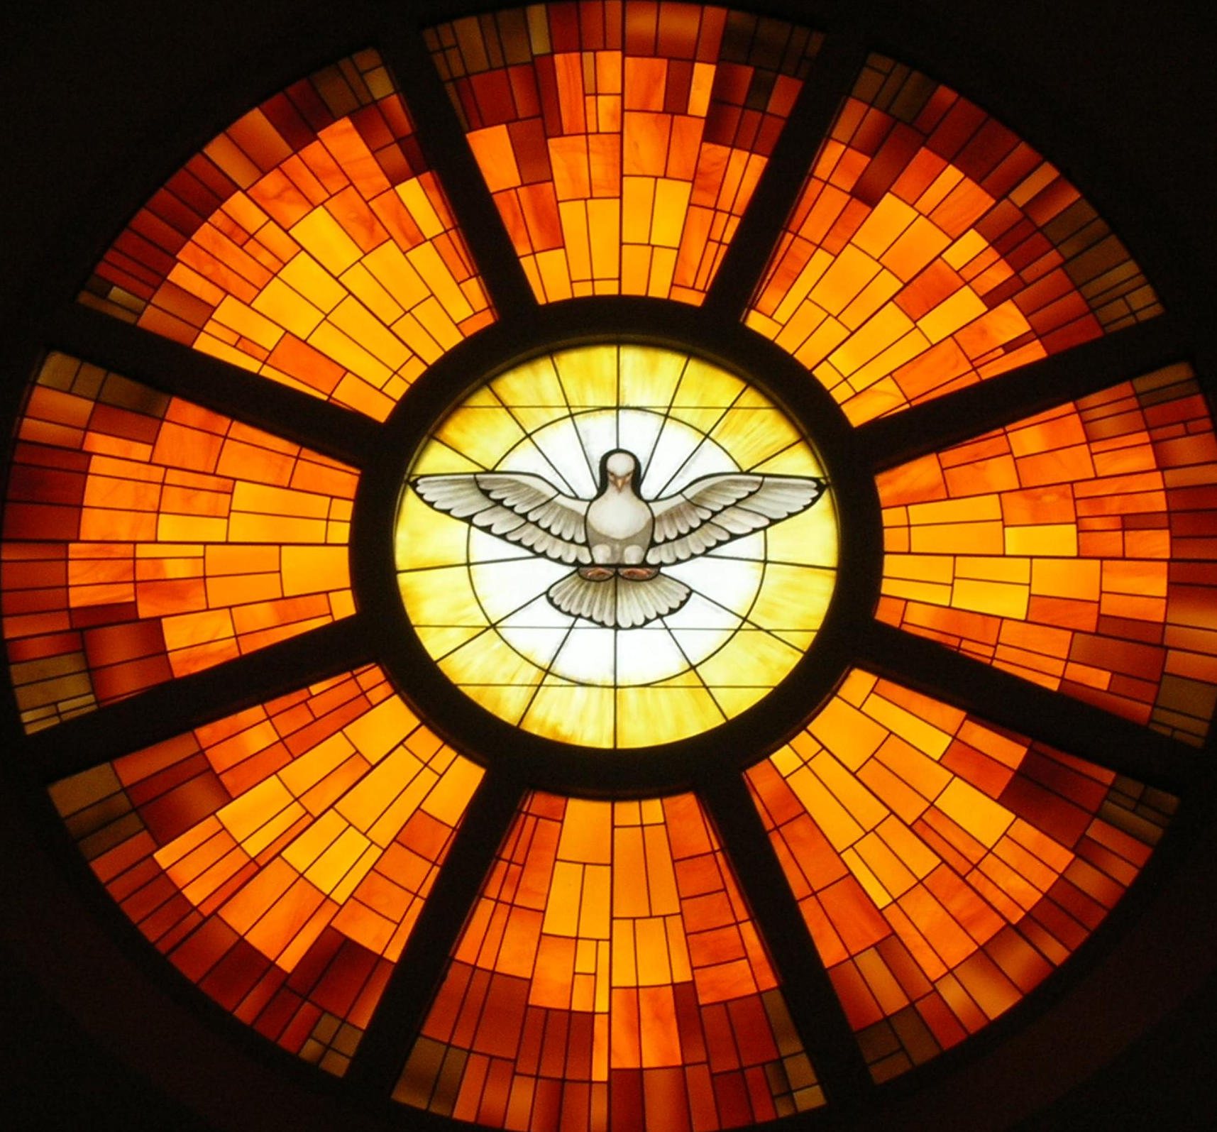
Introduction to Confirmation

Slide 11
Scripture – Acts 2:1-12
When Pentecost day came round, they had all met in one room, when suddenly they heard what sounded like a powerful wind from heaven, the noise of which filled the entire house in which they were sitting; and something appeared to them that seemed like tongues of fire; these separated and came to rest on the head of each of them. They were all filled with the Holy Spirit, and began to speak foreign languages as the Spirit gave them the gift of speech.
Now there were devout men living in Jerusalem from every nation under heaven, and at this sound they all assembled, each one bewildered to hear these men speaking his own language. They were amazed and astonished. ‘Surely’ they said ‘all these men speaking are Galileans? How does it happen that each of us hears them in his own native language? Parthians, Medes and Elamites; people from Mesopotamia, Judaea and Cappadocia, Pontus and Asia, Phrygia and Pamphylia, Egypt and the parts of Libya round Cyrene; as well as visitors from Rome – Jews and proselytes alike – Cretans and Arabs; we hear them preaching in our own language about the marvels of God.’

Slide 12
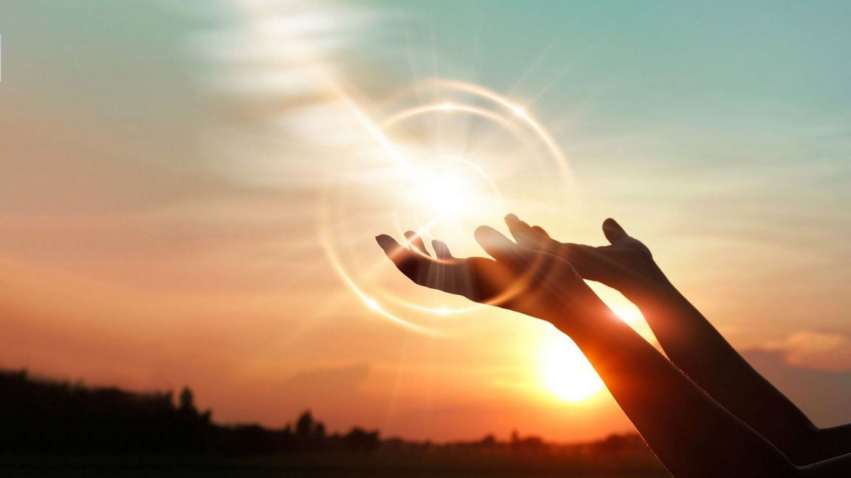
Reflection – Fall Afresh
As you listen to this song, close your eyes and invite the Holy Spirit into your heart. You may wish to hold your palms out to invite the Holy Spirit into your life.

Slide 13
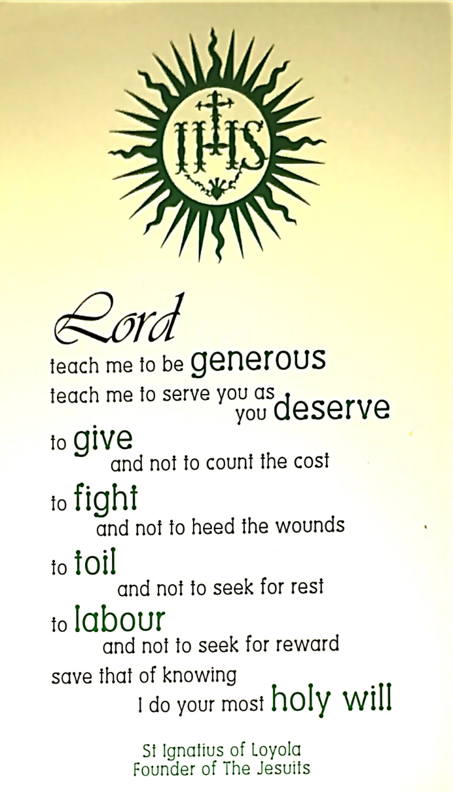
Hero of our Faith
St Ignatius of Loyola
In each session we will look at a different Hero of our Faith.
The saints are wonderful examples to us, that’s why at Confirmation you choose a saints name so they can pray for you and inspire you on your journey of Faith.

Slide 14
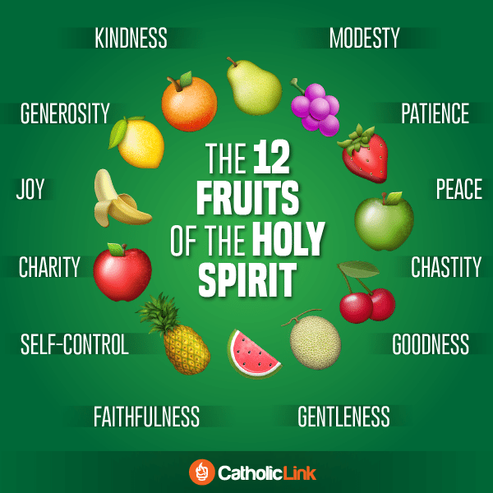
What are the fruits of the Holy Spirit?
“A bad tree cannot bear good fruit”
Jesus

Slide 15
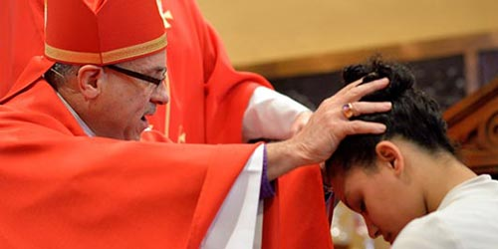
In Isaiah 11:2-3 we read how the Messiah would have these seven gifts. In each session we will explore each gift. The good news is, that through Jesus and by the power of the Holy Spirit, you have already received these gifts at Baptism but you will receive a ‘top up’ at Confirmation!
Wisdom
Understanding
Knowledge
Counsel
Fortitude
Piety
Fear of the Lord/
Wonder & Awe

Slide 16
Situation
One of your friends thinks that it is a waste of time coming to these sessions.
How might you respond based on what you have heard and learnt so far.

Slide 17
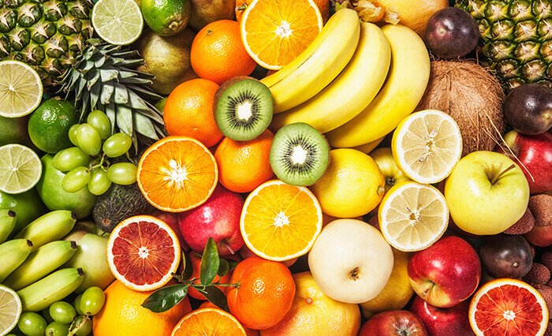
Discussion
Which one Fruit of the Holy Spirit might you find most useful at the moment?
(kindness, generosity, joy, charity, self-control, faithfulness, gentleness, goodness, chastity, peace, patience, modesty)

Slide 18
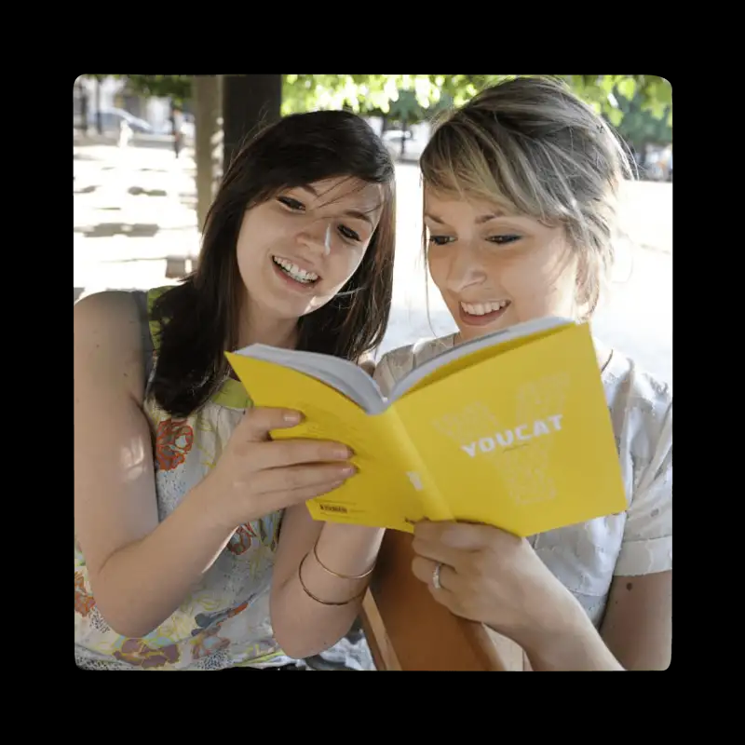
YOUCAT is the Catechism of the Catholic Church for young people.
The most important elements of the faith are summarised in a question-and-answer format.
The YOUCAT was approved by the Vatican.
More than 5 million copies have been sold worldwide, it is one of the best-selling Catholic books in the world.
In each session we will look at what the YOUCAT has to say.
“You need to know your faith with the same precision with which an IT specialist knows the inner workings of a computer”
Pope Benedict

Slide 19
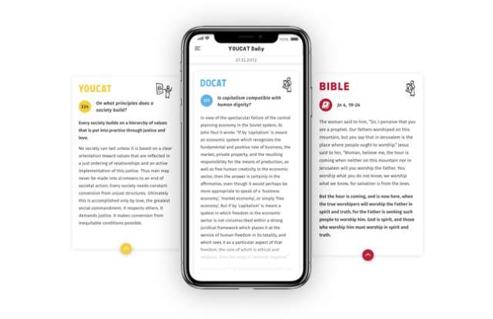
Where to find out more…
@salfordyouth
@salfordyouth
Salford Diocese
YOUCAT Daily App
dioceseofsalford.org.uk/youth
Salford Youth Ministry

Slide 20
A Time of Prayer
Prayer
Heavenly Father, I thank you for the Gift of Jesus, the Holy Spirit and Your Church. Please stay with me on this Journey as I learn more about You and grow closer to You in prayer.
Amen
‘For those who are led by the Spirit of God are the children of God. The Spirit you received does not make you slaves, so that you live in fear again; rather, the Spirit you received brought about your adoption to sonship. And by him we cry, “Abba, Father.” The Spirit himself testifies with our spirit that we are God’s children. Now if we are children, then we are heirs—heirs of God and co-heirs with Christ, if indeed we share in his sufferings in order that we may also share in his glory.’
Romans 8:14-18

Slide 21
“Jesus said to them again:
Peace be with you. As the Father sent me, so I am sending you’
JOHN 20:21

Slide 22
Introductions
Going around the group, each person should say their name, where they are from and one interesting fact about themselves…

Slide 23
GIFTS OF HOLY SPIRIT
Opening Session – The Fruits & Gifts of the Holy Spirit

