Slide 1

GIFTS OF HOLY SPIRIT
Confirmation – Now What?

Slide 2
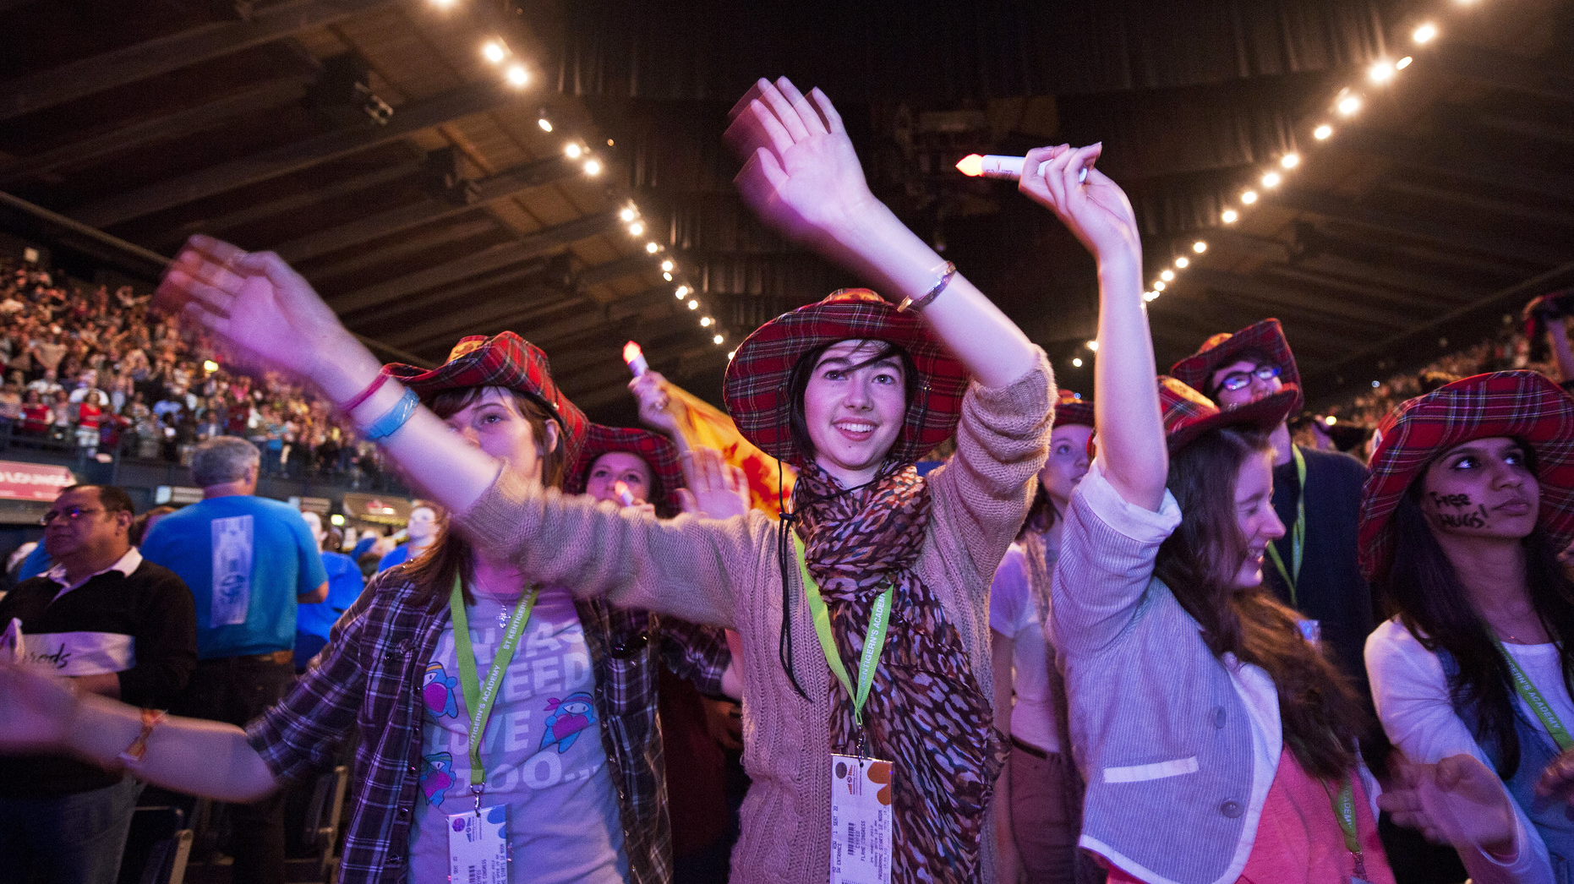
Congratulations, you have been Confirmed and received the Holy Spirit, but this is not the end of the journey, it is just the beginning!
Jesus wants each of us to grow in our faith each day for the rest of our lives by being involved in the life of the parish and in doing so being witnesses to others.
There are so many opportunities within the parish, the diocese and the wider Church to get involved.

Slide 3
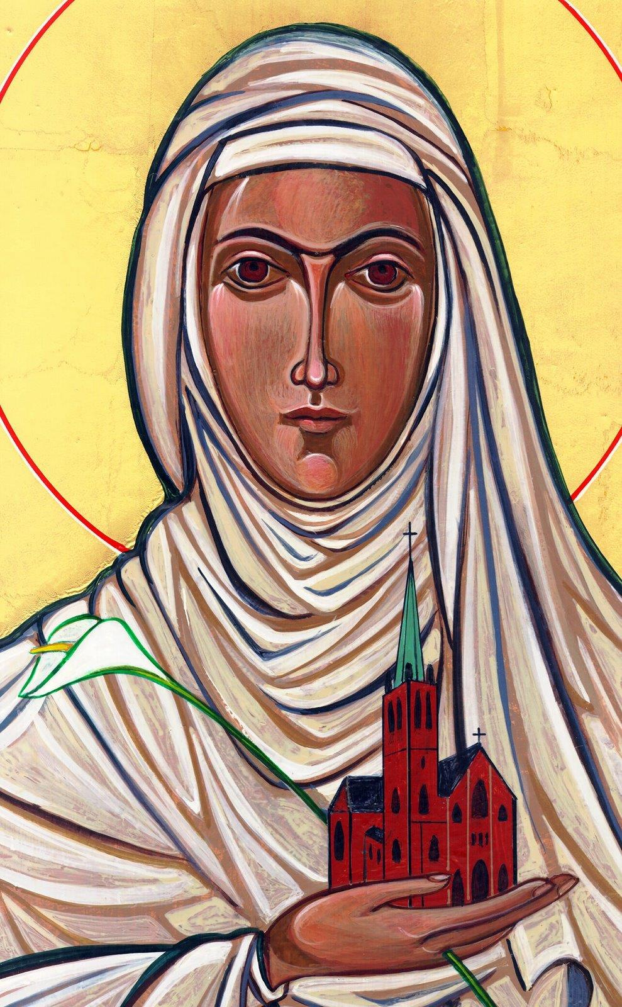
Opening Prayer
Lord Jesus, bless us as we gather together as young people from the Diocese. We are one in your name.
May your light burn brightly within us as we celebrate Your love for us.
Inspire us with your Holy Spirit.
Help us to take Your light and Your love out to the whole world. Show us how to use our gifts and talents to become who You have called us to be. Amen
St Catherine of Siena, Pray for us.

Slide 4
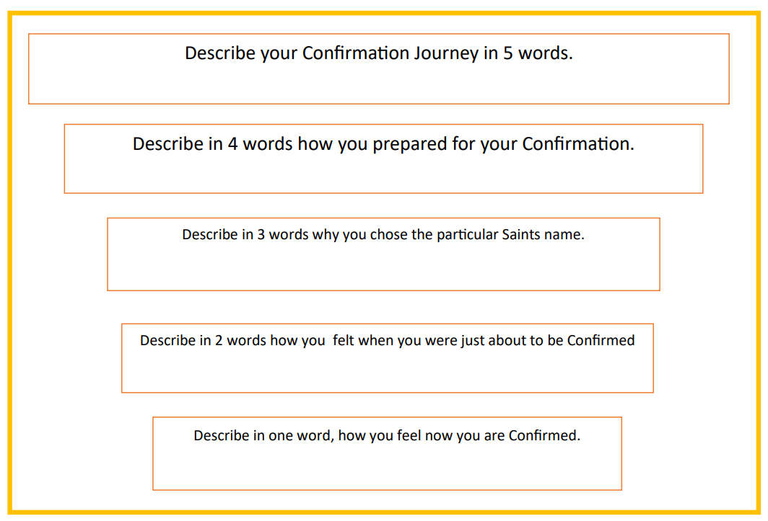
Ice breaker

Slide 5
Introduction
Look at the picture of the swimming pool.
Pick a character which reflects your relationship with God. Are you watching from the sides or fully in the water?
Do you think this has changed since doing these sessions and being Confirmed?

Slide 6
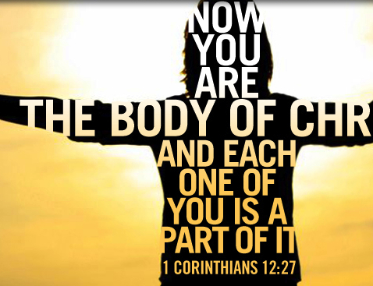
Scripture
1 Corinthians 12:12-14,27
Just as a human body, though it is made up of many parts, is a single unit because all these parts, though many, make one body, so it is with Christ. In the one Spirit we were all baptised, Jews as well as Greeks, slaves as well as citizens, and one Spirit was given to us all to drink. Nor is the body to be identified with any one of its many parts. Now you together are Christ’s body; but each of you is a different part of it.

Slide 7


The Body of Christ – The Church
We are all needed in this body, we all have our unique part to play

Slide 8

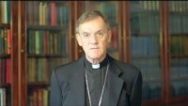





Roles in the parish
Bishop John is asking our parishes in our diocese to take part in Hope in the Future.
Think about all the important roles in a parish.
Which role could you do?

Slide 9




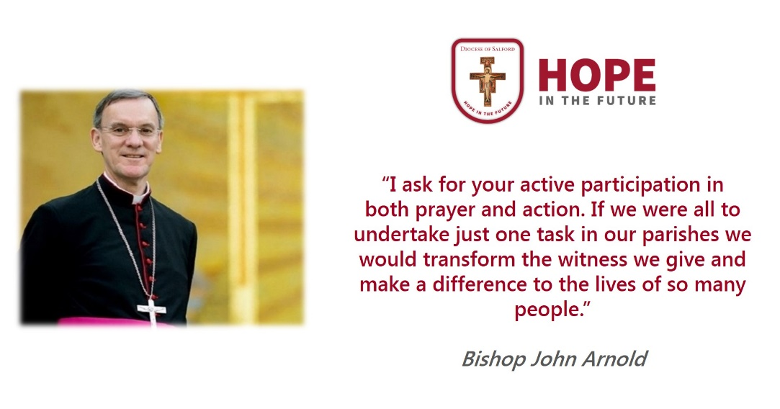
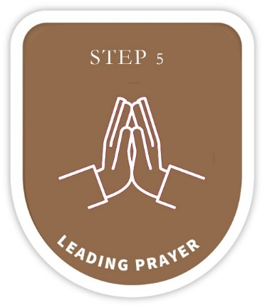


7 steps to getting more involved in your parish…
A great starting point may be to speak to your Parish Priest or another young person who is involved in the parish and ask how you can help out …

Slide 10



7 steps to getting more involved in your parish…
Through school could you make prayer cards for…
The Sick
People preparing for Baptism
First Holy Communion
Marriage Prep
RCIA Candidates
Those new to the Parish
You could take a more active role into the life of the parish community.
Welcomers
Hospitality
Readings
Bidding Prayers
Offertory
Collection
Music
Announcements
Helping with the next Holy Communion/Confirmation programme
Social action
Maintenance (cleaning, flower arranging)

Slide 11


7 steps to getting more involved in your parish…
Get to know and understand the structure of the parish.
Roles within the parish
Make a display in church or school about the parish
Help put together a parish welcome booklet
Young People to lead aspects of the
liturgical life of the parish.
Stations of the Cross
Stations of Mary
Pentecost liturgy

Slide 12


7 steps to getting more involved in your parish…
Lead and facilitate new initiatives in the prayer life of the parish community by leading/setting up:
Speakers on Prayer, How to pray
Exhibition (School/Parish) – different traditions of prayer
Rosary Groups
Parish/School prayer group
Lectio
Pope’s monthly prayer intention –published online/in the newsletter
Fostering the growth of the young people in the parish community by inviting them to be involved:
Parish Shared Leadership Team
School Chaplaincy Teams/ Caritas Ambassador
Mini Vinnies linking in with parish SVP group
Social Justice parish groups
Get involved with the CYMFED Faith in Action Award (more info later)

Slide 13

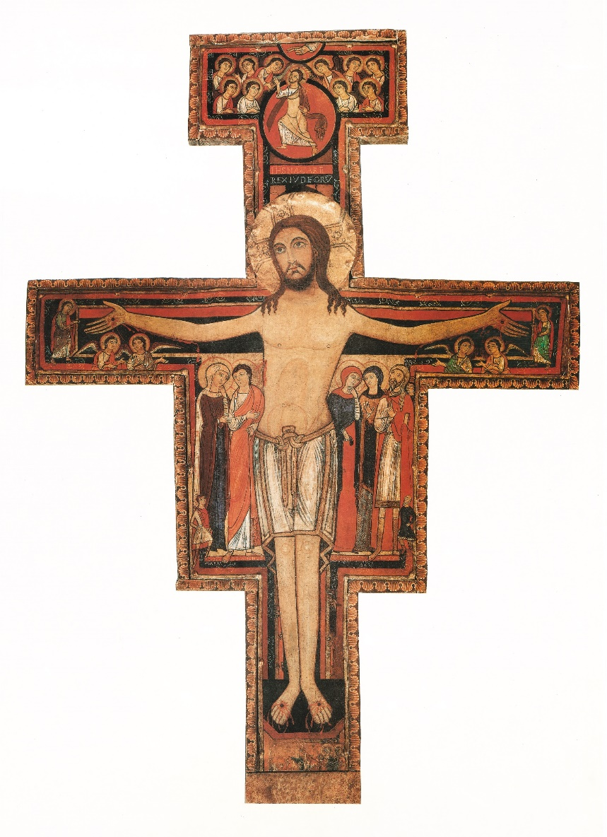
7 steps to getting more involved in your parish…
Join the Parish Hope in the Future Team
Commitment/Willingness to be active both in the school and parish community.
Helping to grow our parish community
Growing as a Missionary Disciple and Ambassador for Jesus
Attend diocesan training & formation days on behalf of the parish youth

Slide 14

CYMFED Faith in Action Award
The CYMFed (Catholic Youth Ministry Federation) Faith in Action award recognises, rewards and celebrates the active faith and service of children and young people in their school and parish. You will receive an official qualification and pin badge whilst serving God at the same time.
The award is for children and young people between the ages of 10 – 18 which has 4 levels:
1. Pin – At this early stage, young people will begin a journey of discovering what it means for faith to be active.
2. Bronze – Young people at the Bronze Level take the initial steps in responding to their faith, by way of serving others.
3. Silver – This level encourages a maturity of faith which is expressed in terms of leadership and initiative.
4. Gold - The essence of the Gold Award is found in the young people’s desire to develop and establish new ideas in terms of outreach and missionary work on behalf of the Church community.
You can collect credits from what you do at HOME, in SCHOOL and the PARISH. Speak to your teacher or priest for more information.

Slide 15



Post Confirmation Leadership Programme
This new Post Confirmation Leadership Programme (PCLP) for young people is a collaboration between the Office for Youth Ministry and Young Christian Workers.
It has been based on the ‘Be the Difference’ programme. It creates opportunities for the young people to develop as leaders by exploring the reality around them and striving to make a difference. It enables them to take an active part in the life of their Church, school and community.
The Leadership Programme consists of eight units each with three progressive stages for the home, school and parish. The units are:
1. Being Missionary Disciples
2. Communication and Listening skills to become a Young Leader
3. The Friendship Circle
4. Prayer
5. The Review of Life, The Responsibilities of a Leader
6. Tackling Finance and Fundraising
7. Parish Youth Leadership Team/Diocesan Youth Council
8. Practical Ideas/resources
For more information about the PCLP, please email Youth@dioceseofsalford.org.uk

Slide 16
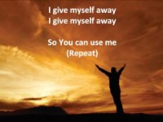
Reflection – how can you serve your parish?
Having heard all the ways you could serve your parish, take time to prayerful discern how you can use your Gifts and Talents to build up your parish.
At the heart of all vocations is a YES. If you say yes, God can use you in amazing ways. Remember, in Confirmation, God has given you all you need to do what He is asking of you.
Have a listen to this hymn ‘I give myself away so you can use me’

Slide 17






Where to find out more…
@salfordyouth
@salfordyouth
Salford Diocese
dioceseofsalford.org.uk/youth
youth@dioceseofsalford.org.uk
Salford Youth Ministry

Slide 18
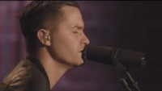
A Time of Prayer
Prayer
Jesus, help me to build my life on You, the only firm foundation. Give me a generous heart to serve you in the ways you are calling me all the days of my life.
Amen
“Jesus said, let your light shine before others, that they may see your good deeds and glorify your Father in heaven.”
Matthew 5:16

Slide 19
“Jesus said to them again:
Peace be with you.
As the Father sent me, so I am sending you’
JOHN 20:21

Slide 20
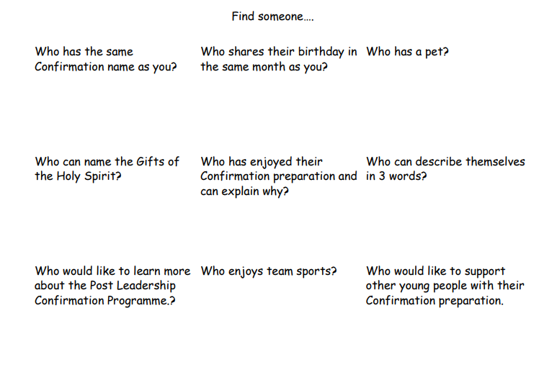
Human Bingo

Slide 21
GIFTS OF HOLY SPIRIT
Confirmation – Now What?

